Slide 1
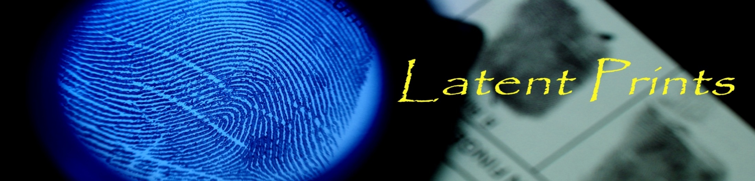

Apr. 30th, 2016
Minnowbrook Forensic Science Workshop
Deciphering Distortion
in Latent Prints
David Tate, MS, CLPE
Latent Print Examiner
dptate@syr.edu

Slide 2
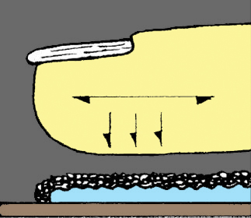
_{Elements of a Latent Print}
_{Anatomical aspects}
_{Lateral Movement}
_{Deposition pressure}
_{Development medium}
_{Matrix}
_{Substrate}
Ashbaugh, D.R. (1999). Quantitative-Qualitative Friction Ridge Analysis: An Introduction Basic and Advanced Ridgeology; CRC Press, New York, NY.

Slide 3

_{Anatomical Considerations}

Slide 4
_{Anatomical Considerations}
Maceo, A. (2009). Qualitative assessment of skin deformation: A pilot study. Journal of Forensic Identification. 59 (4).

Slide 5
_{Anatomical Considerations}
Maceo, A. (2009). Qualitative assessment of skin deformation: A pilot study. Journal of Forensic Identification. 59 (4).

Slide 6
Deposition Pressure and
Lateral Movement

Slide 7
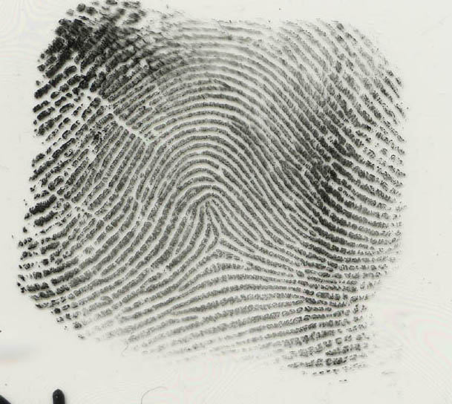
Normal/Controlled Pressure
rolled

Slide 8
Deposition Pressure
1. Maceo, A. (2009). Qualitative assessment of skin deformation: A pilot study. Journal of Forensic Identification. 59 (4).

Slide 9
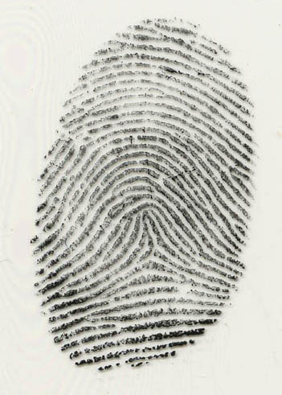
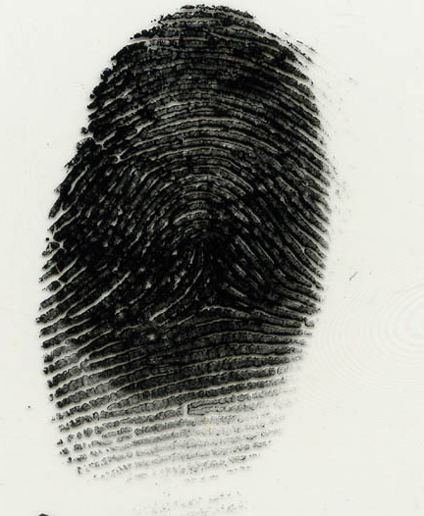
Deposition Pressure
heavy pressure
light pressure

Slide 10
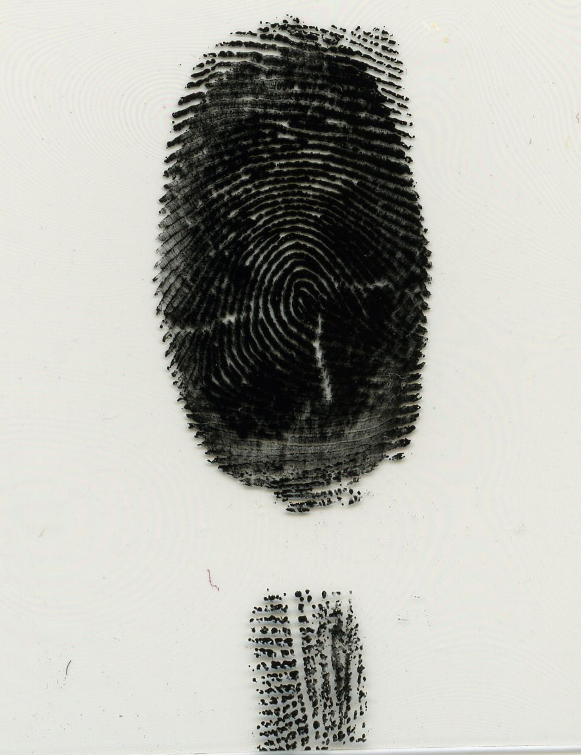
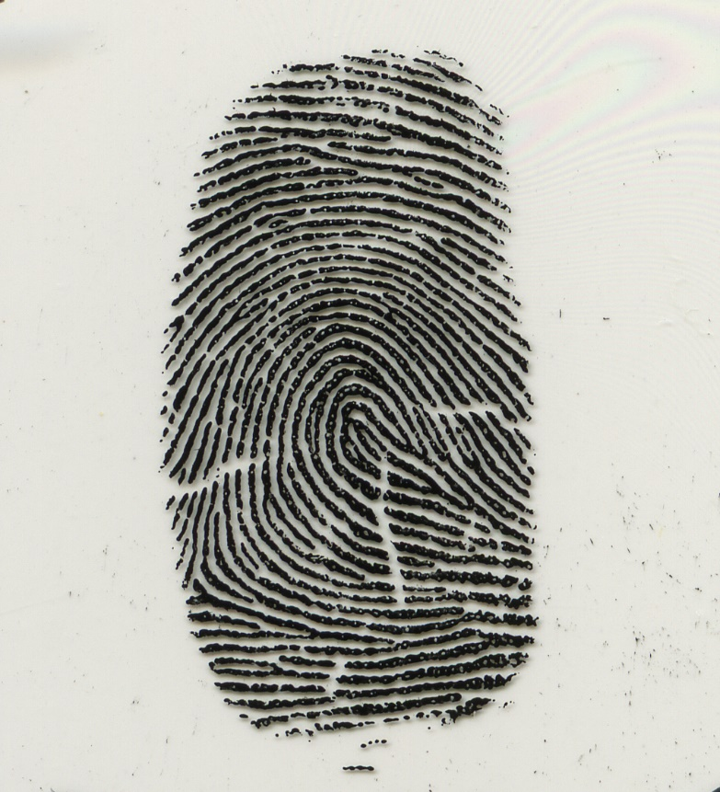
Deposition Pressure
Light – normal deposition pressure
_{Heavy deposition pressure →}

Slide 11
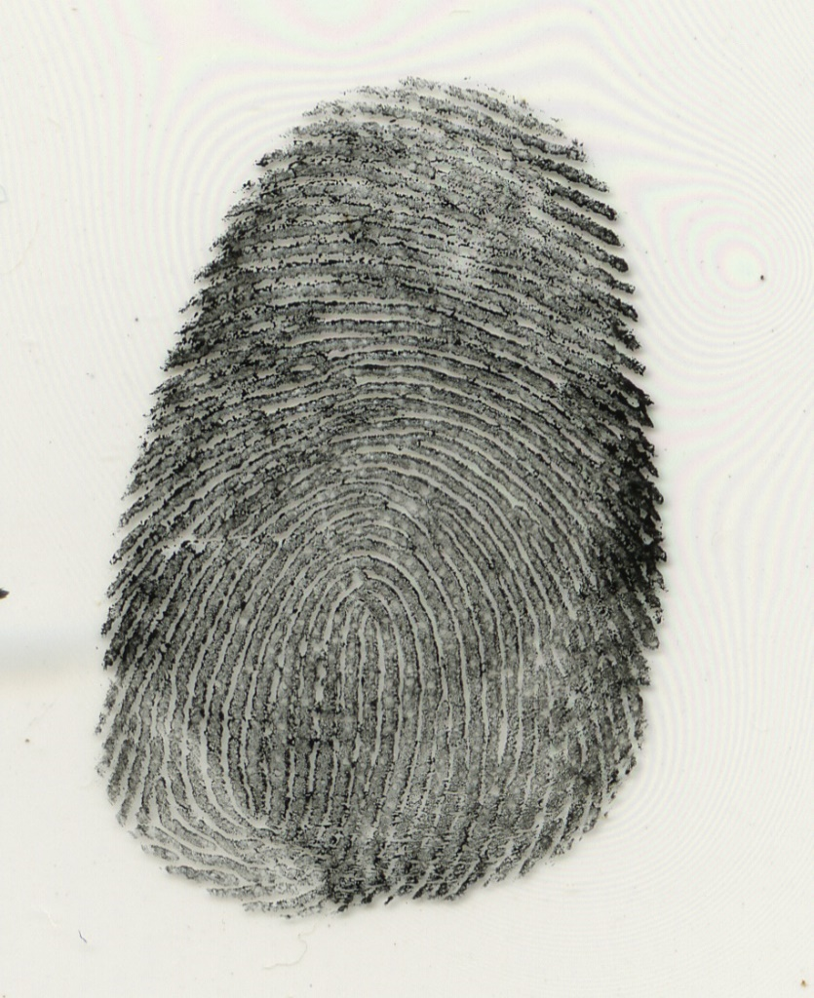
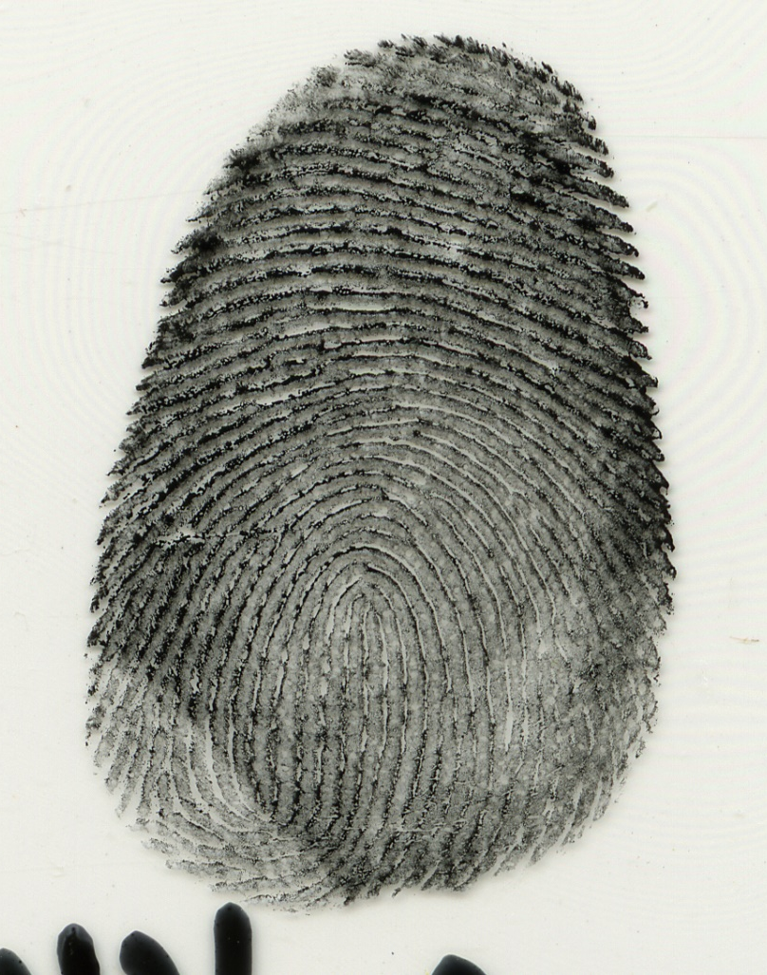
Deposition Pressure
_{normal deposition pressure}
_{Heavy deposition pressure}

Slide 12
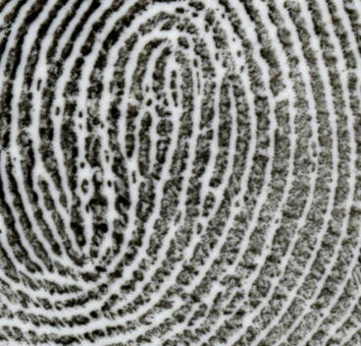
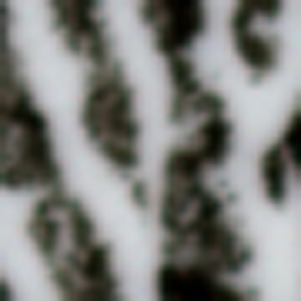
Level Two Detail – Minutiae types
Sometimes there is uncertainty as to the exact type of minutiae…
…deposition pressure can affect the appearance of minutiae type…
…but the examination is about ridge paths and not just minutiae.

Slide 13
Lateral Movement and
Shearing Stress

Slide 14
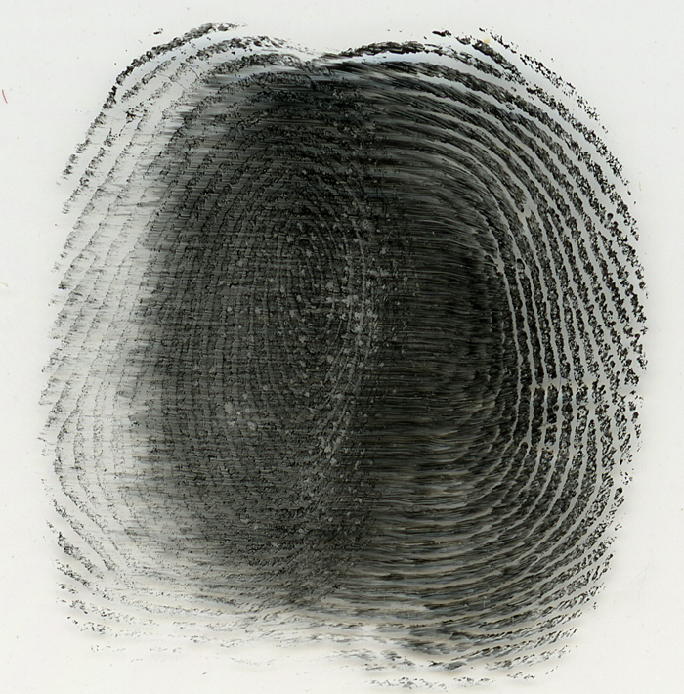
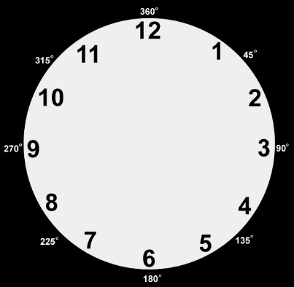
Lateral Movement

Slide 15
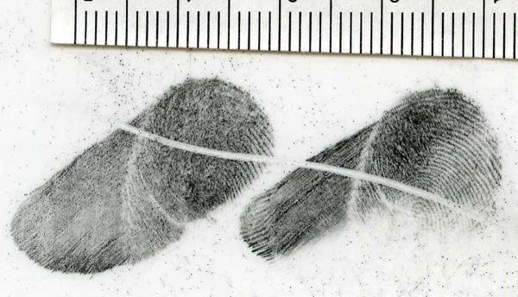
movement

Slide 16
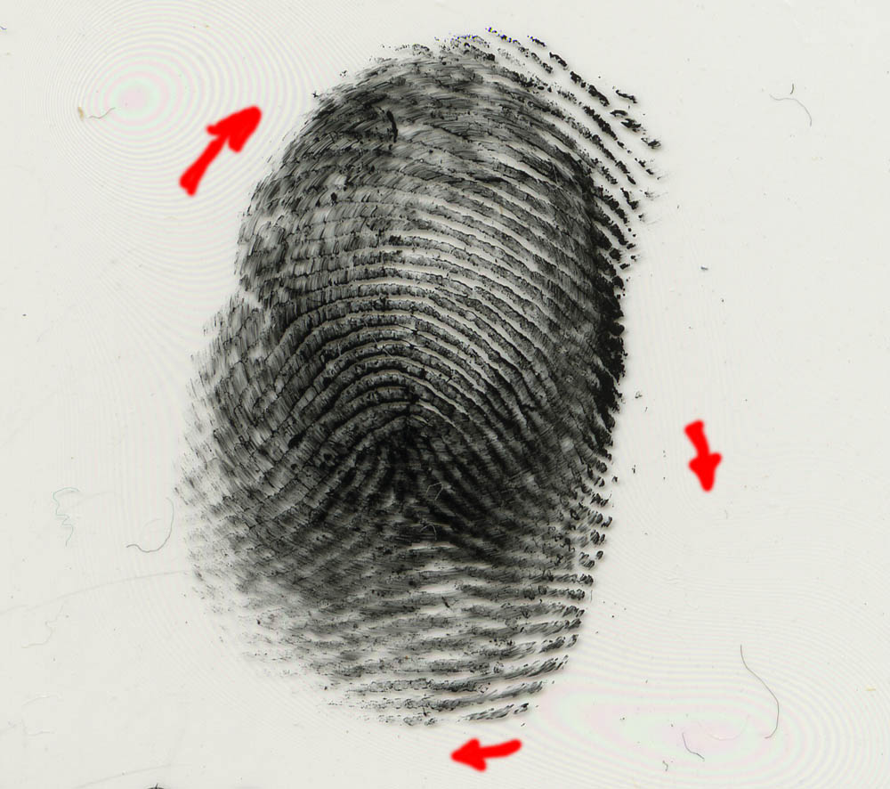
Rotational movement with medium/heavy pressure

Slide 17
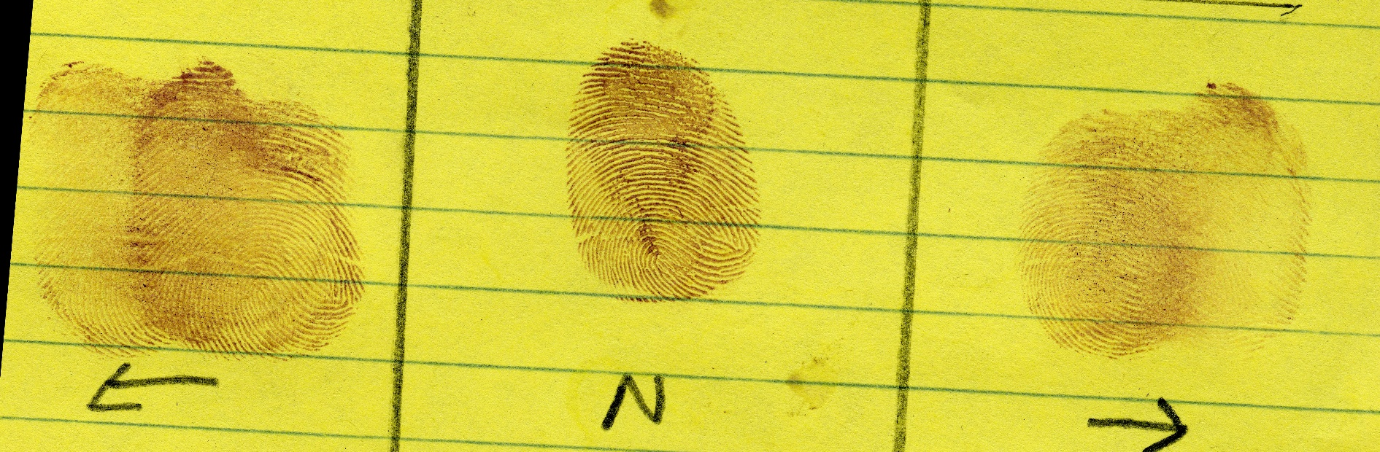
Lateral Movement on porous substrate

Slide 18
Matrix

Slide 19
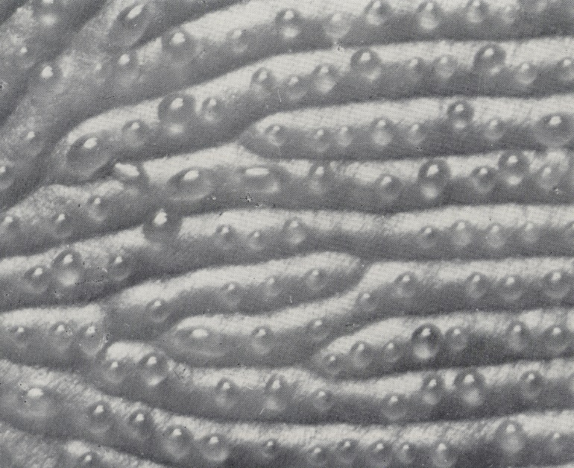
Matrix
Def. the substance transferred from the friction ridges to a surface/substrate
Water (99.0-99.5%) from sweat
Oils, fatty acids – from glands not found on the hands
Organic compounds (amino acids, etc.) from sweat
Inorganic compounds (salts, etc.) from sweat
Epithelial cells that are shed/removed
Contaminants (blood, dirt, etc.)

Slide 20
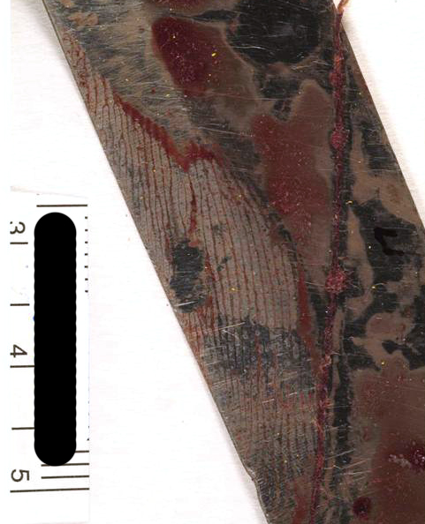
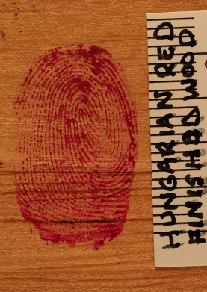
Matrix: blood

Slide 21
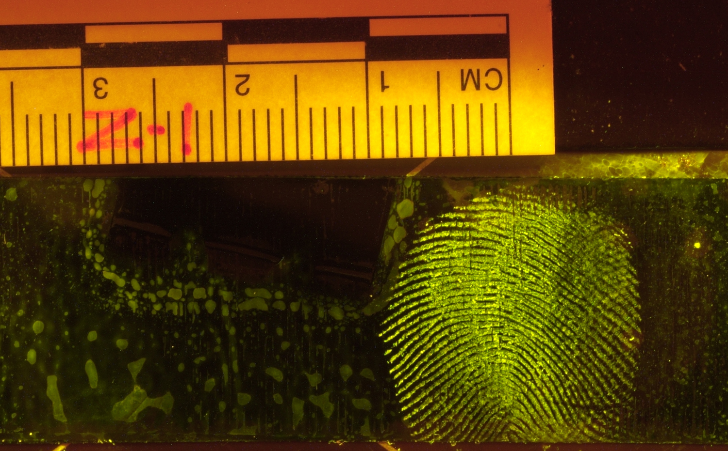
Matrix
epithelial cells on the adhesive side of electrical tape

Slide 22
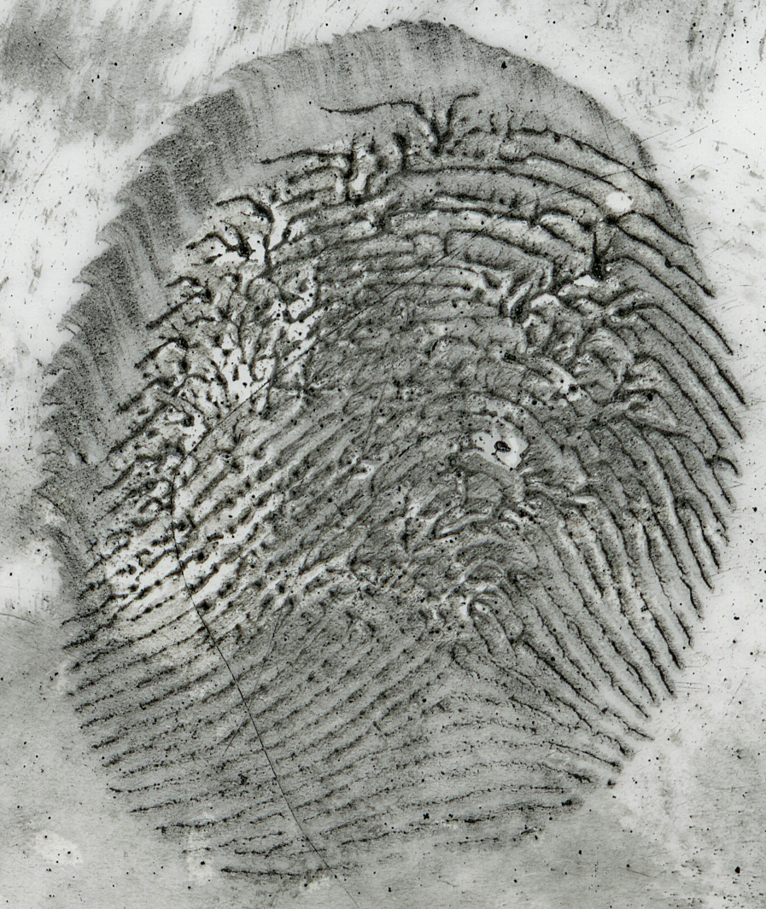

Matrix
Hand lotion on a plastic bottle. Powdered and lifted.

Slide 23
Substrate/Surface

Slide 24
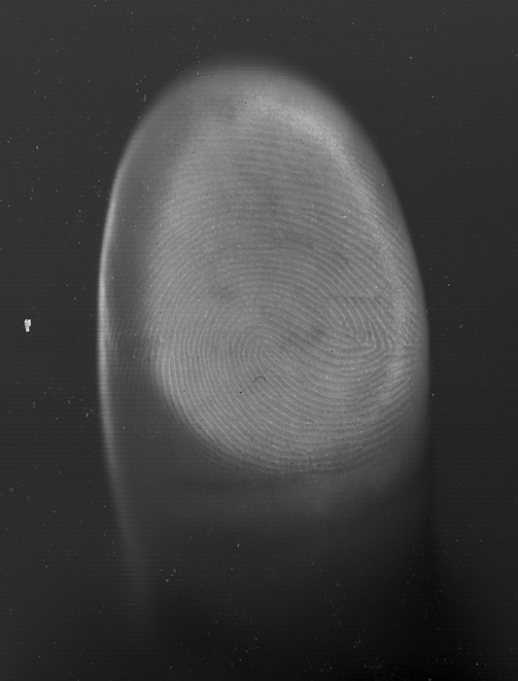
Substrate
Def. the surface upon which a friction ridge impression is deposited
_{Glass substrate}

Slide 25
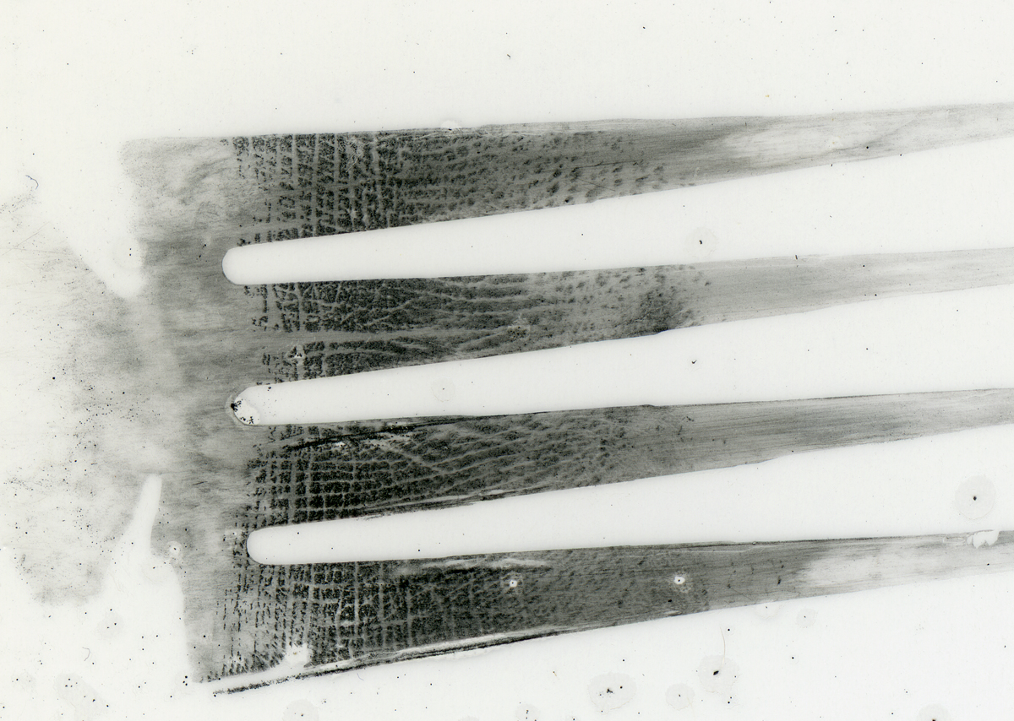
Subtrate
_{Fork}
Developed with black magna powder and tape lifted

Slide 26
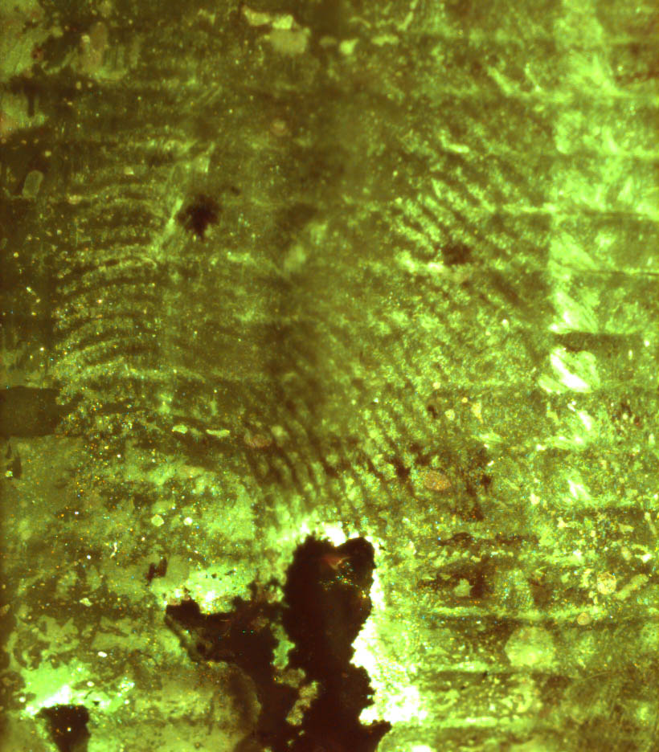
Subtrate

Slide 27
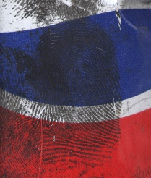
Subtrate

Slide 28
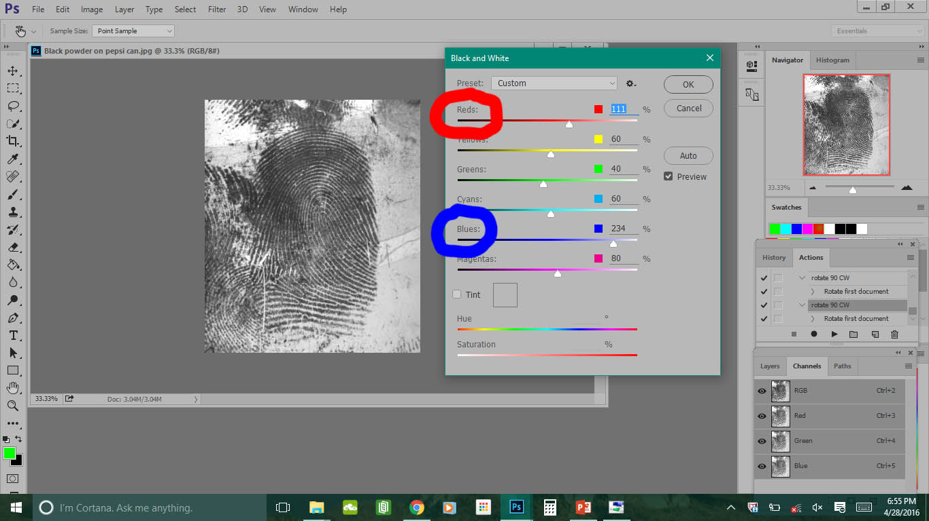

Slide 29
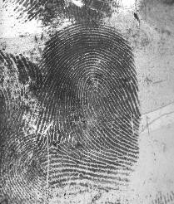

Slide 30
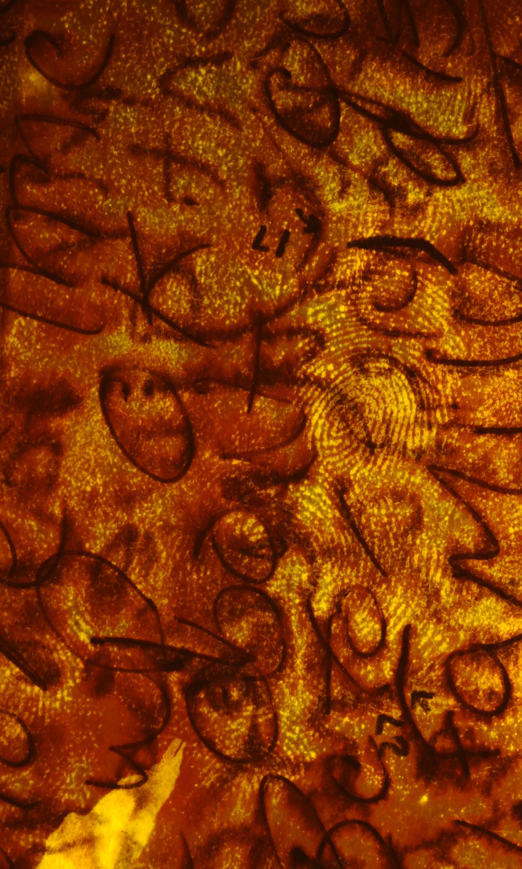
Subtrate

Slide 31
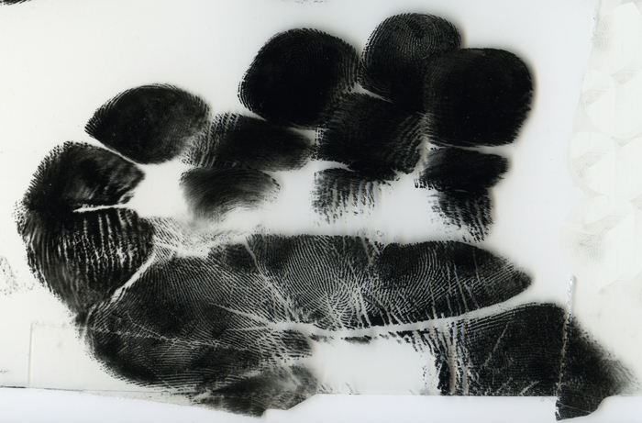
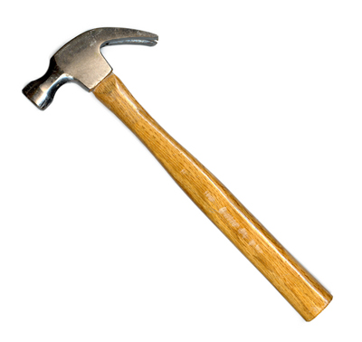
Curved substrates

Slide 32
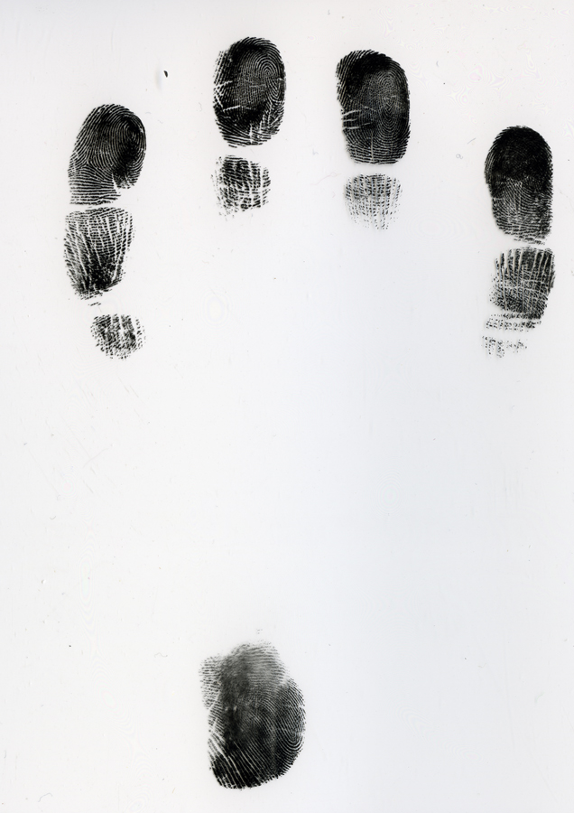

Curved substrates

Slide 33
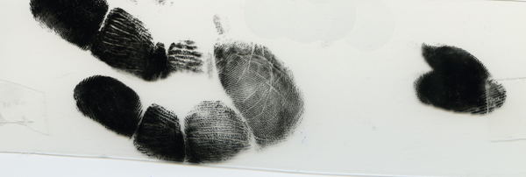
Curved substrates
_{door knob}

Slide 34
Medium

Slide 35
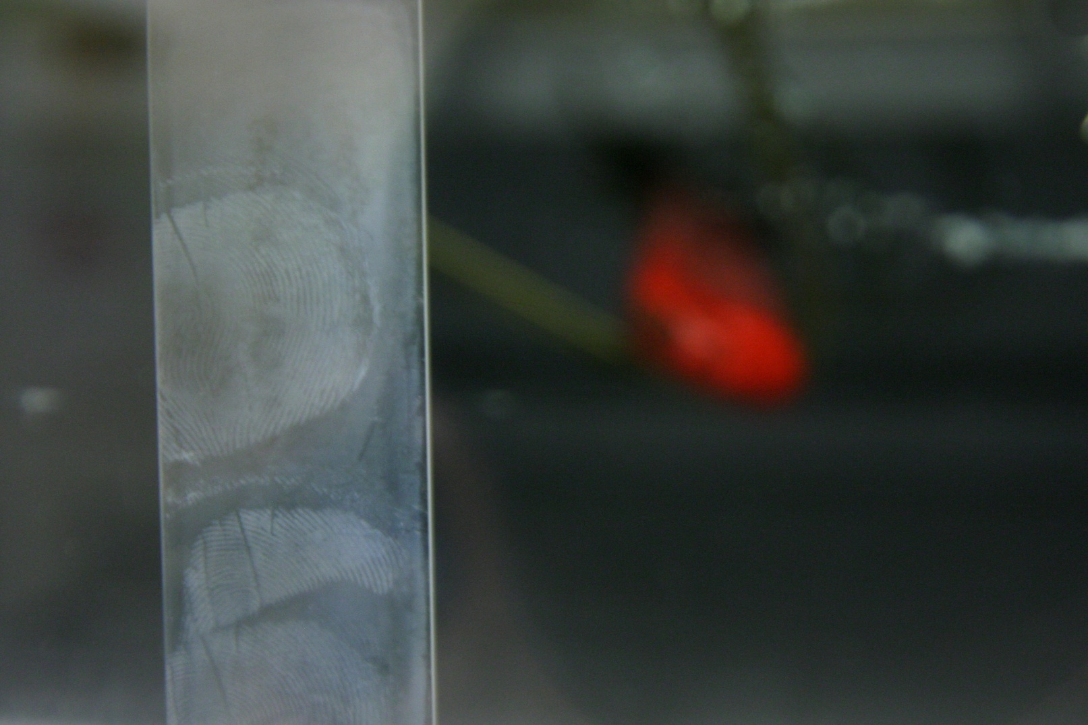
Cyanoacrylate Fuming

Slide 36
Cyanoacrylate Fuming
Proven successful at revealing latent prints on non-porous items
Creates a more-durable latent print
Can be further enhanced with the application of fluorescing dyes

Slide 37
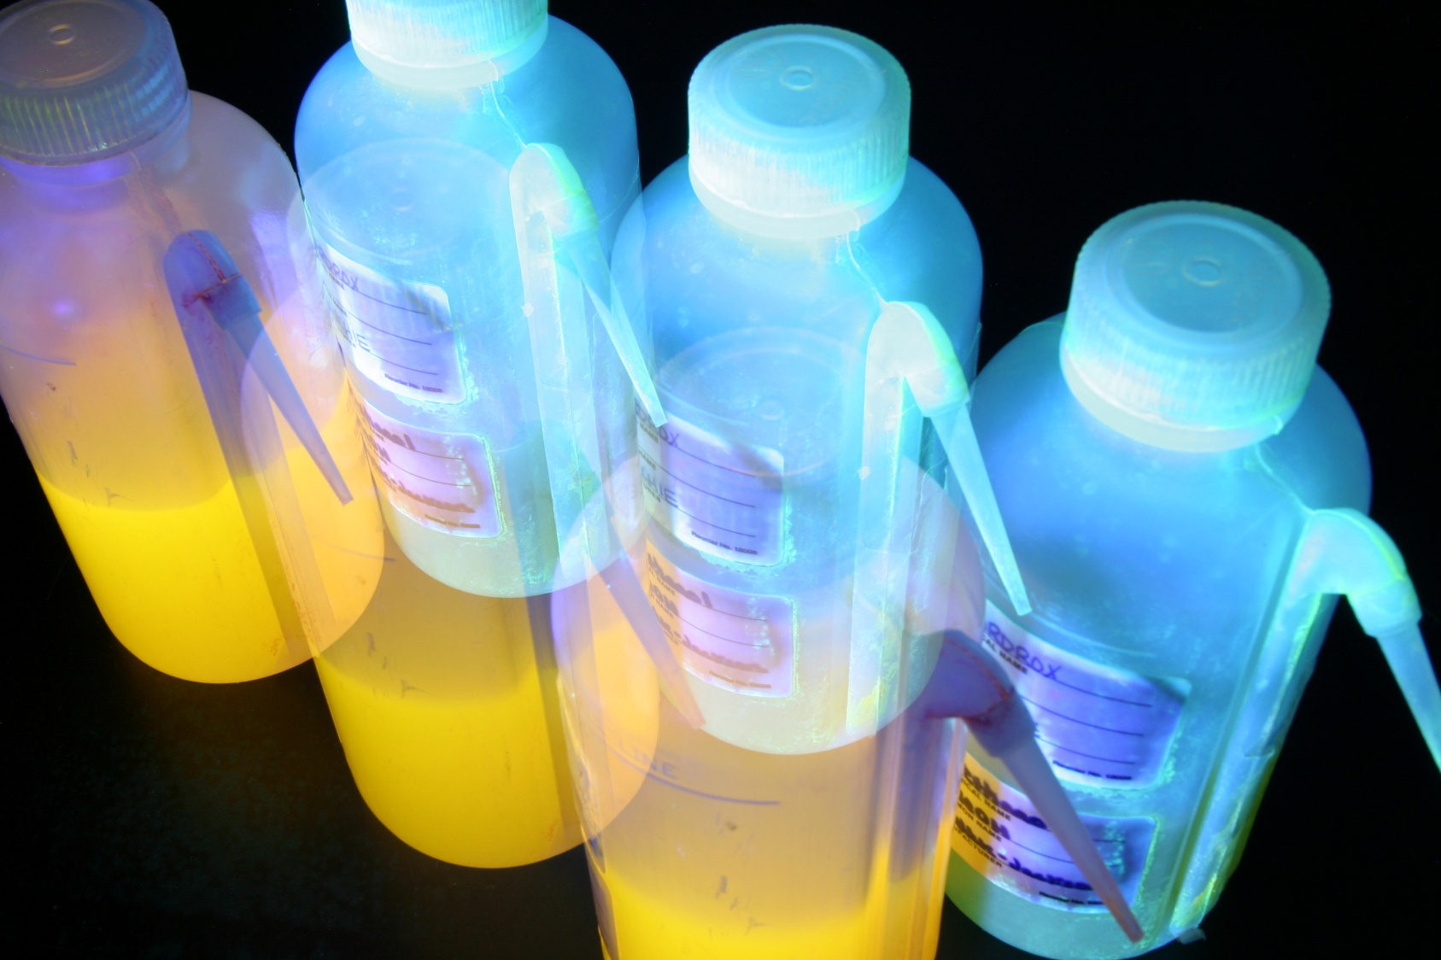
Dye Staining

Slide 38
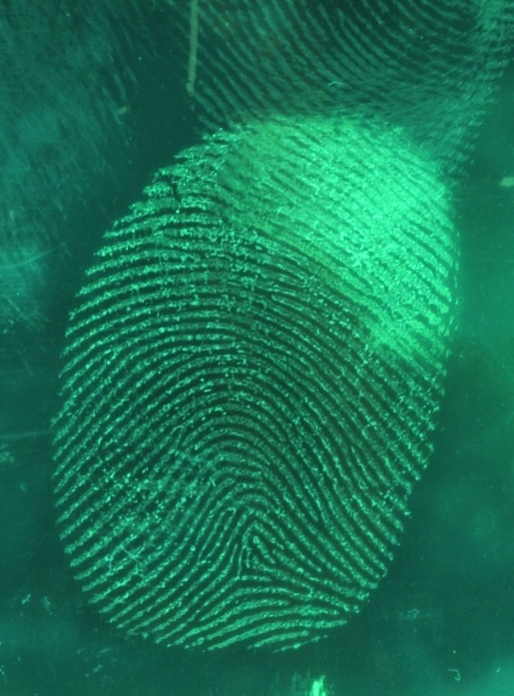
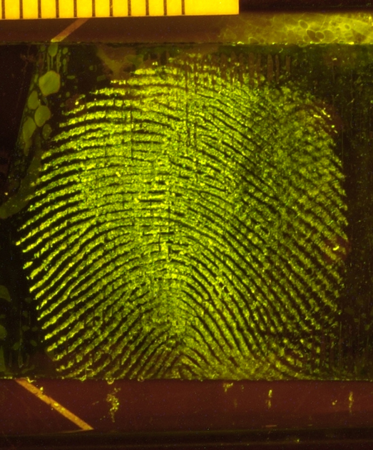
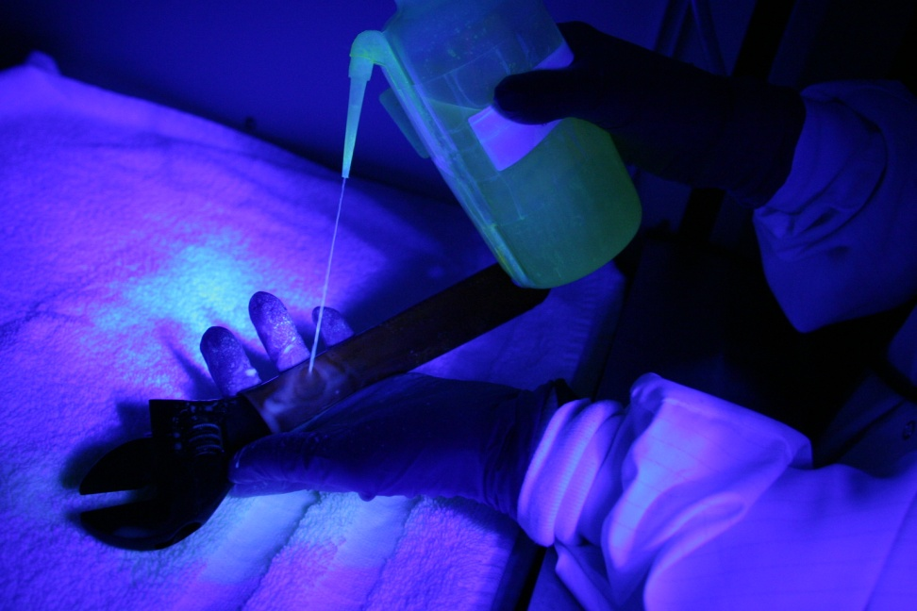
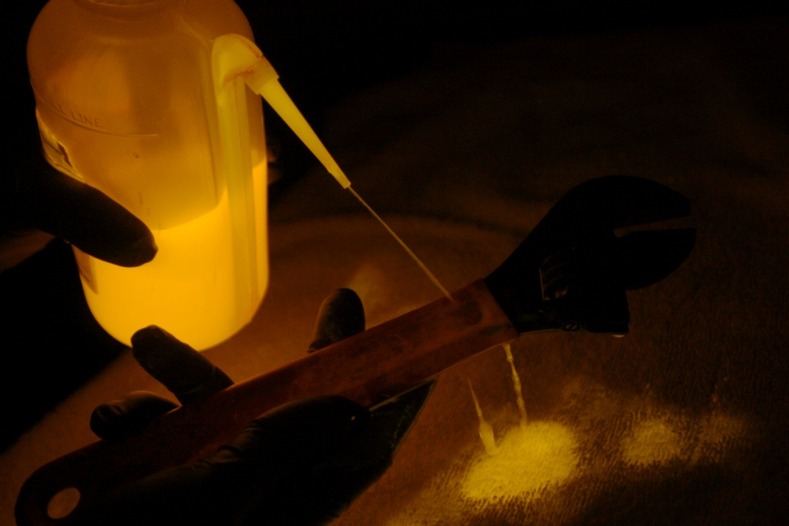
Dye Staining
Ardrox with UV Light
Rhodamine 6G with the ALS

Slide 39
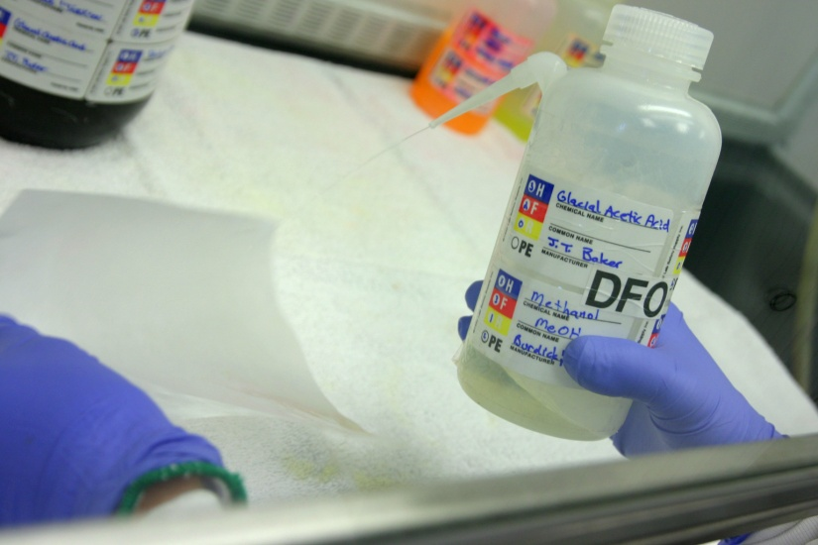
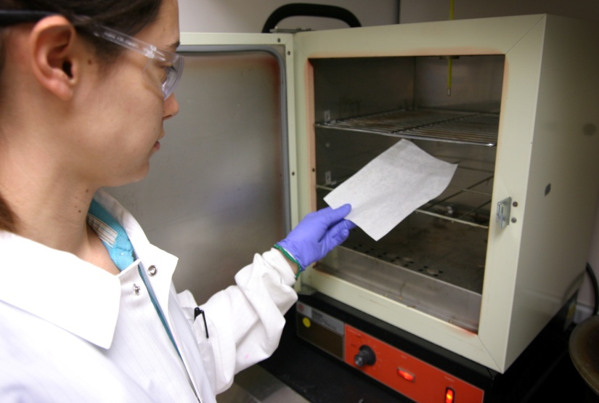
1,8-diazafluoren-9-one (DFO)
DFO reacts with the amino acids present in latent print residue
Fluoresces with the ALS (~530nm)

Slide 40

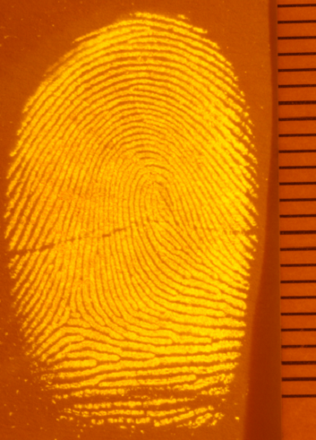
DFO
(1,8-diazafluoren-9-one)

Slide 41
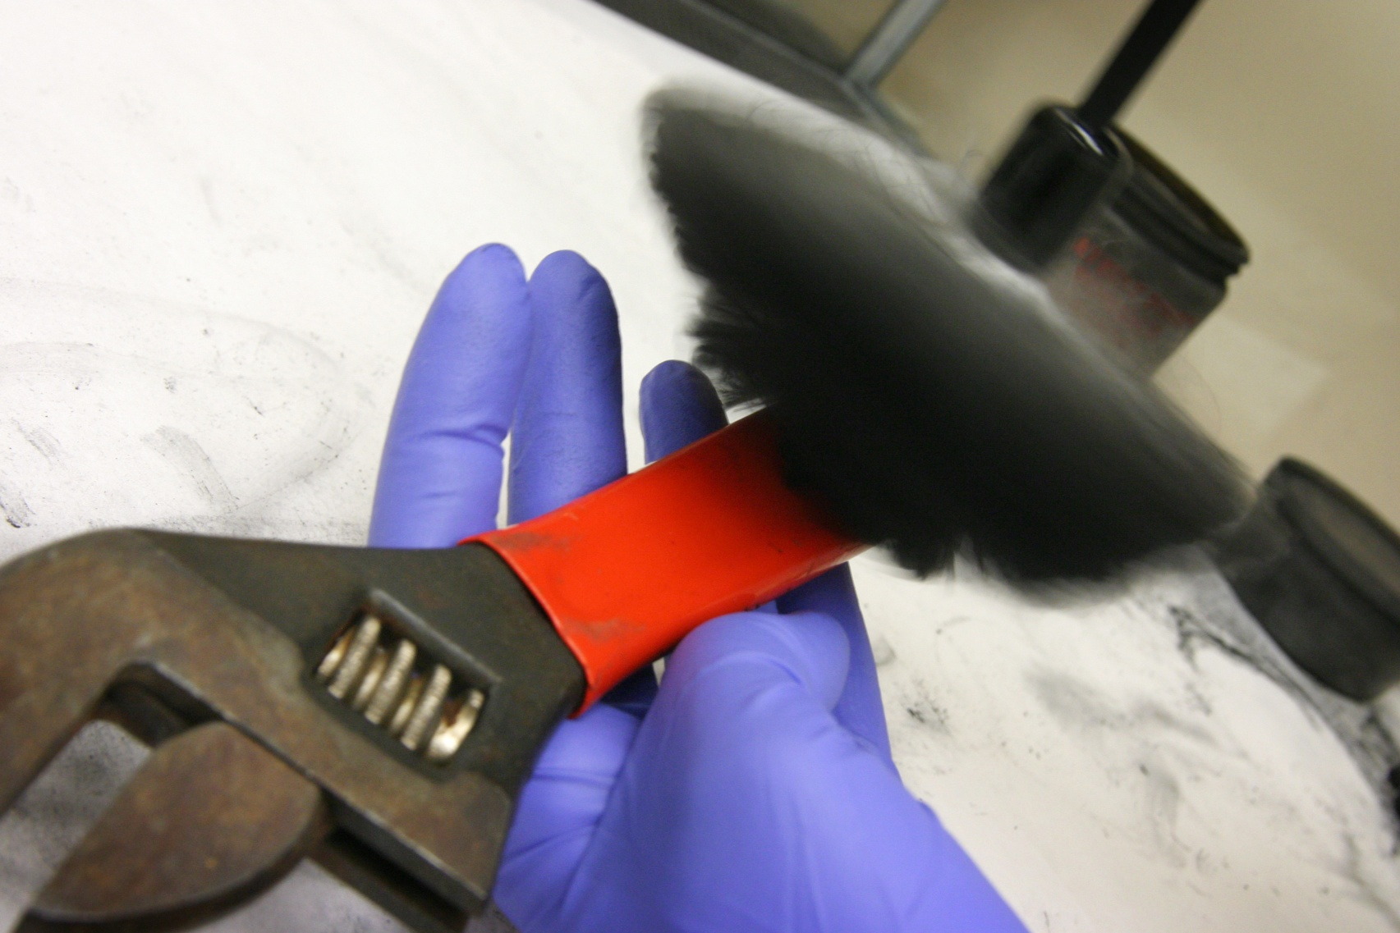
Powdering

Slide 42
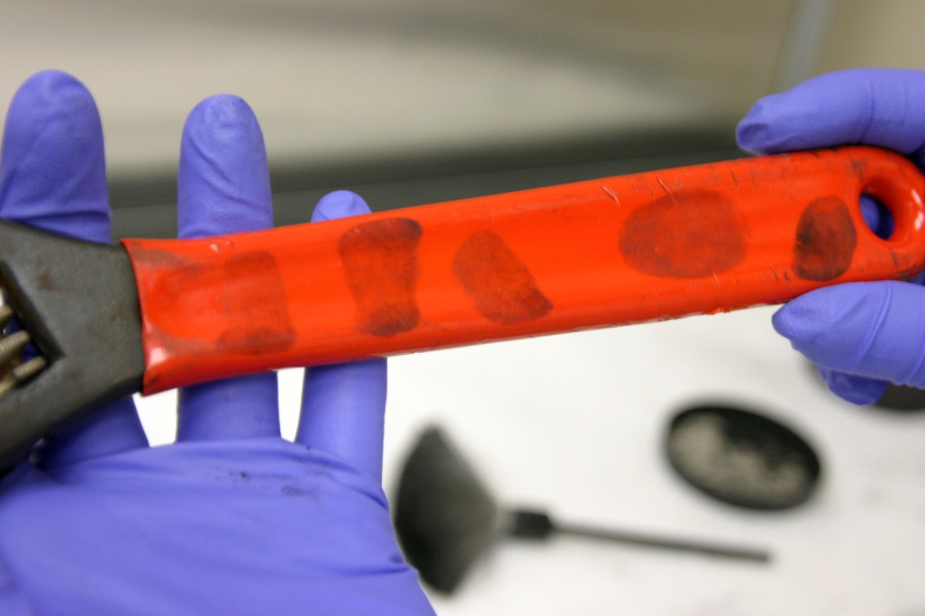
Powdering
Powdering is used to develop latent prints or enhance CA prints
Powder can either be magnetic, fluorescent, bi-chromatic
Relies on a physical adherence of particulate to the matrix
Cheap and easier to employ at a scene but less sensitive than more laboratory based techniques such as dye staining

Slide 43
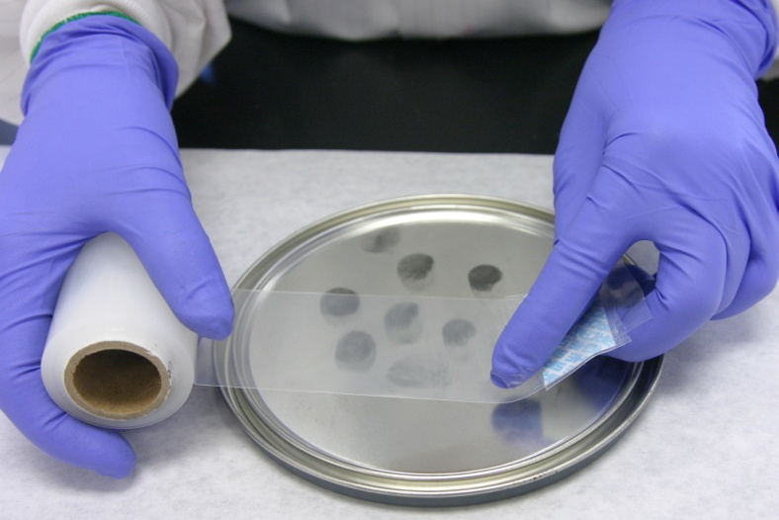
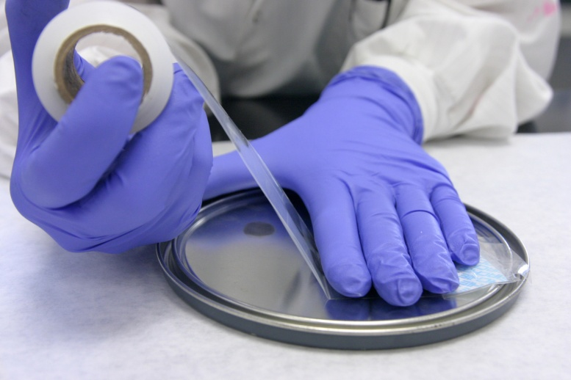
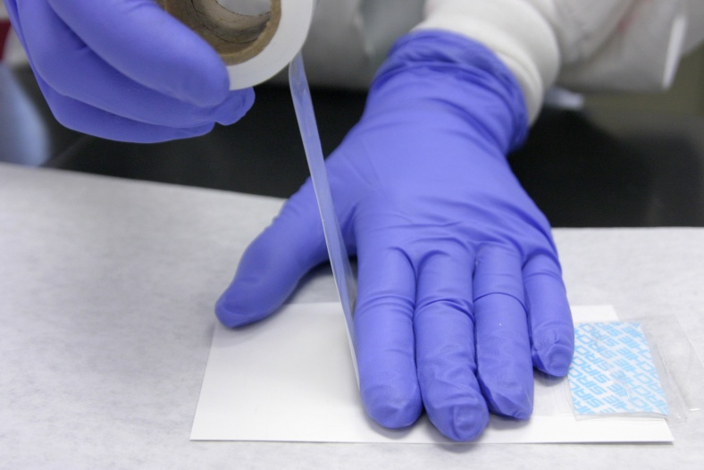
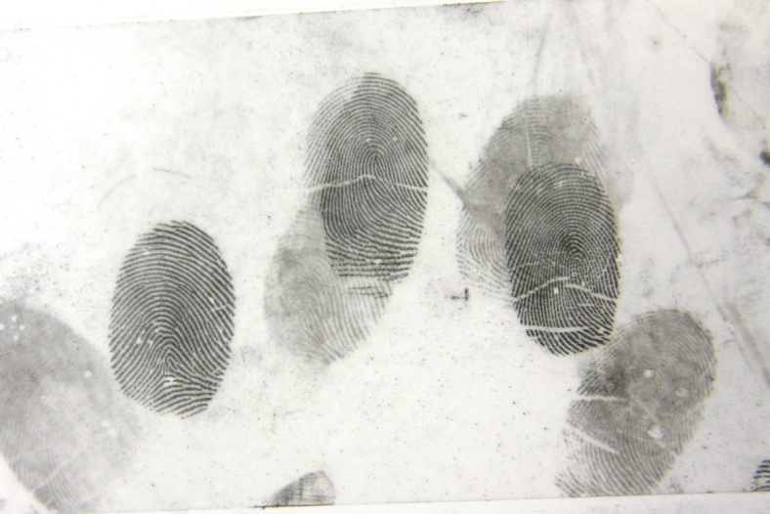
Lifting

Slide 44
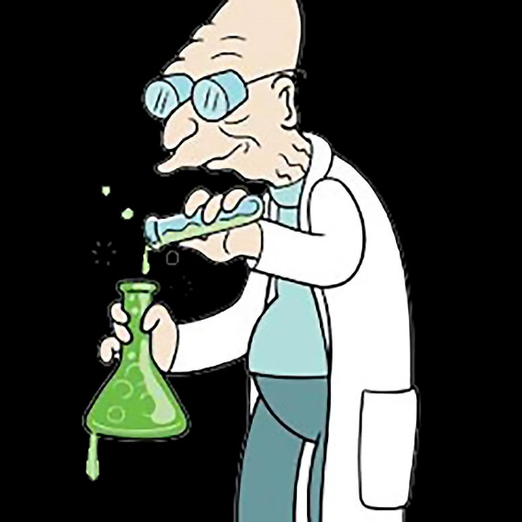
Lab Time !

