Slide 1
Crime Scene Group 1
Beth, Marysusan, Rebecca, Donna, Deborah, and photographer Jason

Slide 2
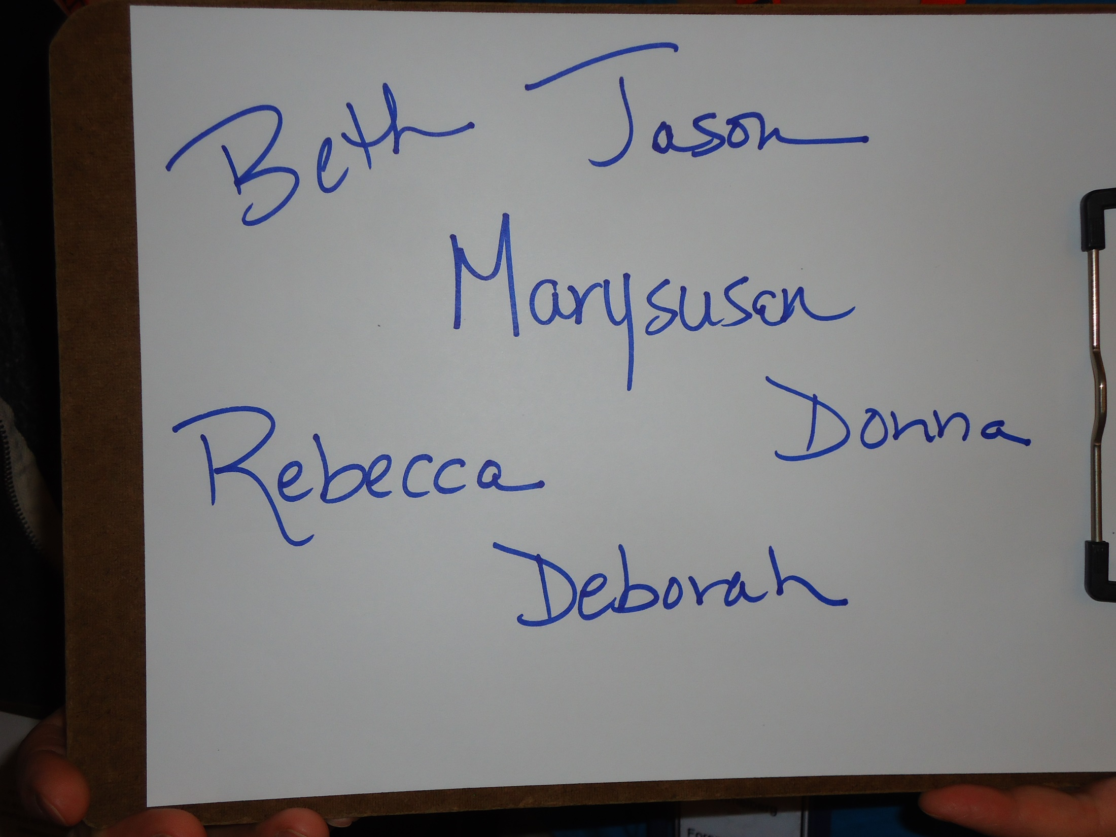

Slide 3
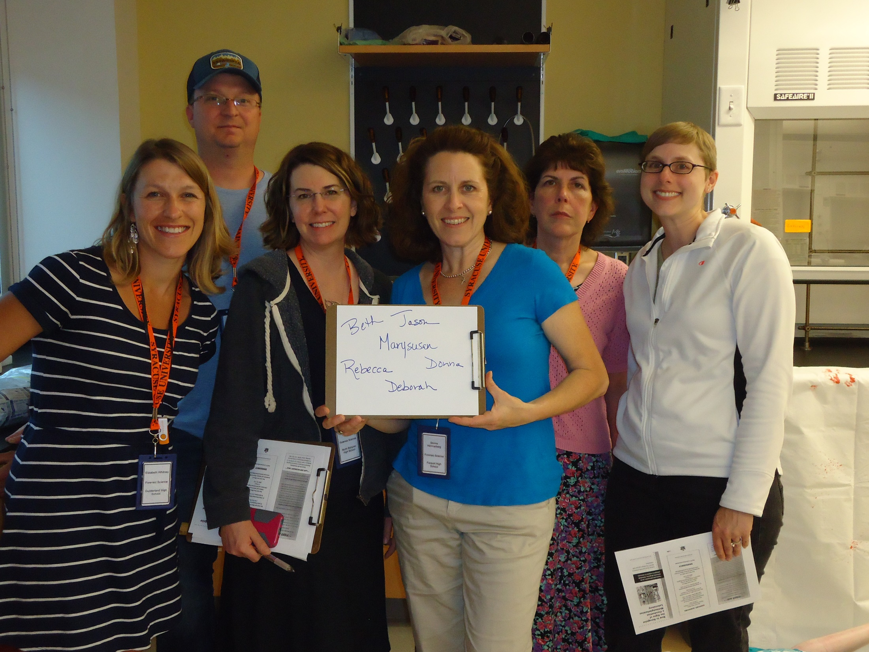

Slide 4
Crime scene
Mary knoll note taker
Jason Clarke, photographer. Enter 6:20 pm
Lights on
Have temp 70
2 victims,
Victim 1
Floor head facing south, face up.
Signs of lividity backside of head and arms.
Dark grey shorts
Turquoise t shirt
Signs of blood
3 Shell casing under body 1 between shoulder, one under the waist, one under knees.
3 additional to the west of the left leg
45 caliber winchester

Slide 5
Victim 2
One seated at counter
Blonde hair
Feet do not touch ground
Camp pants
Blood visible on shirt
Knife (36 cm blade, 13 cm hilt)
and broken bottle on floor near victim 2
Two shell casings, to the left of victim 2.
3 other shell casings to the left of victim 1 feet.
Wearing closed toed shoes, but there are sandals under her chair.
Nylon bindings on hands. Clips on wrists and legs are hooked to an electrical outlet.
Syringe protruding from right bicep.
3-6 stab wounds lower right peritoneal cavity

Slide 6
Bench from right to left
Acetone
Ziplock bag contains three pill bottle and one liquid bottle. All pill bottles are empty, some liquid. Clear colorless liquid.
Sudafed
Street drugs
Filter papers
Filtration set up with orange liquid, no solids
Vials containing solids, orange, purple, green and yellow
A tablets in amber prescription bottles.
Three open match packs. Three headless matches, the syringes without needles.
6 liquid vails
1 orange vails
Bottle labeled insulin with needle but no syringe
Third syringe has needle, no apparent liquid
Baking soda, with spatula and product
Epsom salt box
Kosher salt box.

Slide 7
Second filtration set up with red liquid.
Cigarillo
Scale
Drain cleaner
4 100 dollar bills
Baggie with 4 pink and 3 yellow tablets.
Nail polish remover regular acetone based
Bottle of dry gas treatment
Bleach
Seth artist Beth whitney 6:29 pm
Rebecca Torres measurement specialist
Donna himmelberg measurement specialist
6:33 pm

Slide 8
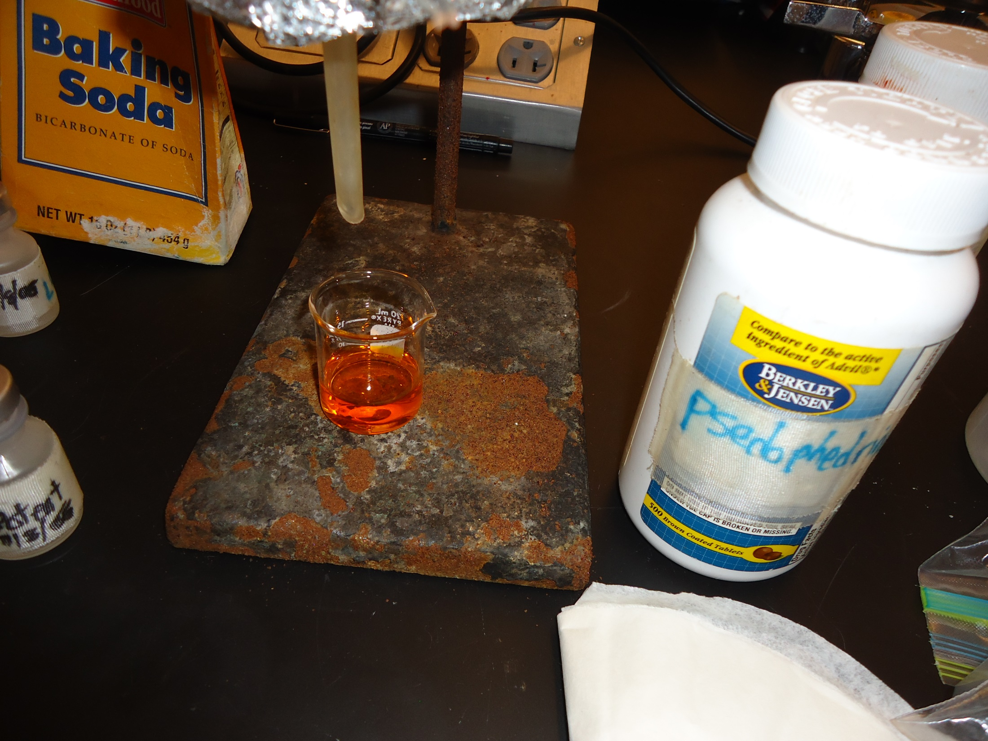

Slide 9
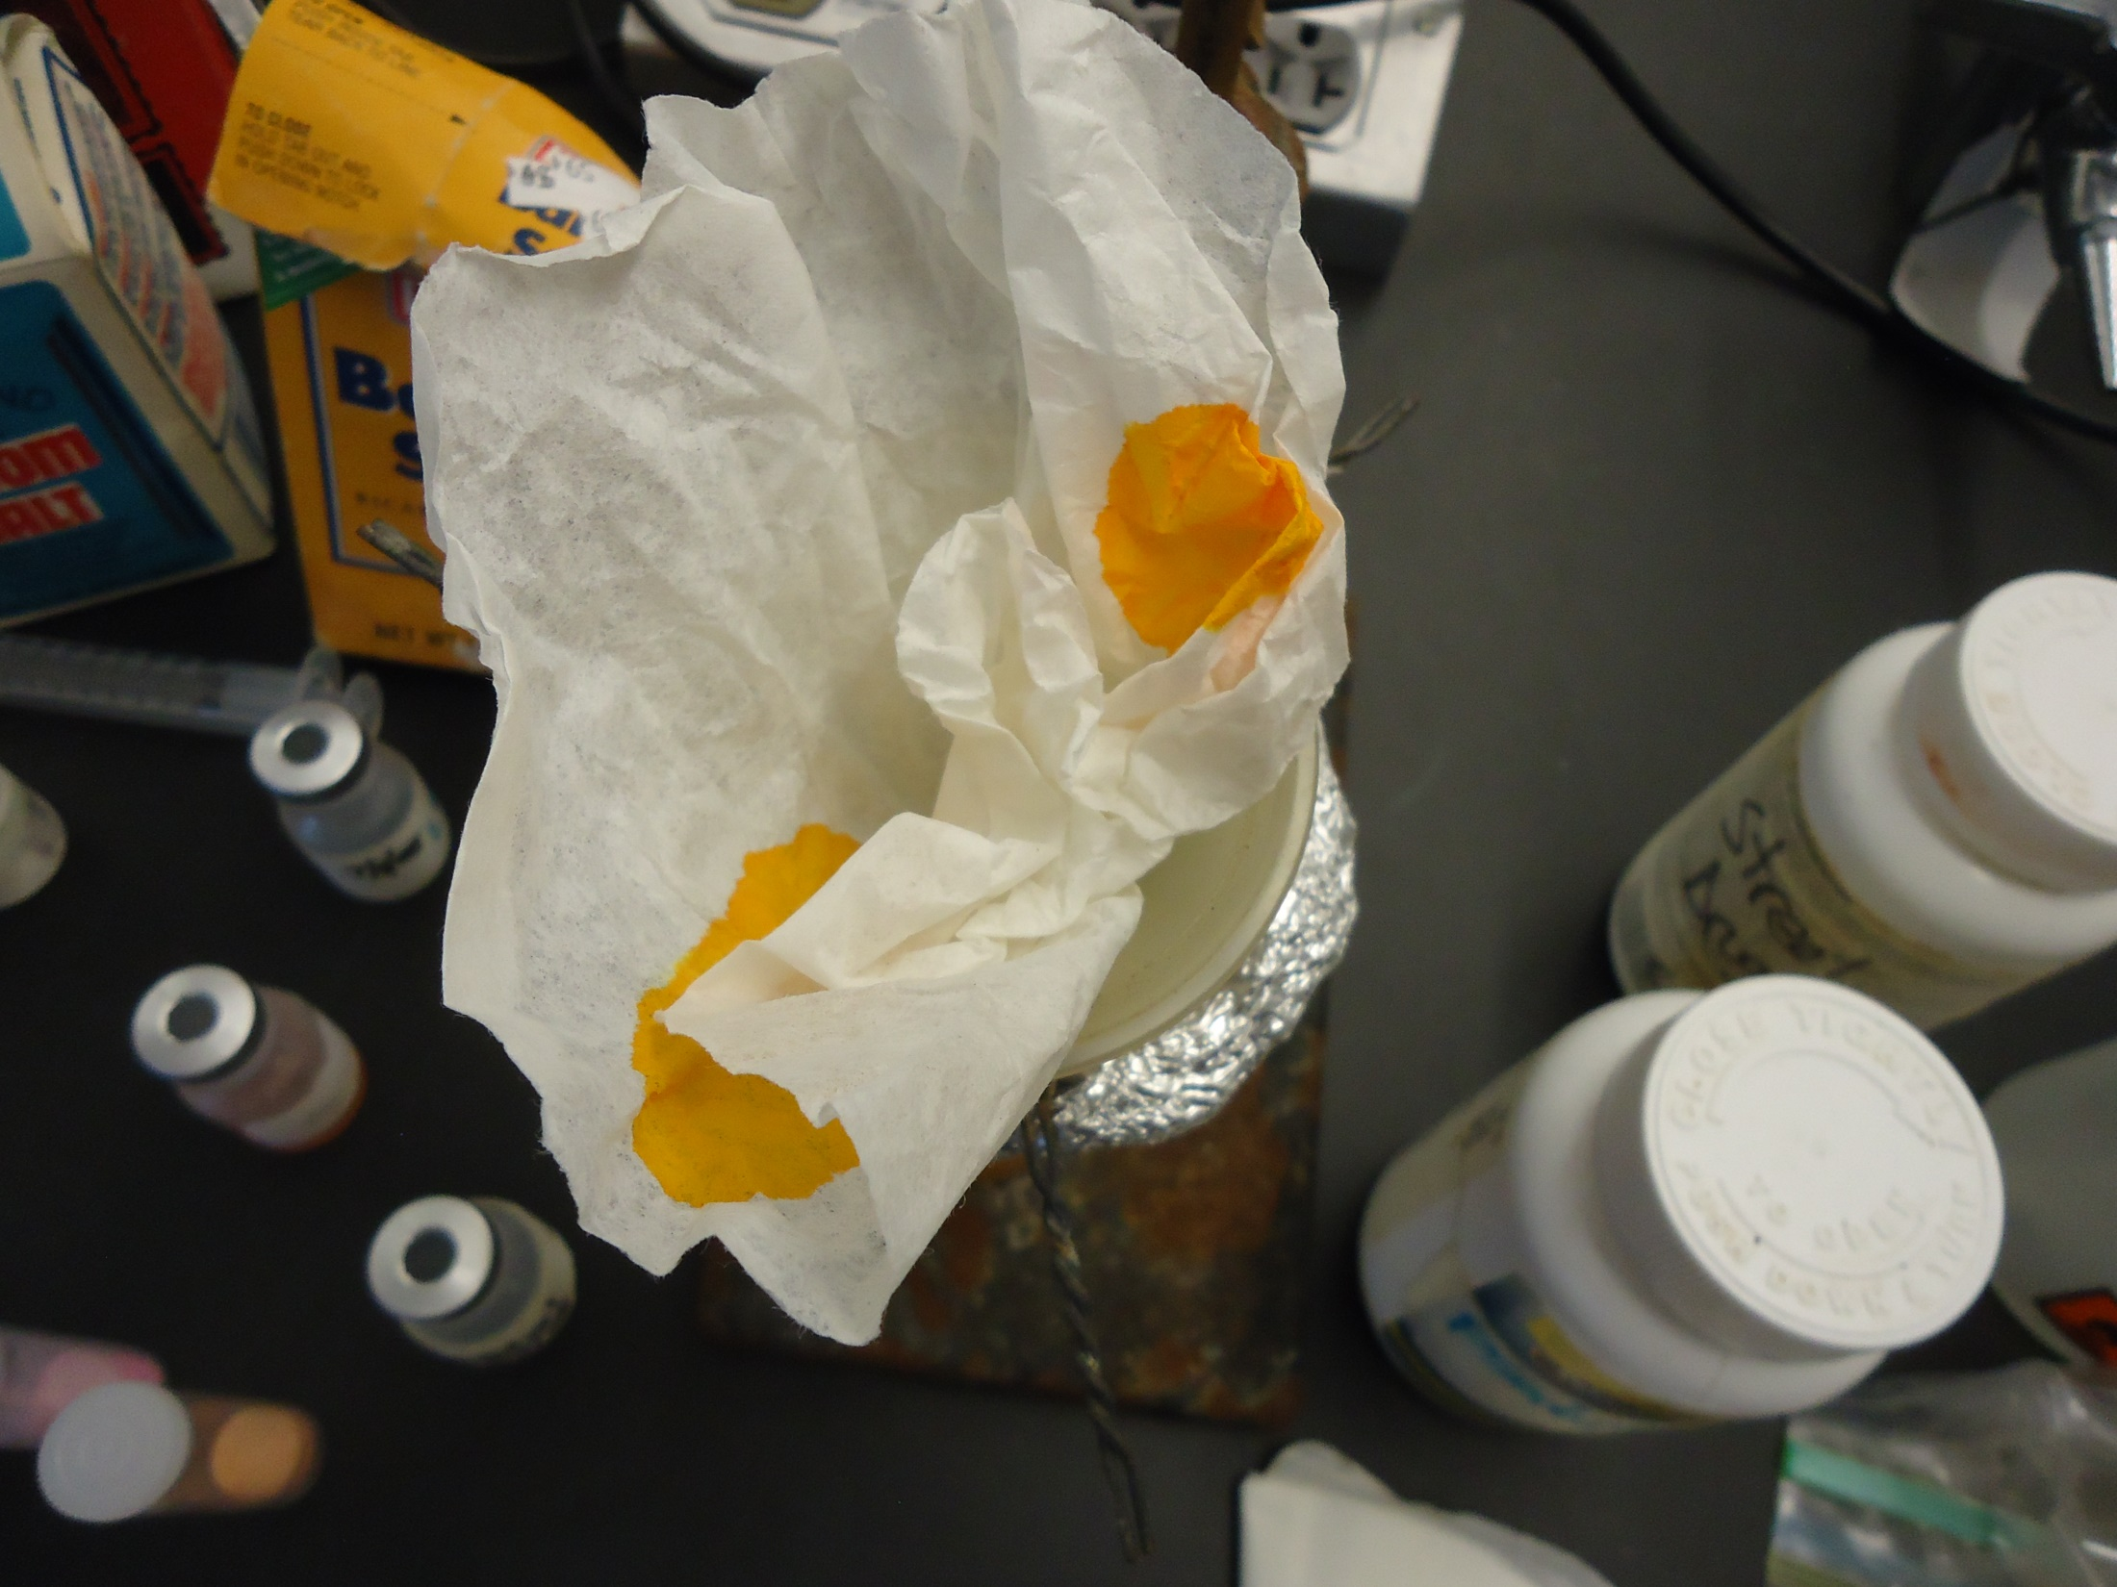

Slide 11
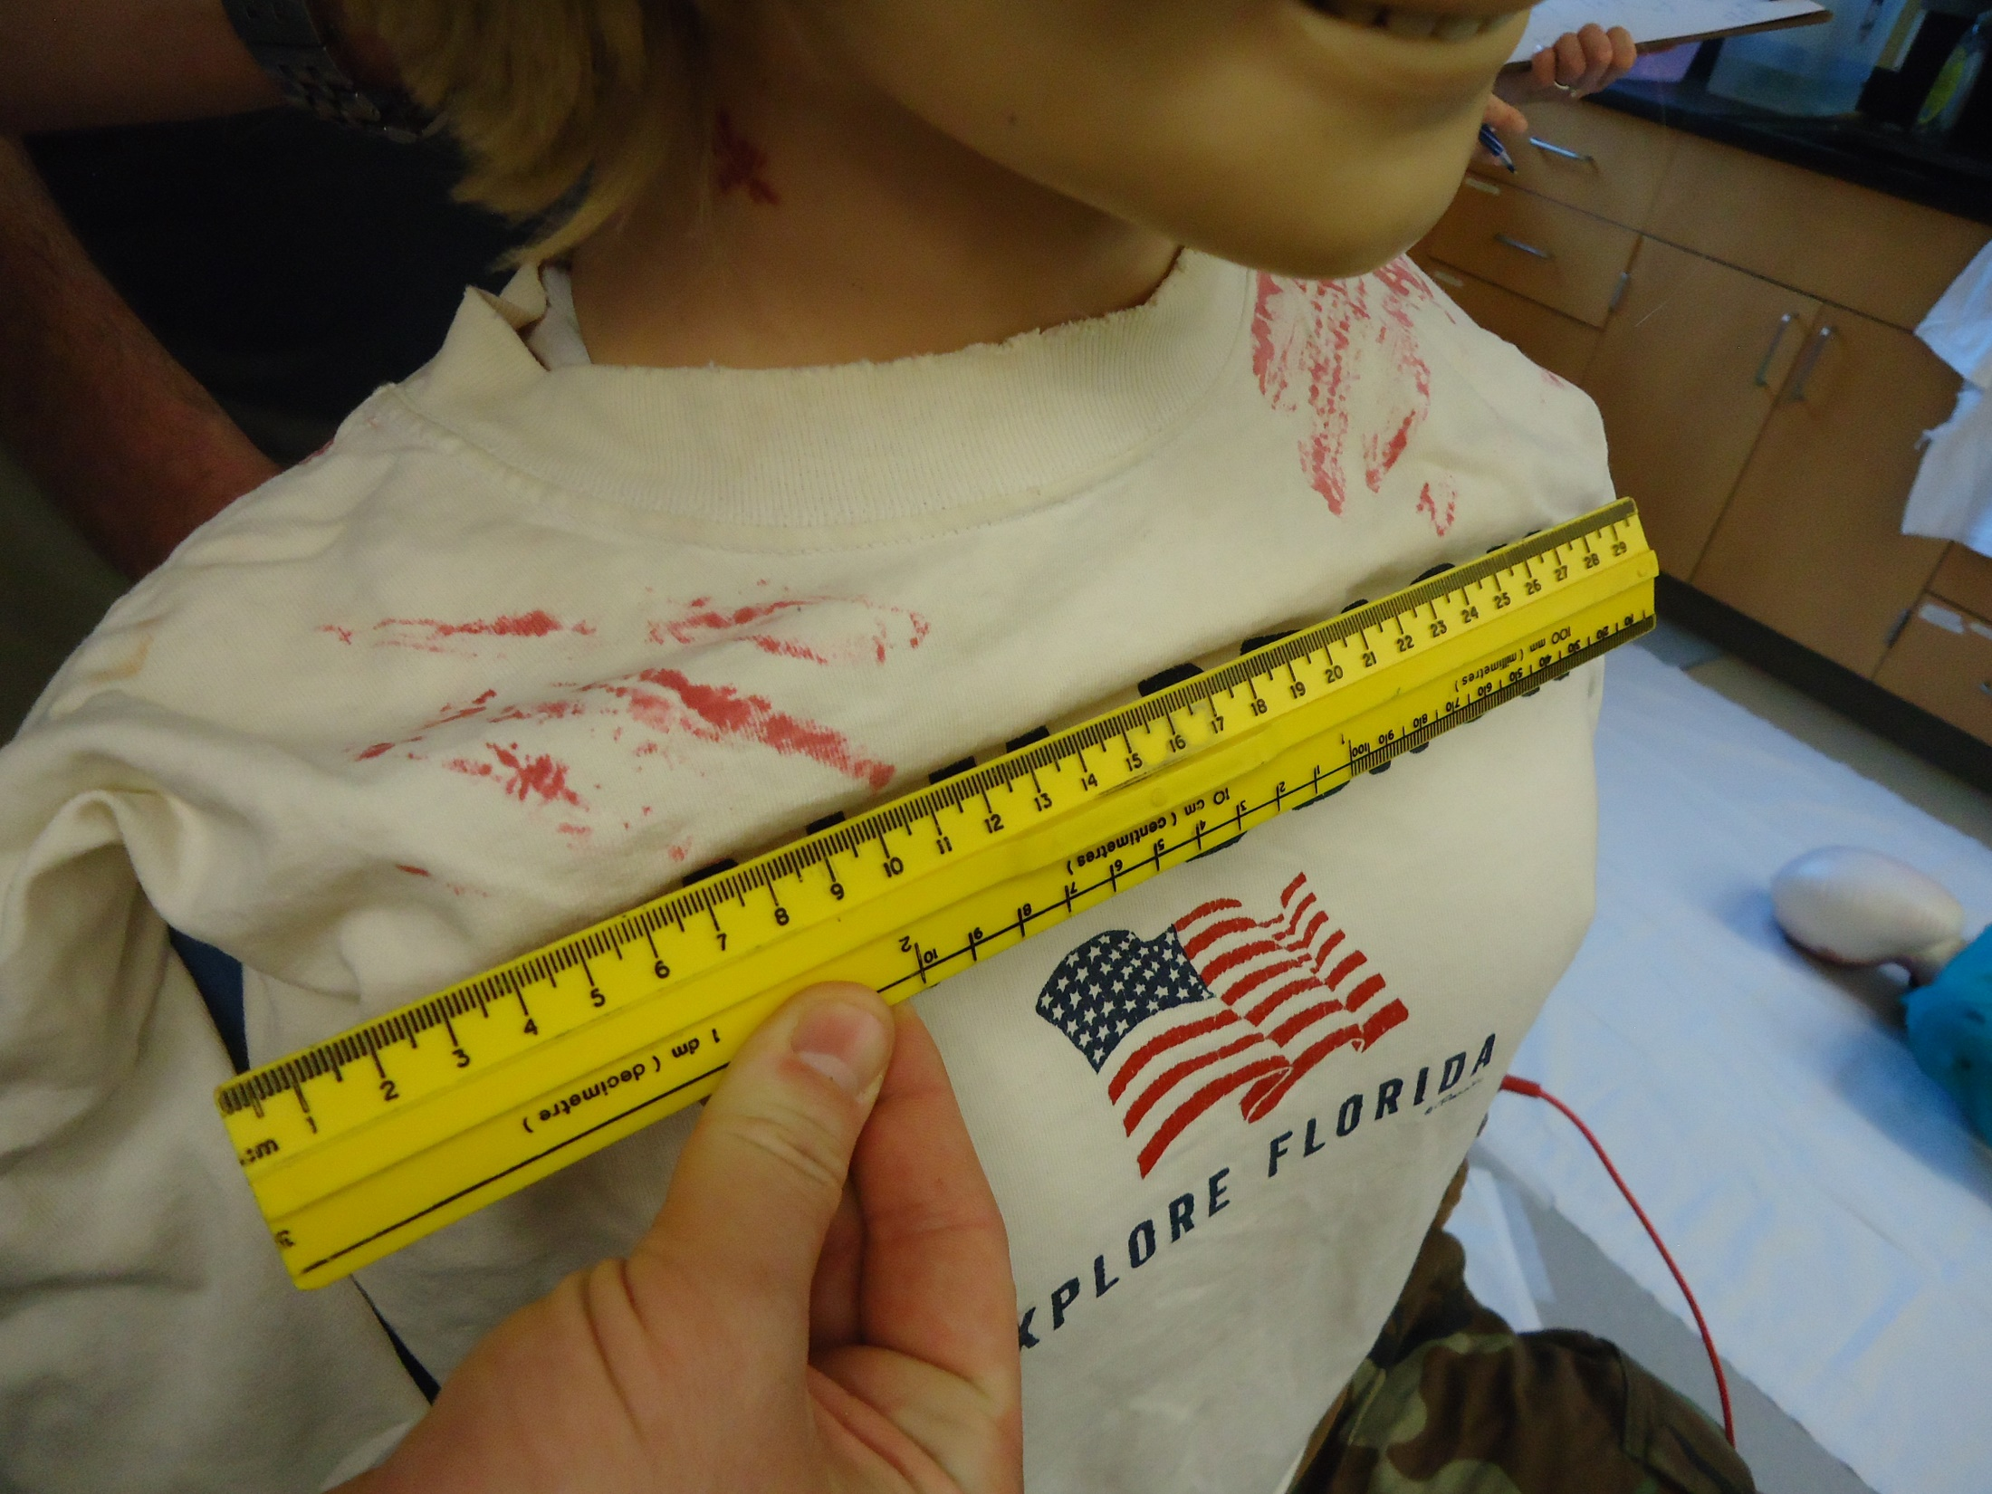

Slide 12
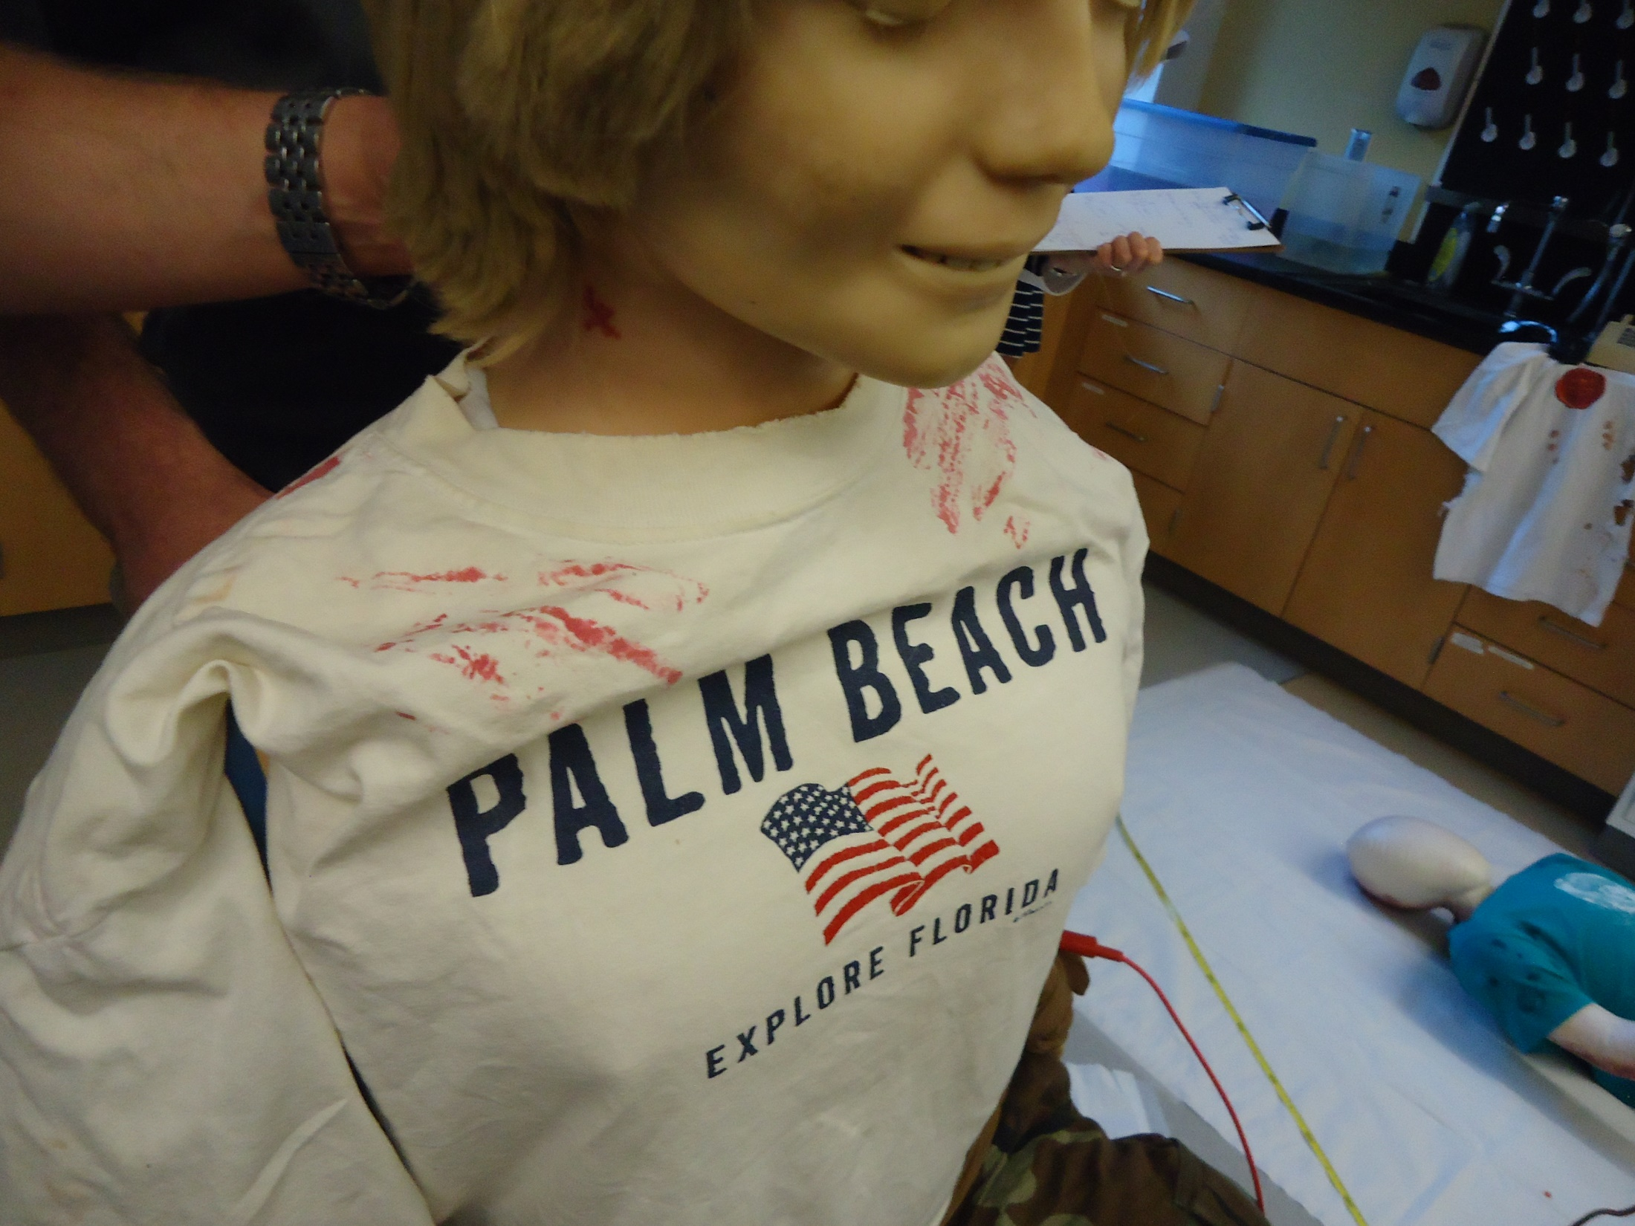

Slide 13
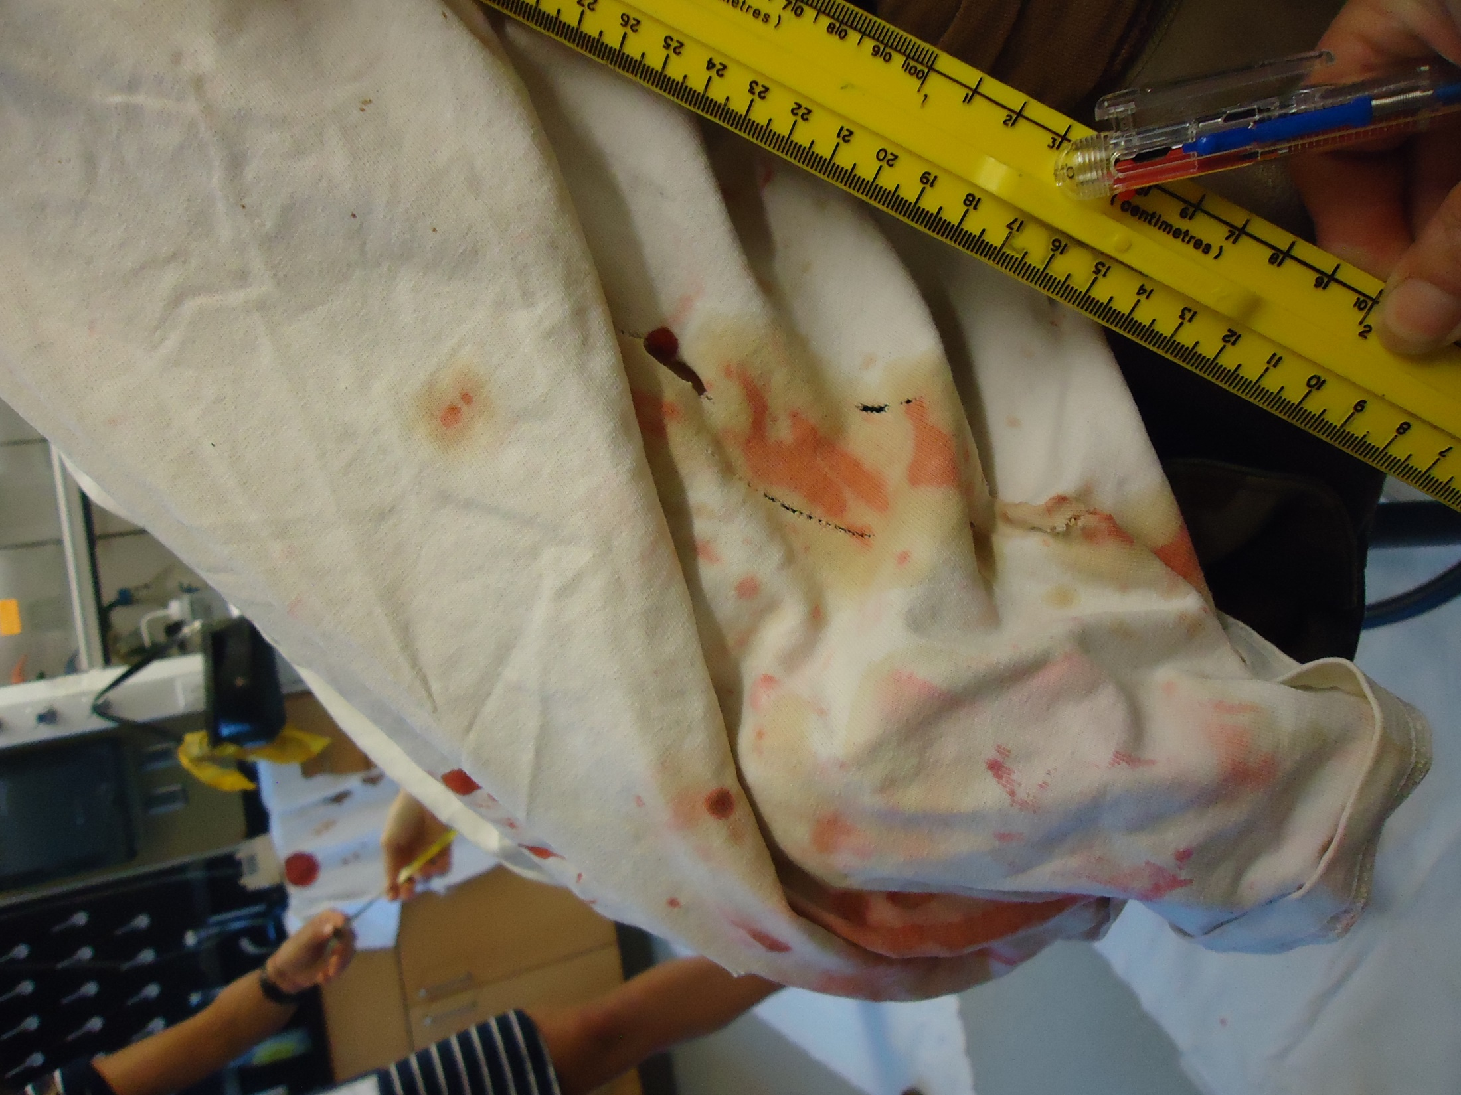

Slide 14
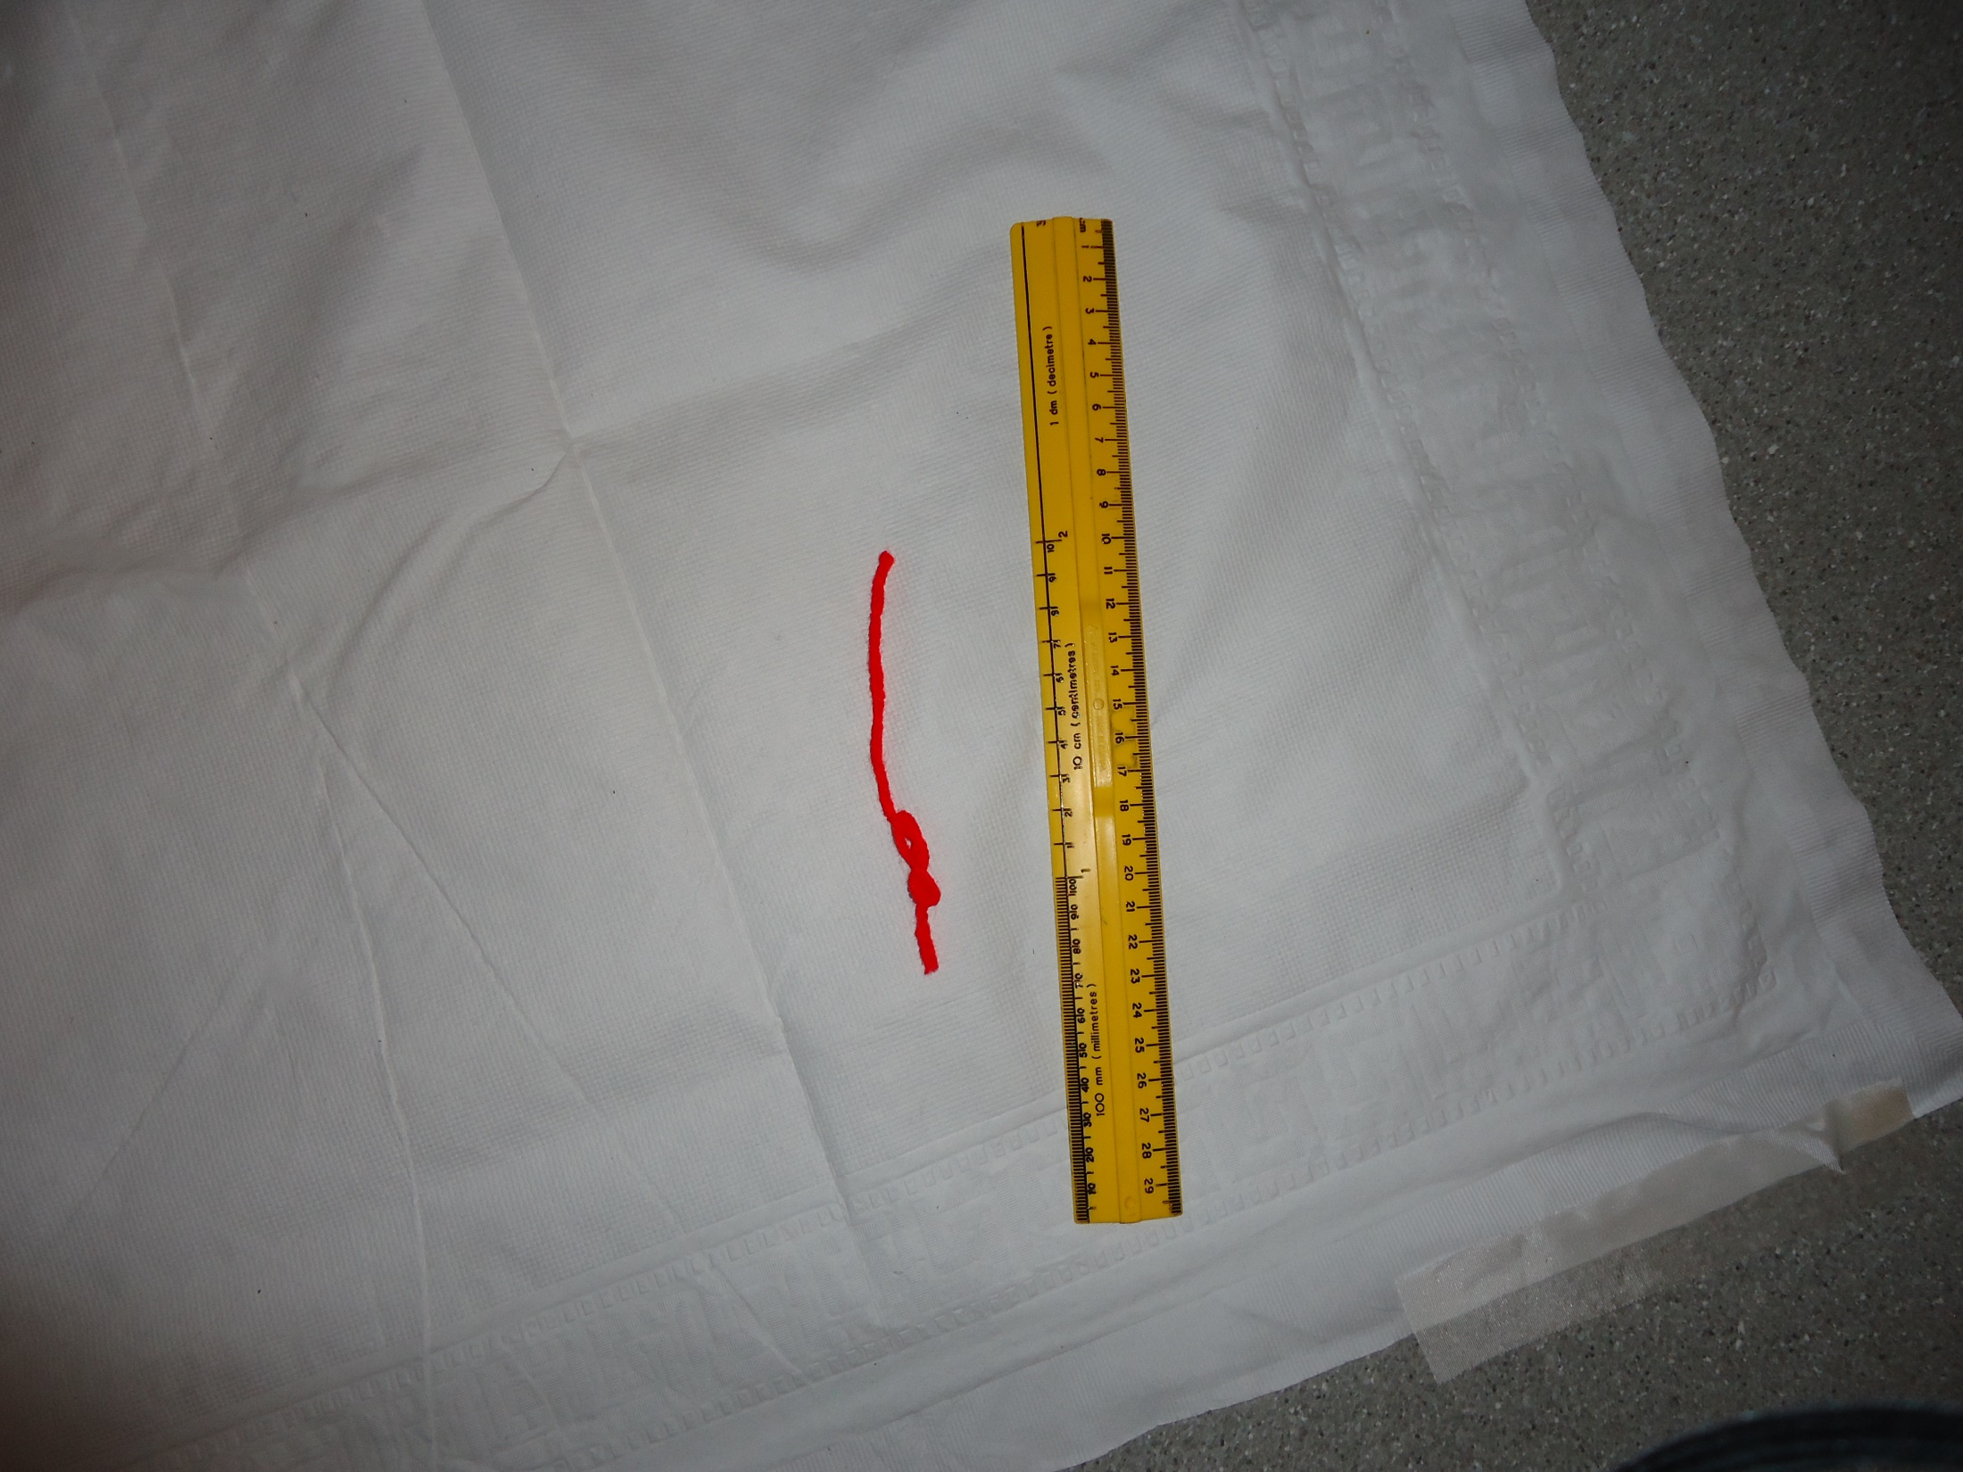

Slide 15
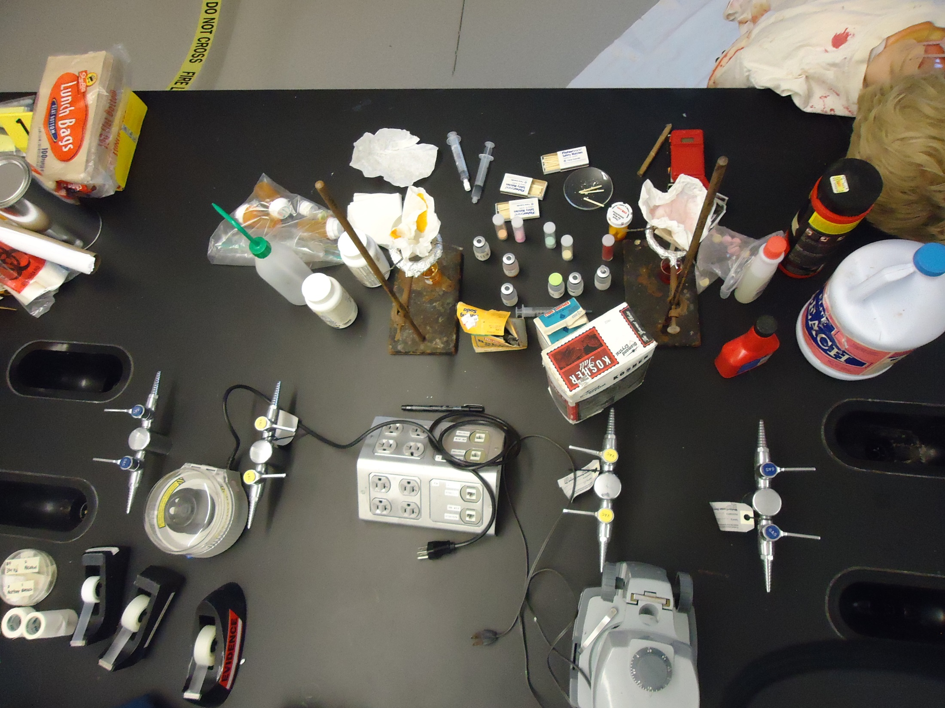

Slide 16
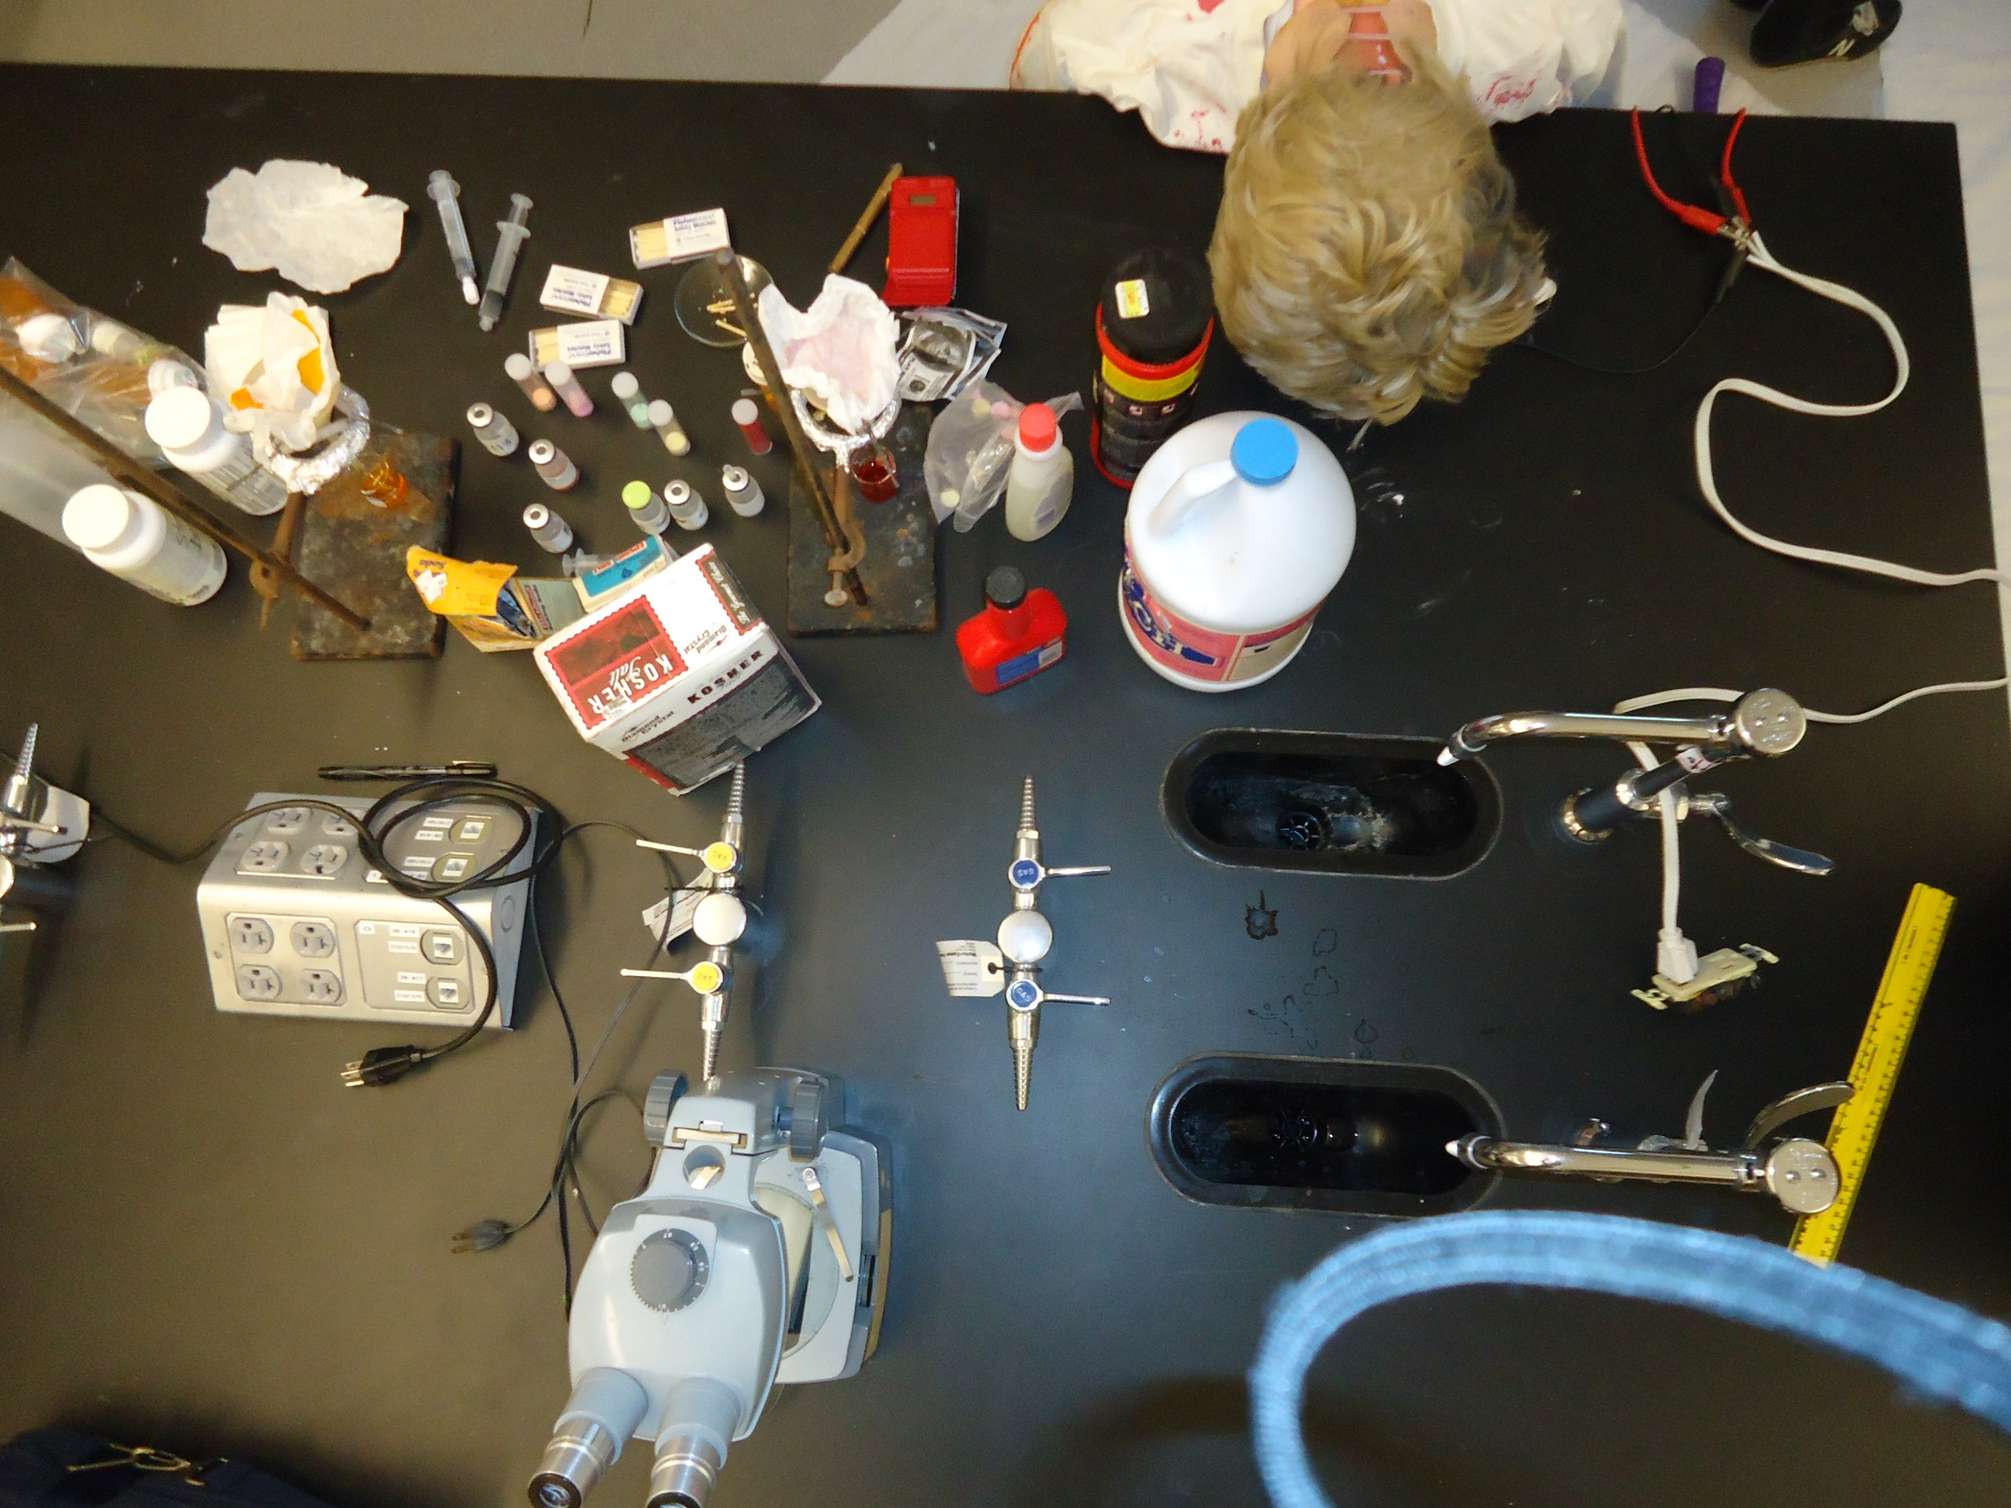

Slide 17
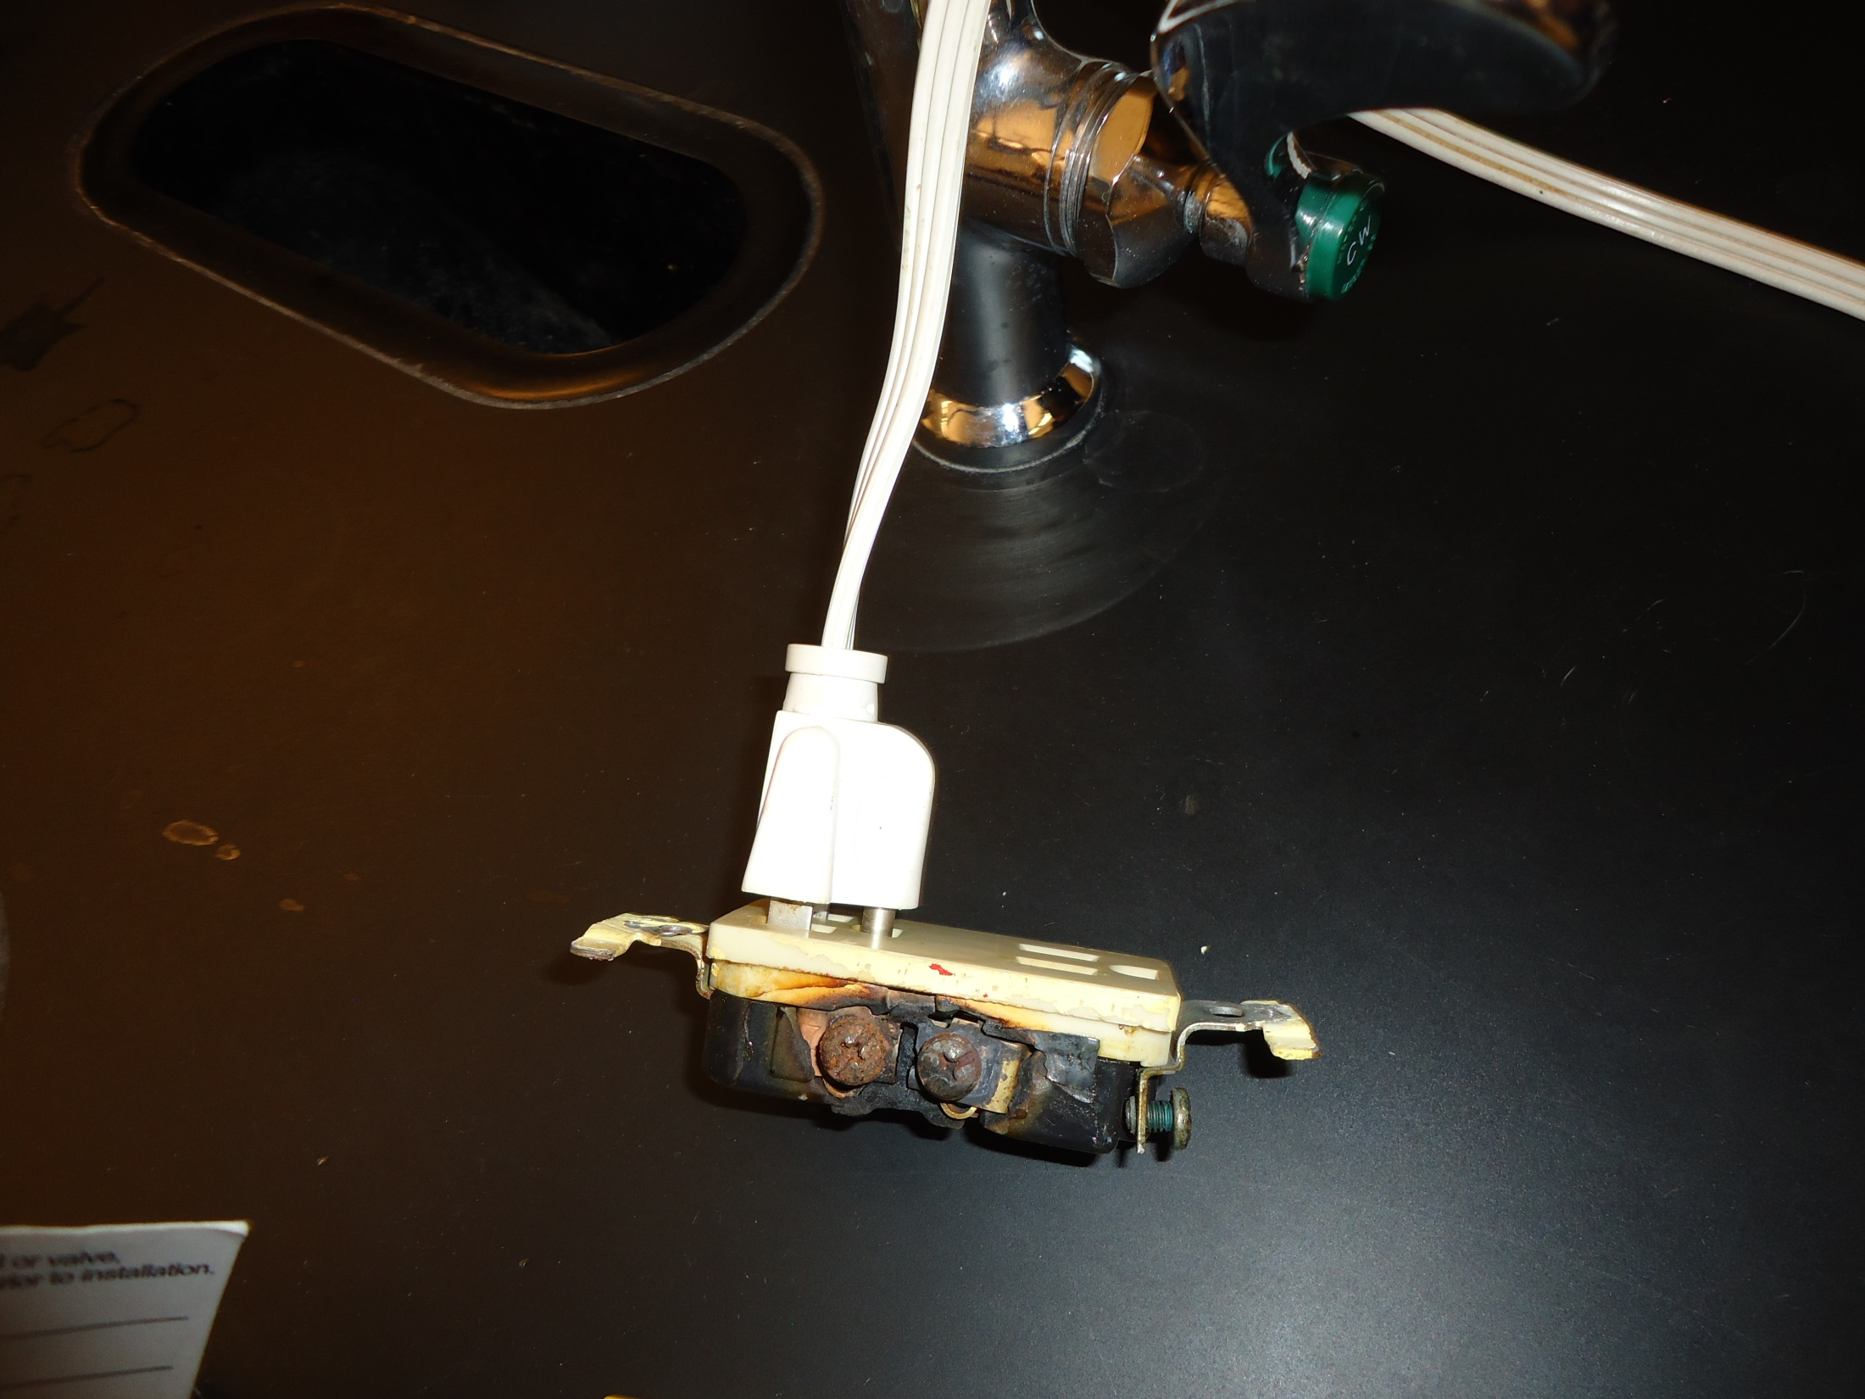

Slide 18
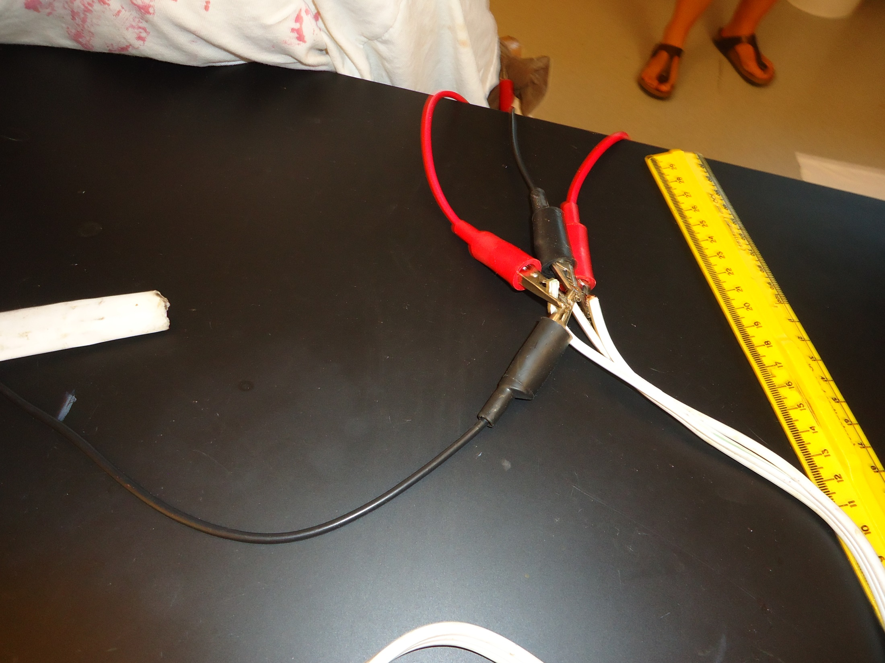

Slide 20
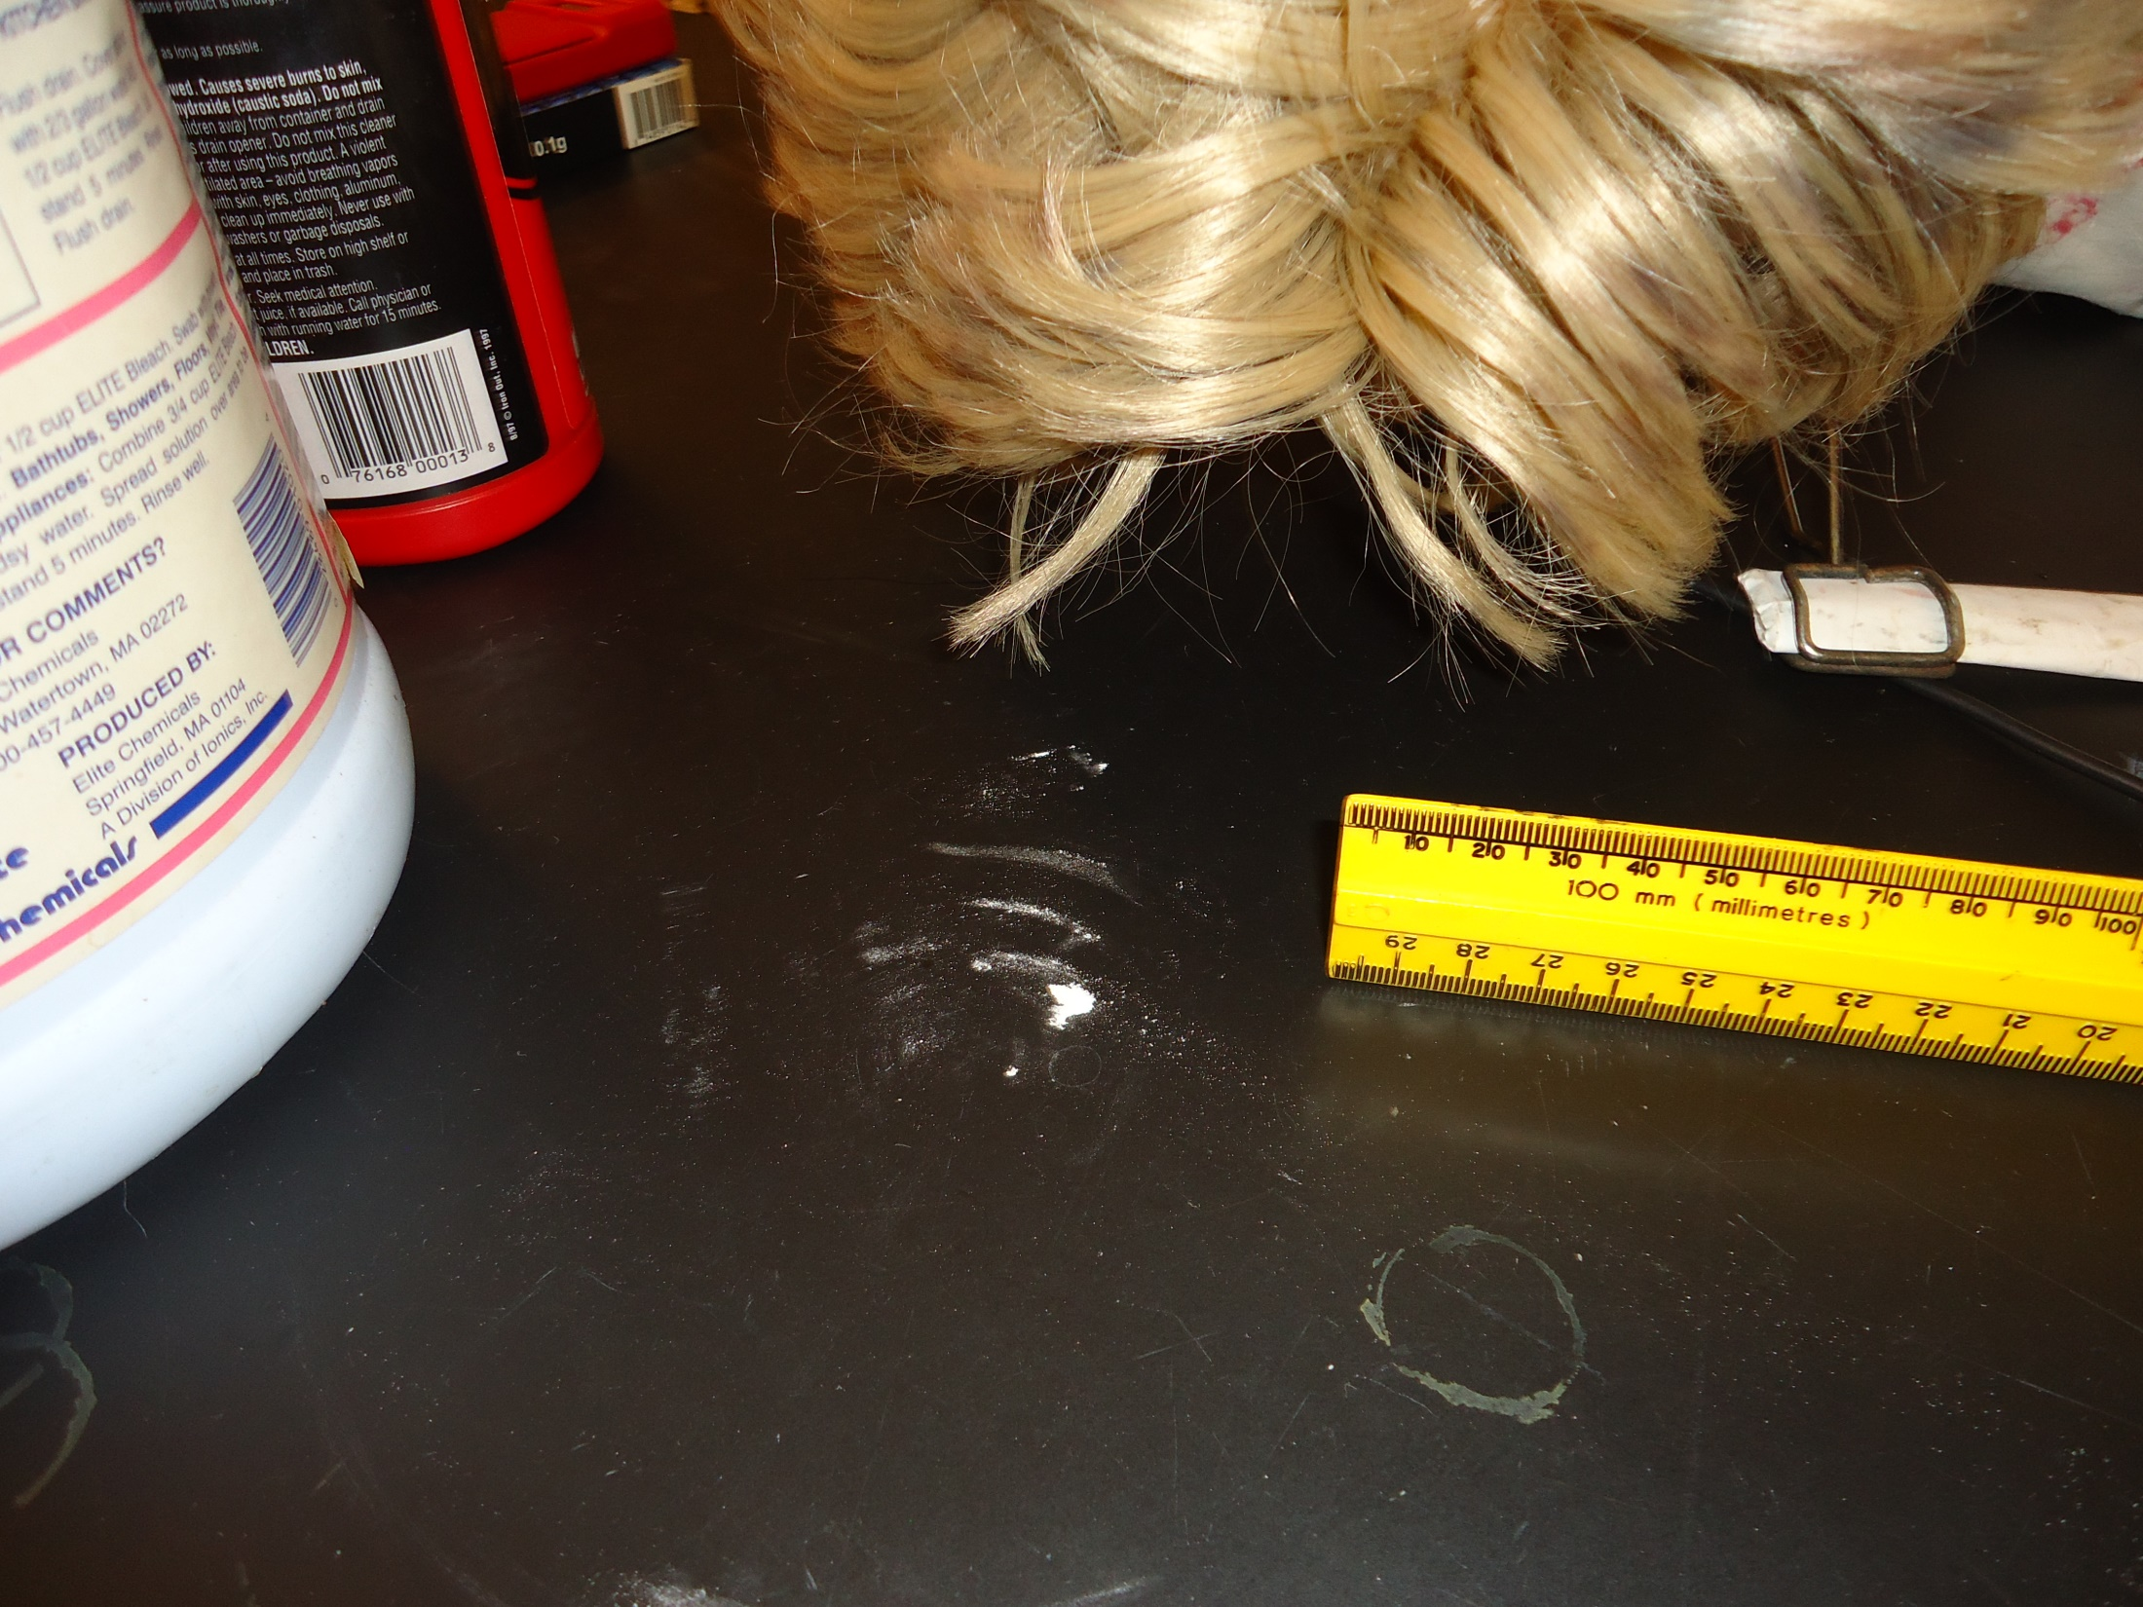

Slide 21
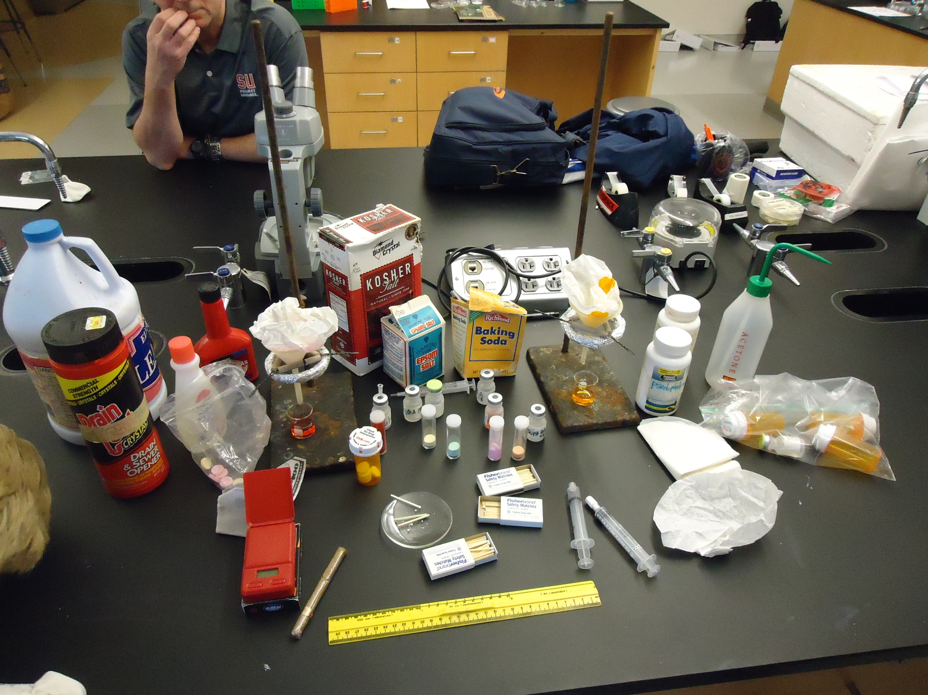

Slide 22
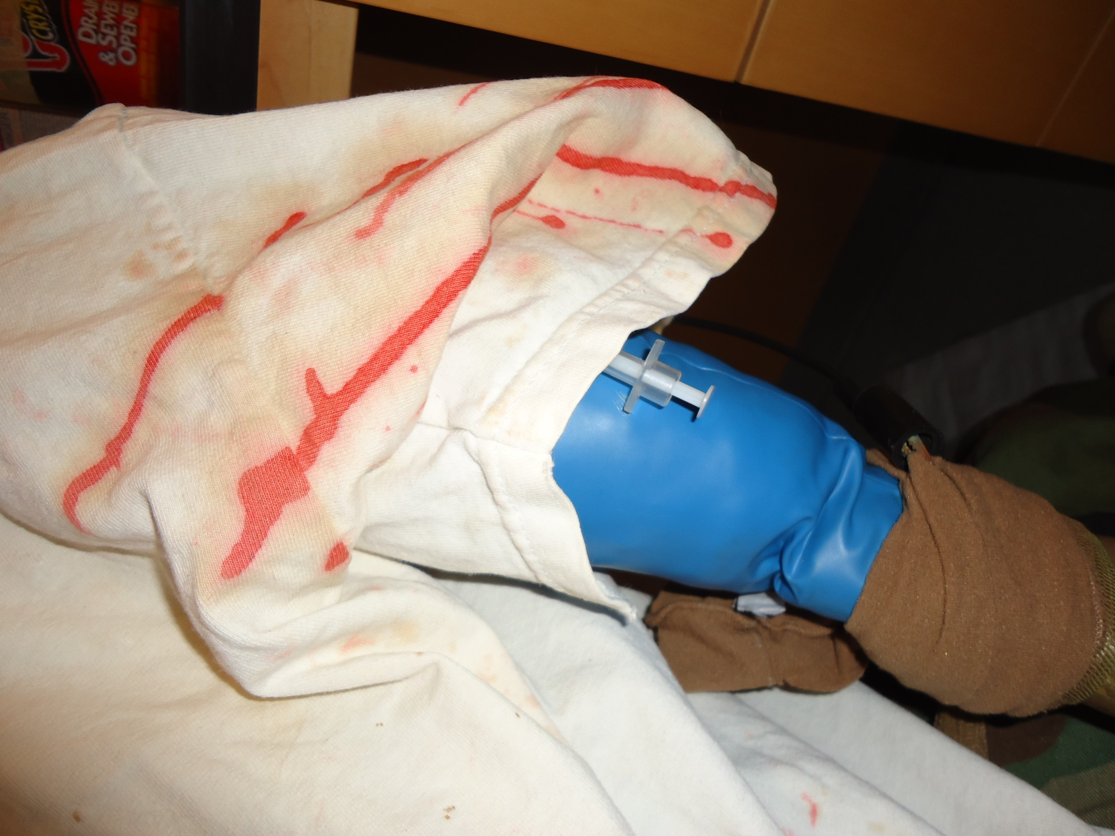

Slide 23
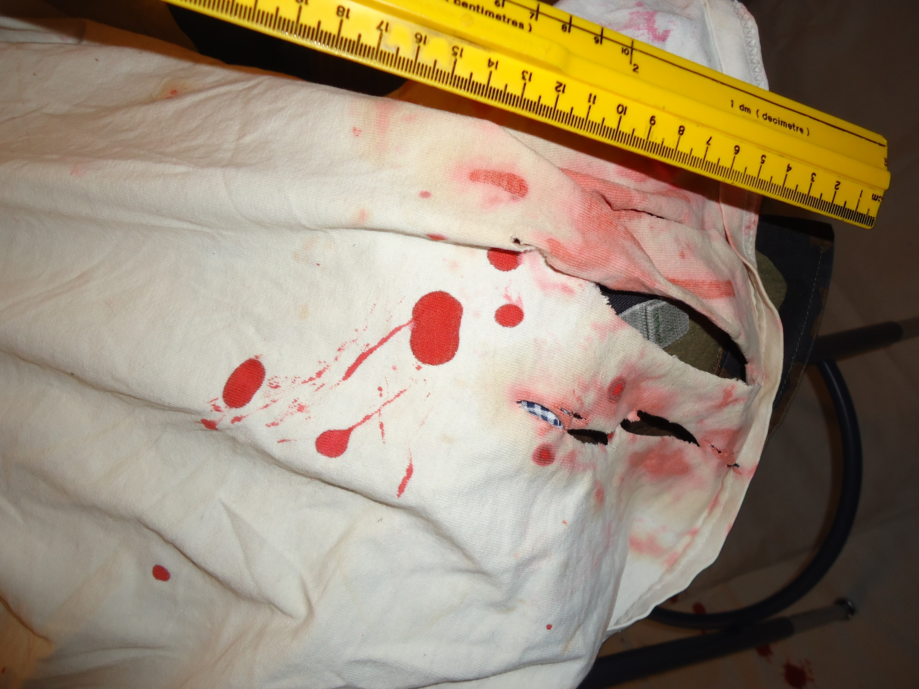

Slide 24
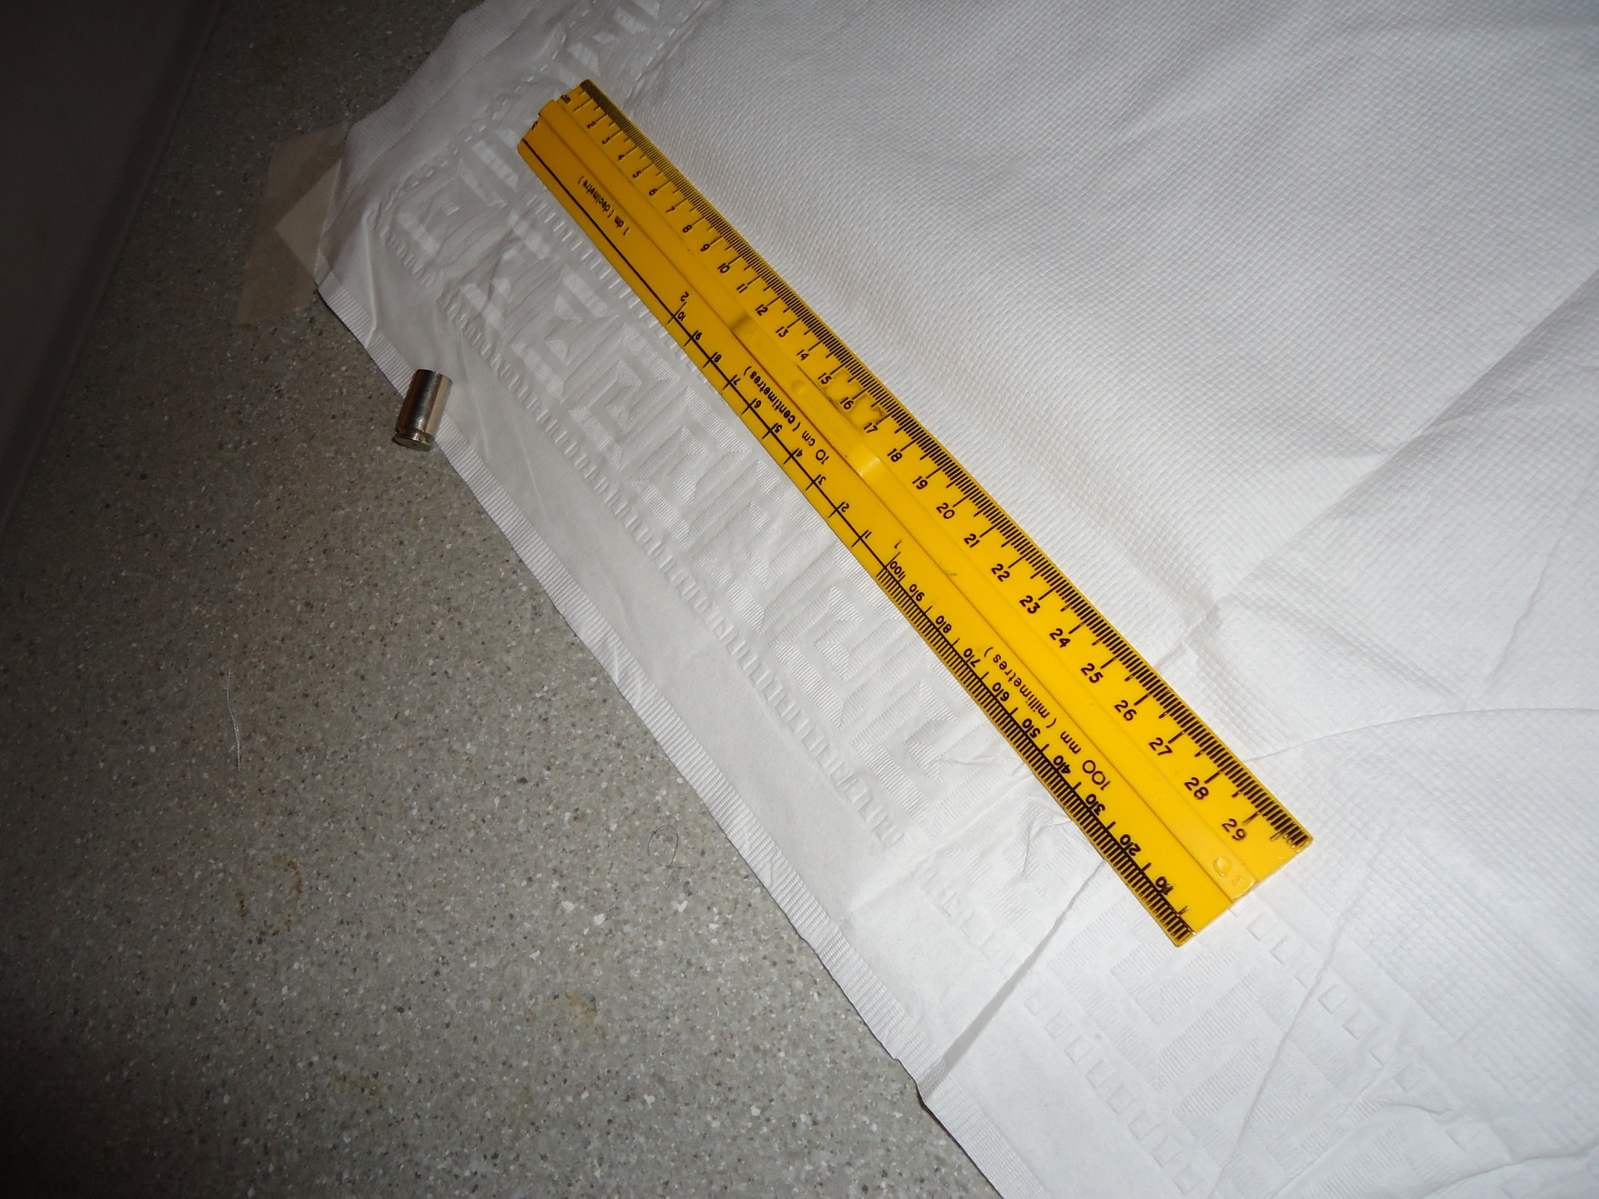

Slide 25
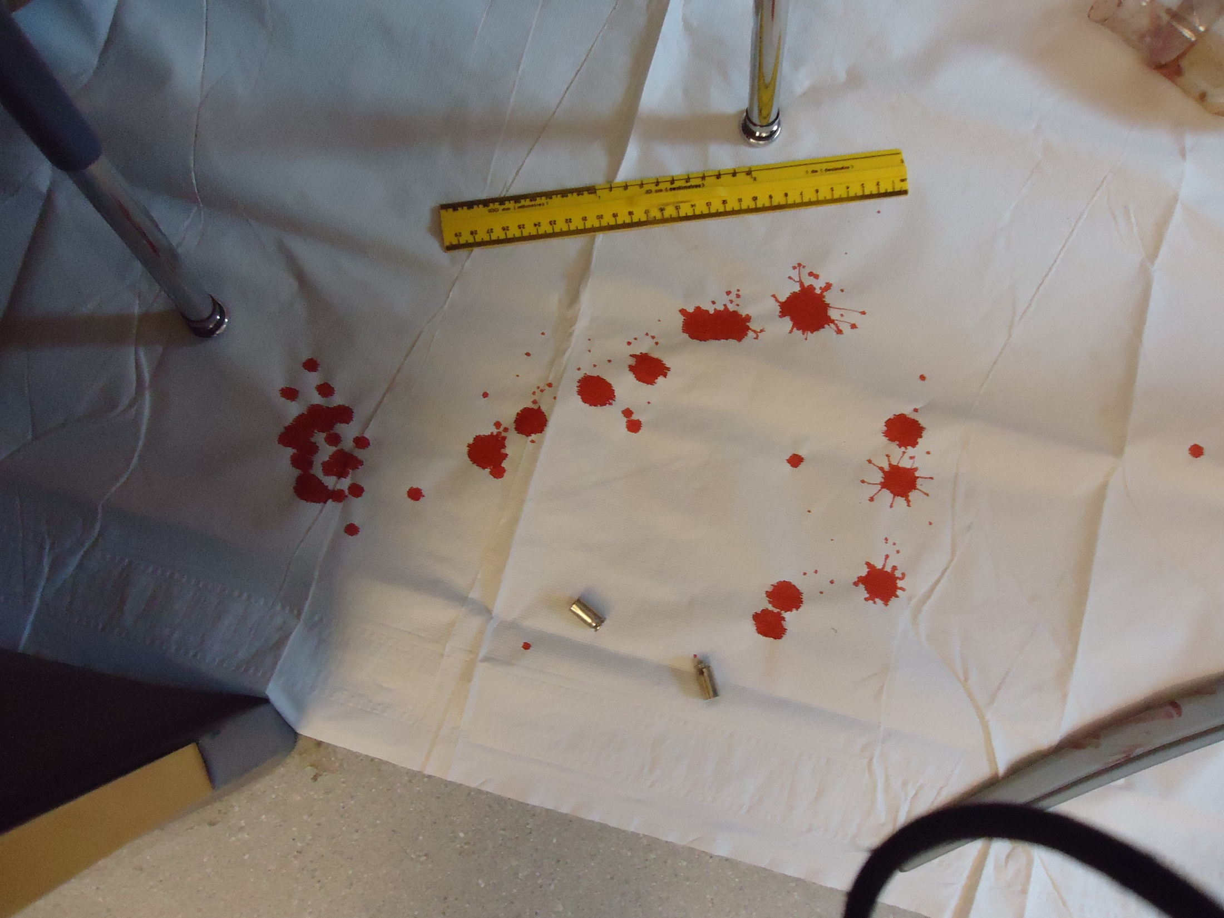

Slide 26
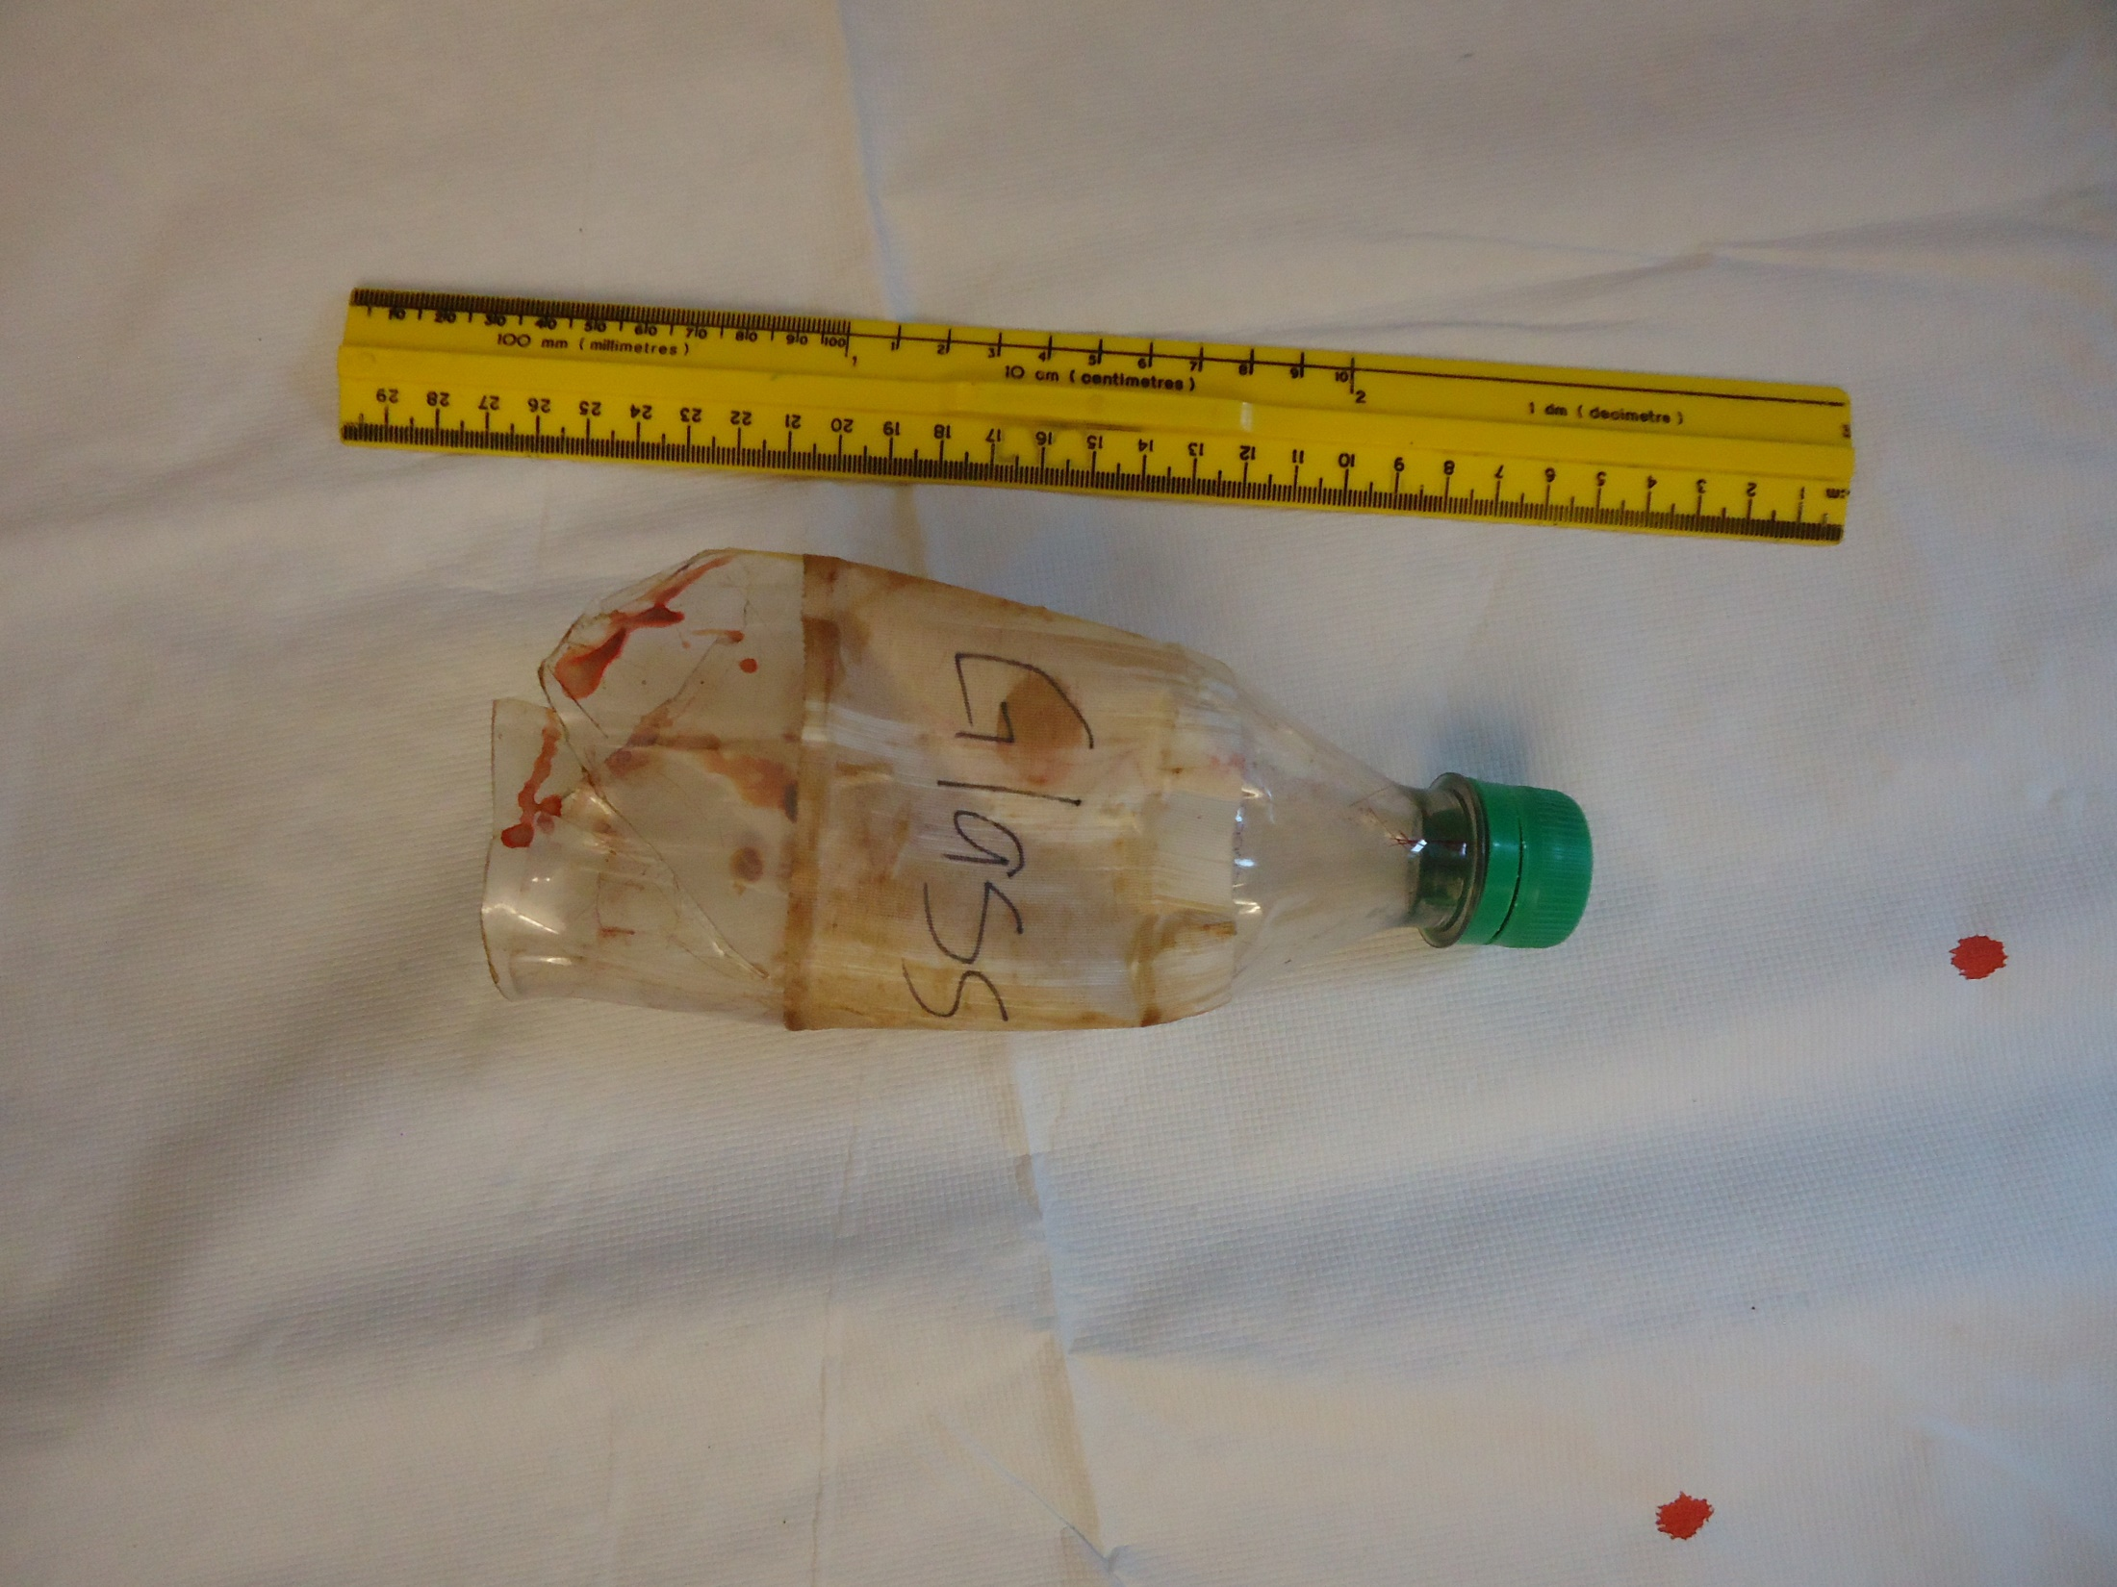

Slide 28
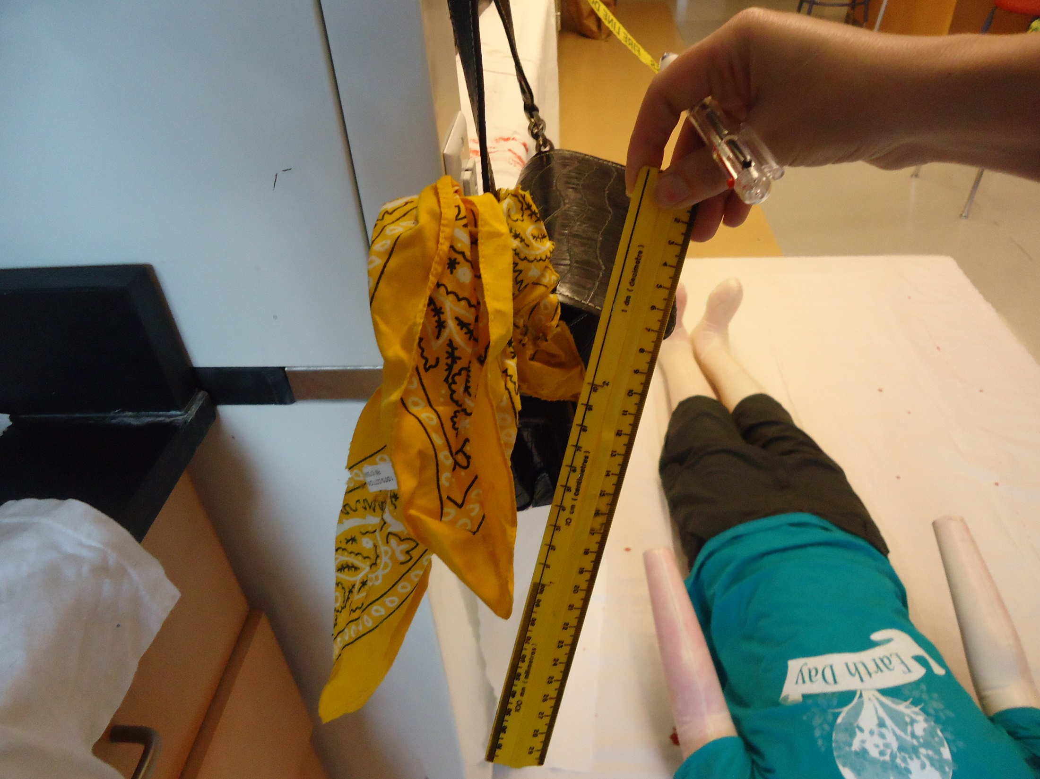

Slide 29
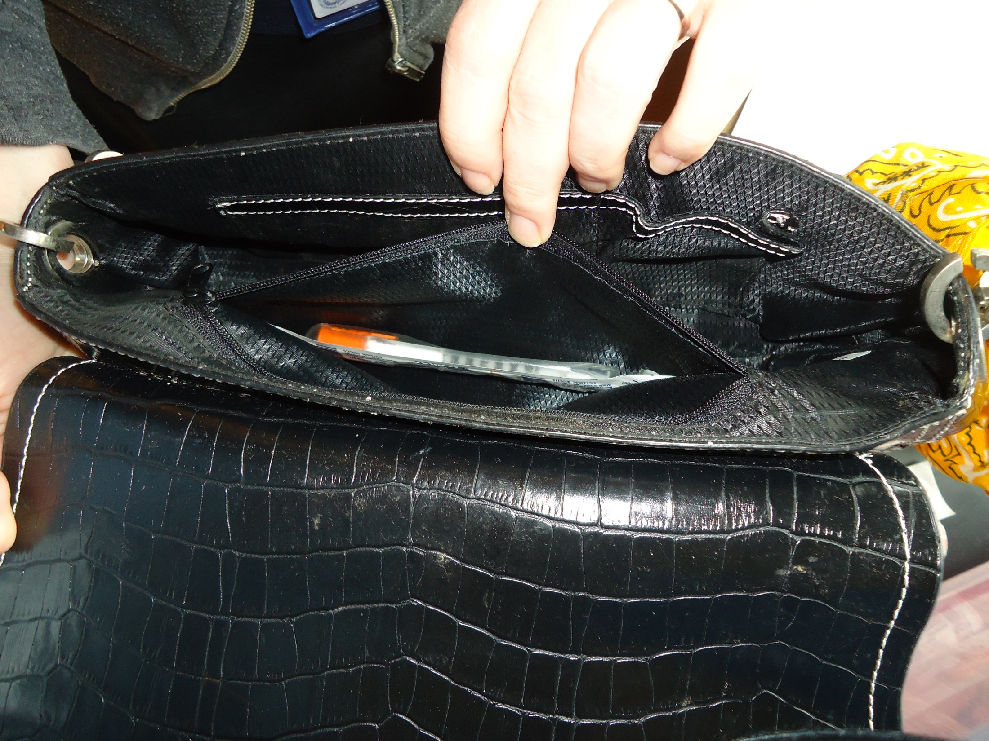

Slide 30
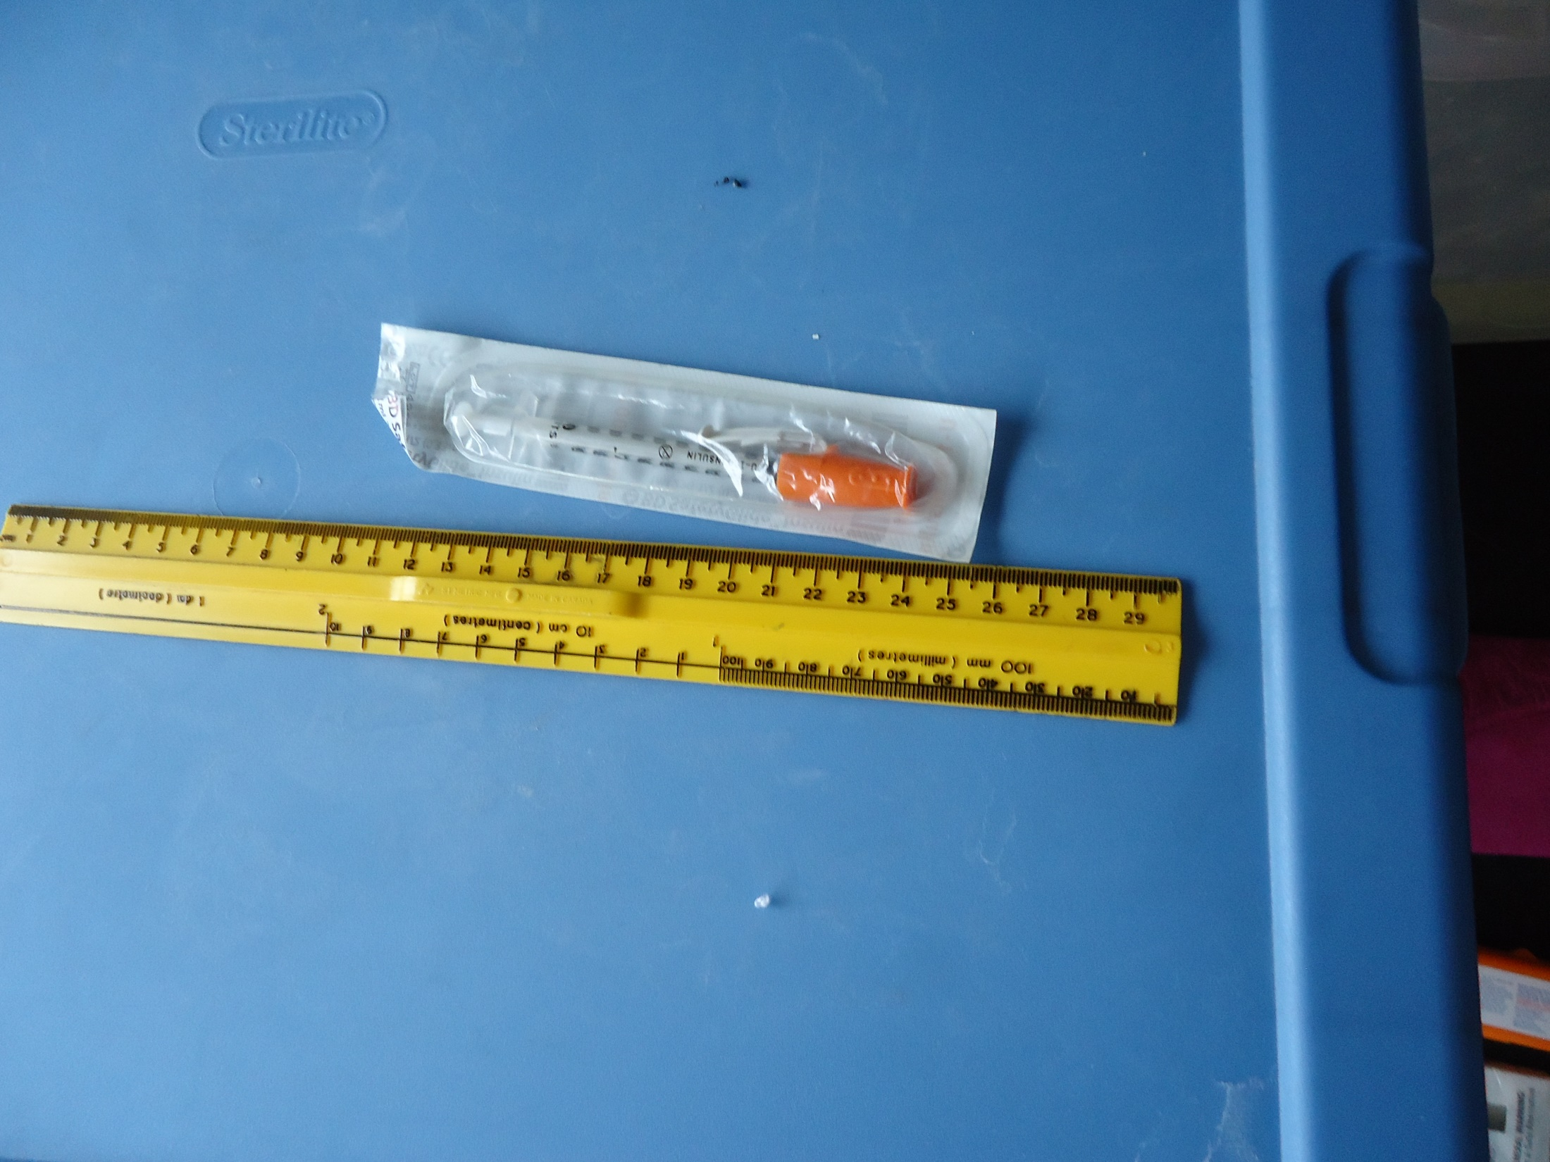

Slide 31
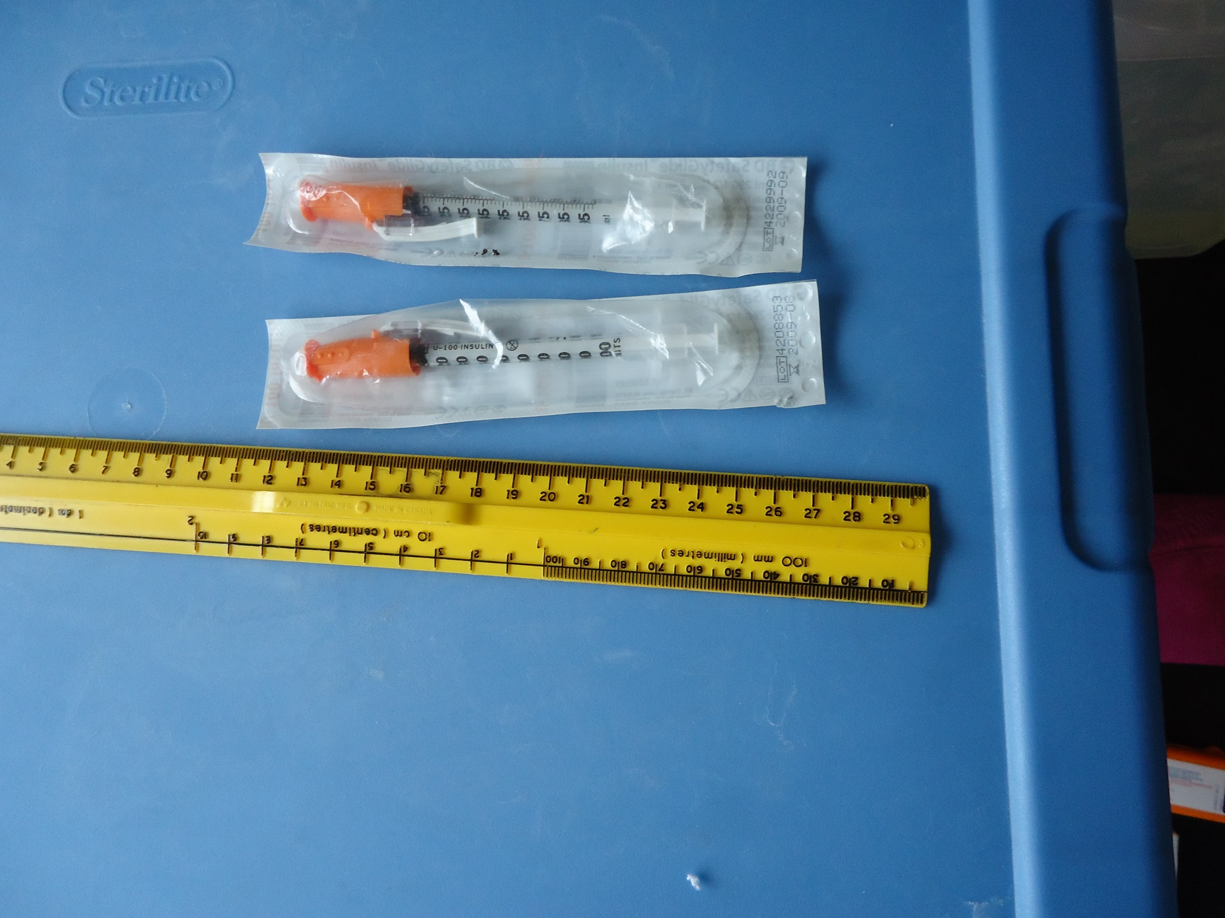

Slide 32
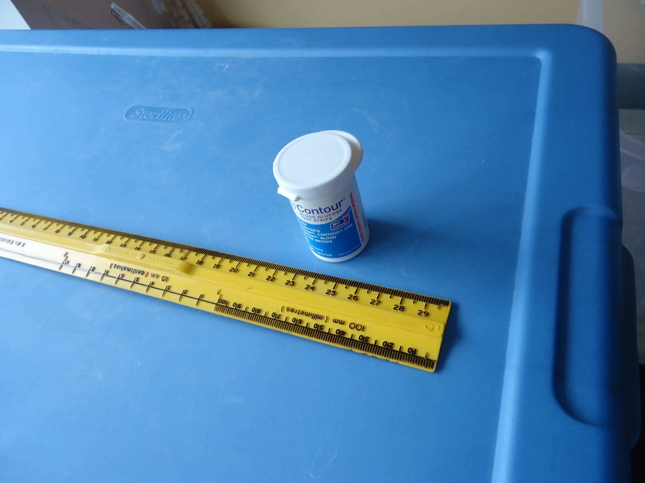

Slide 33
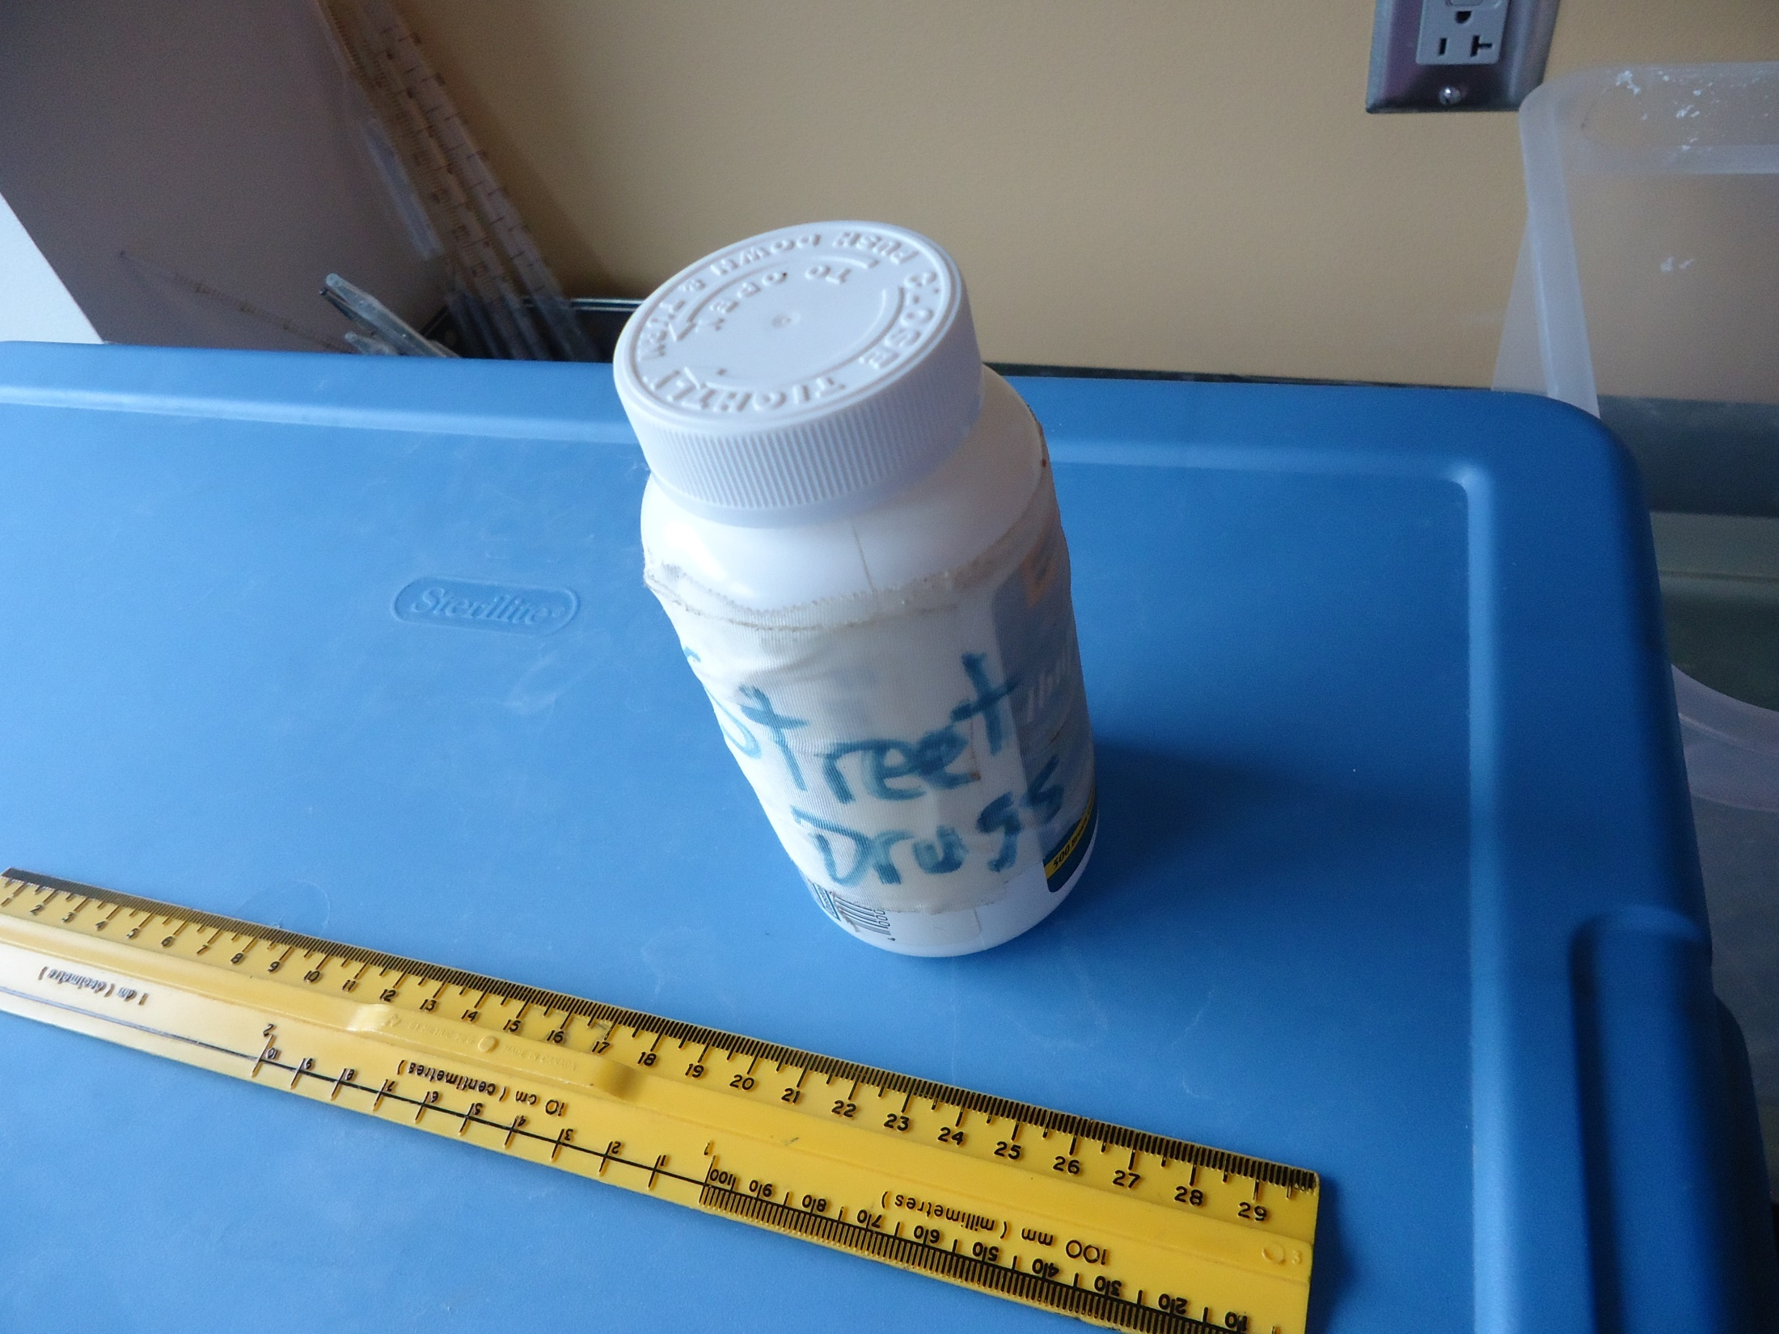

Slide 34
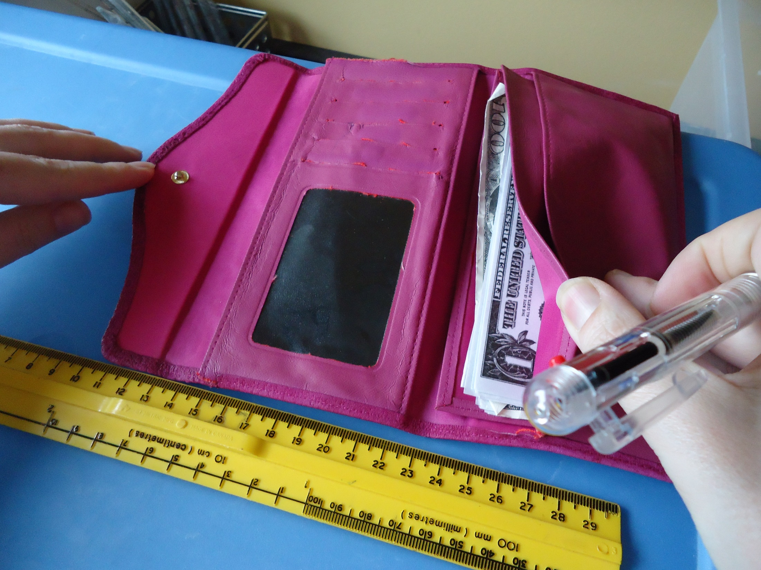

Slide 35
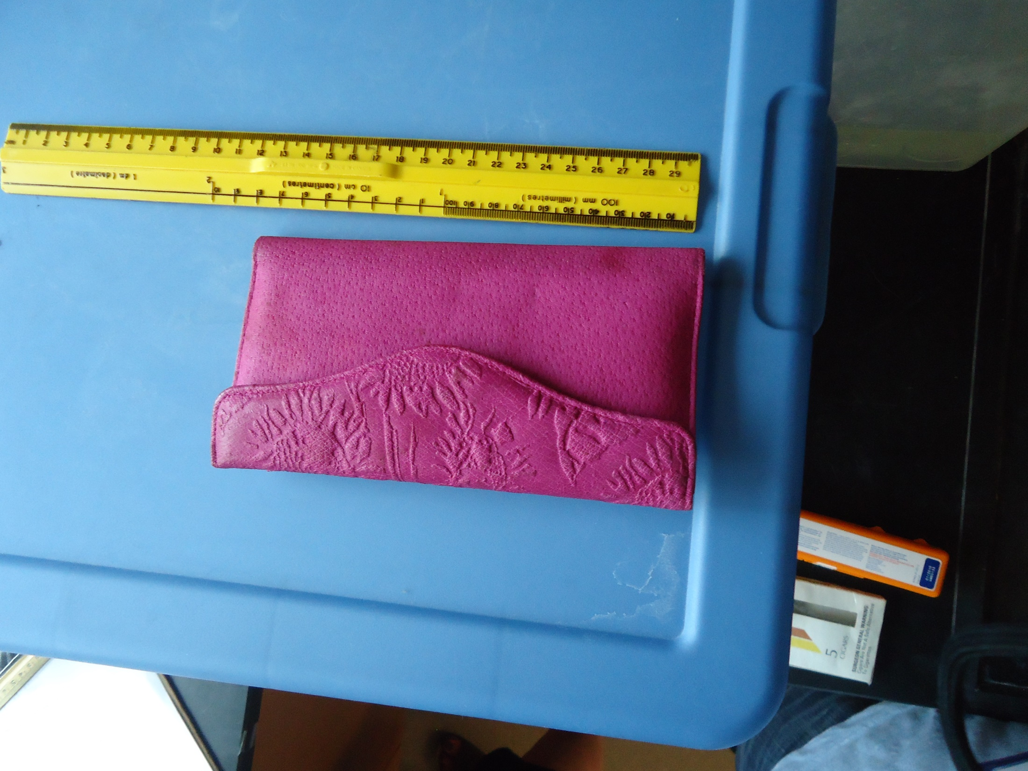

Slide 36
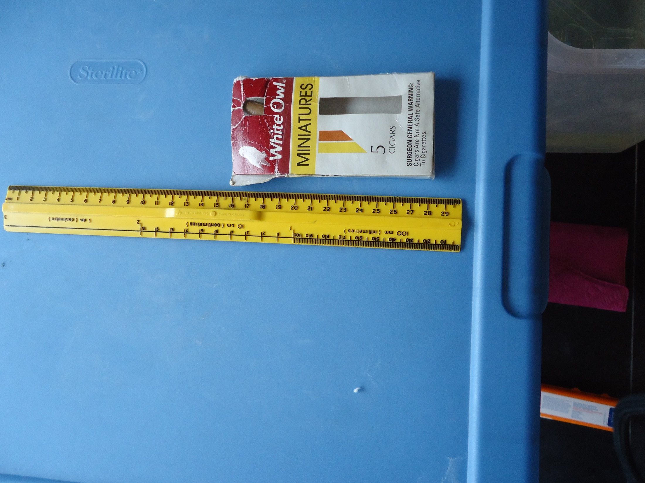

Slide 37
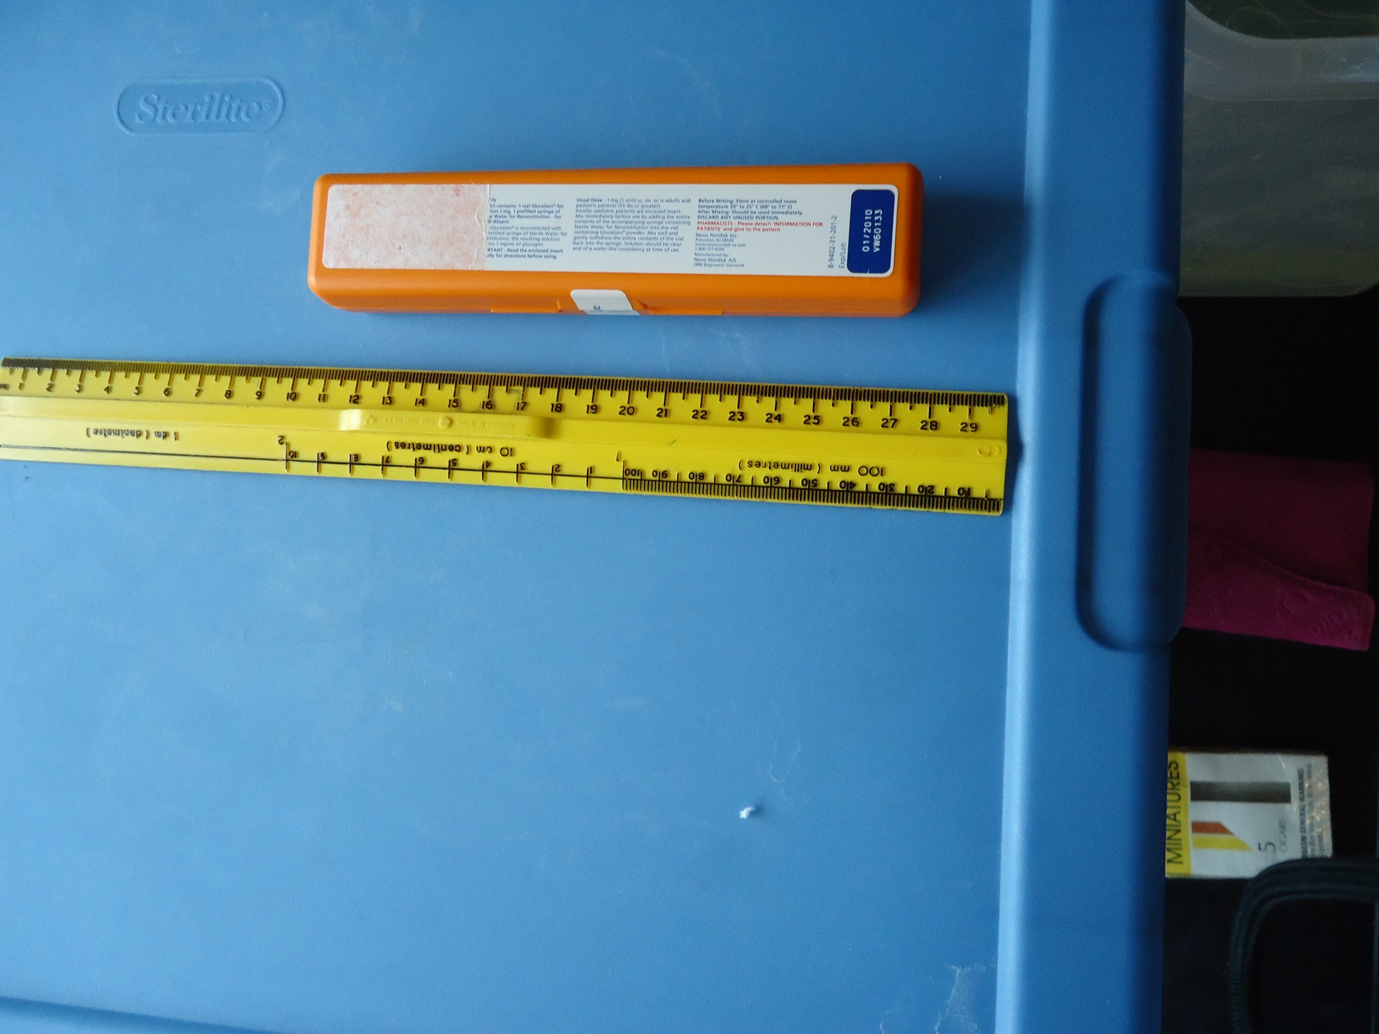

Slide 38
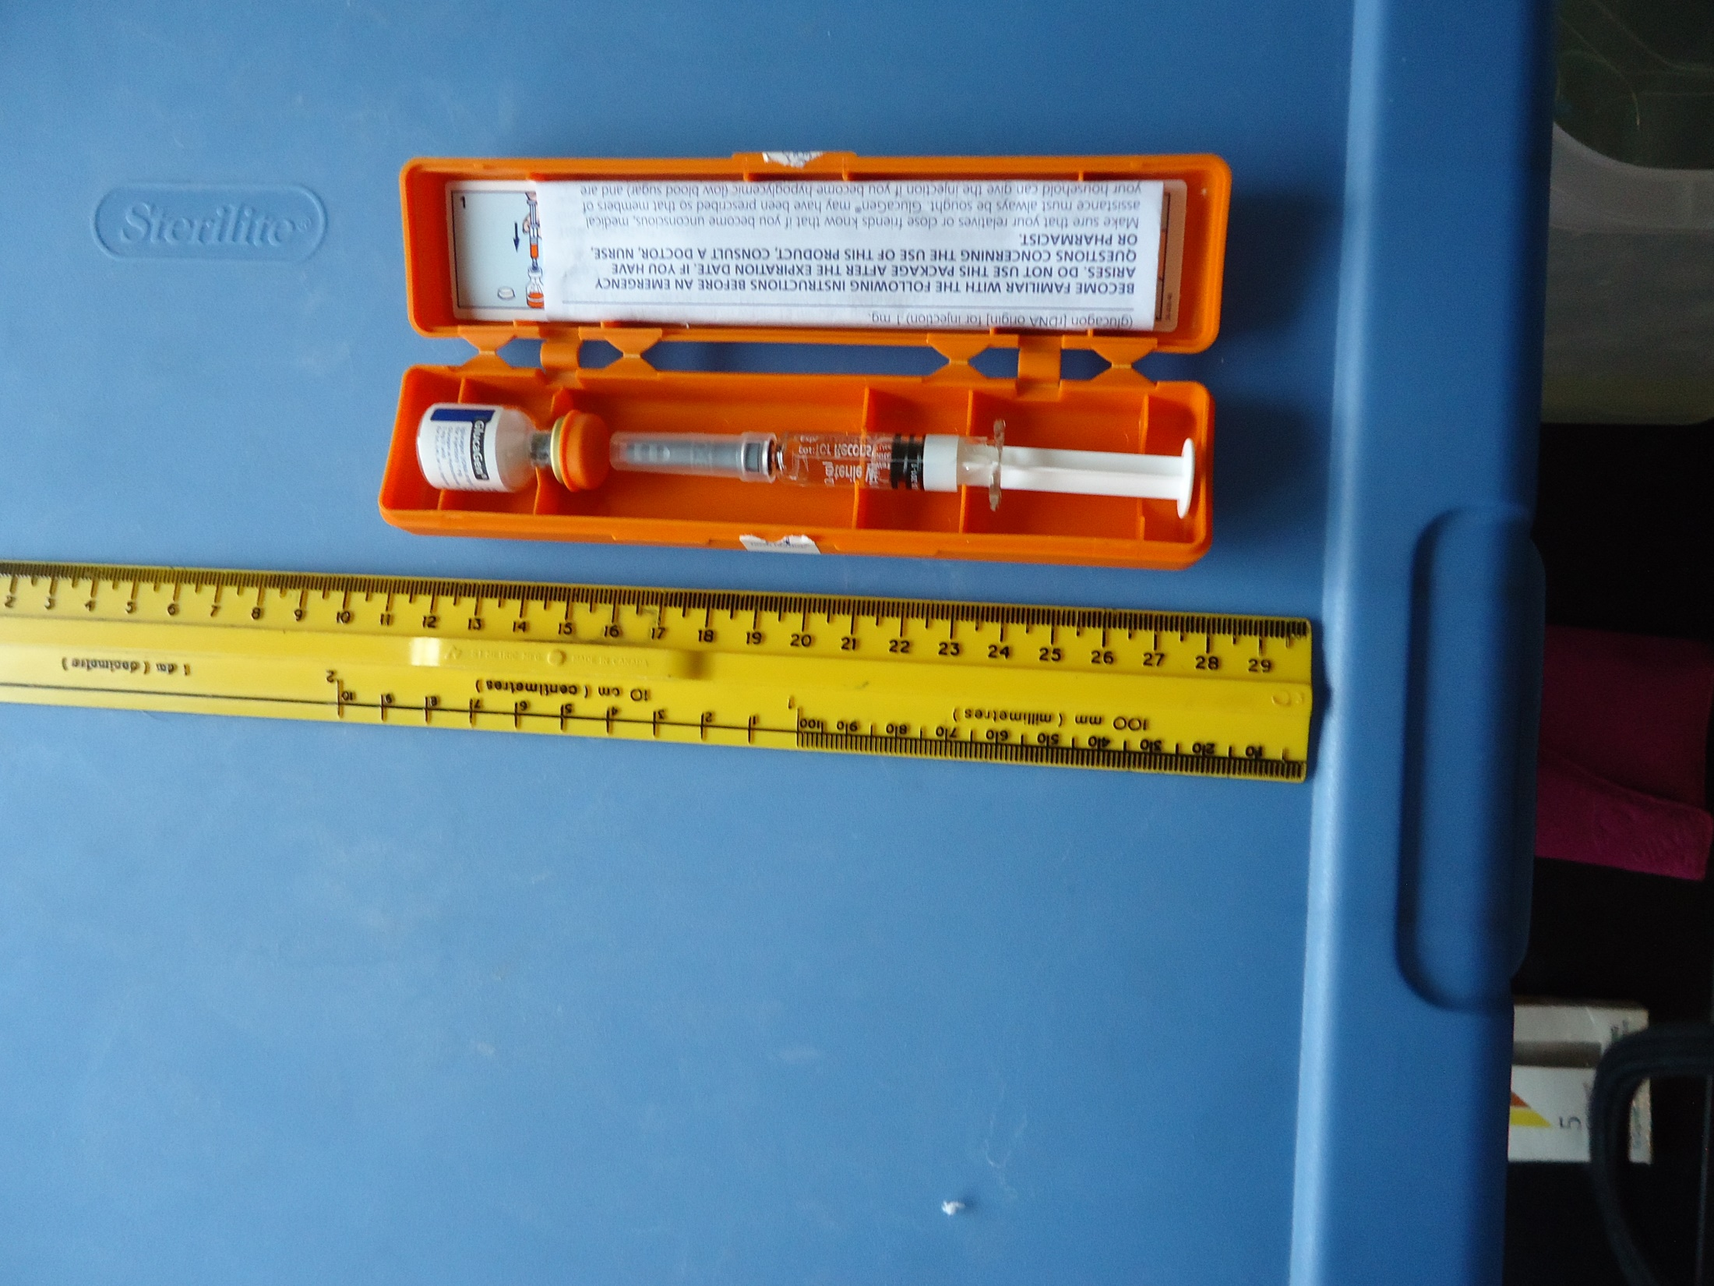

Slide 39
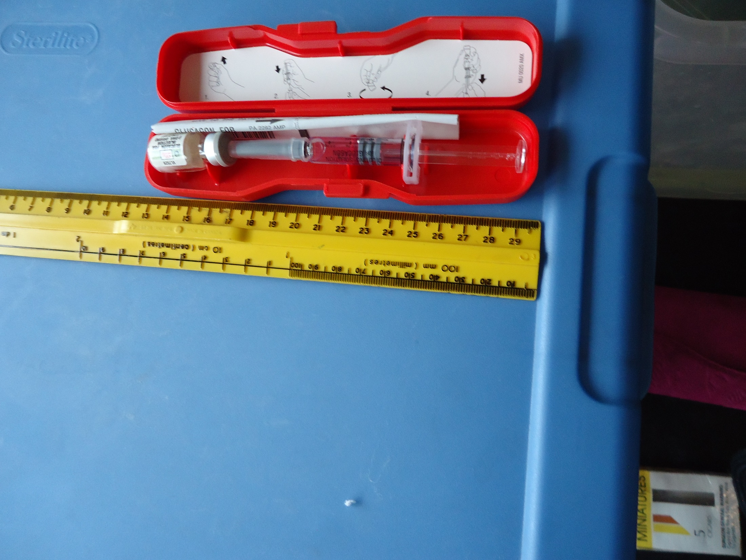

Slide 40
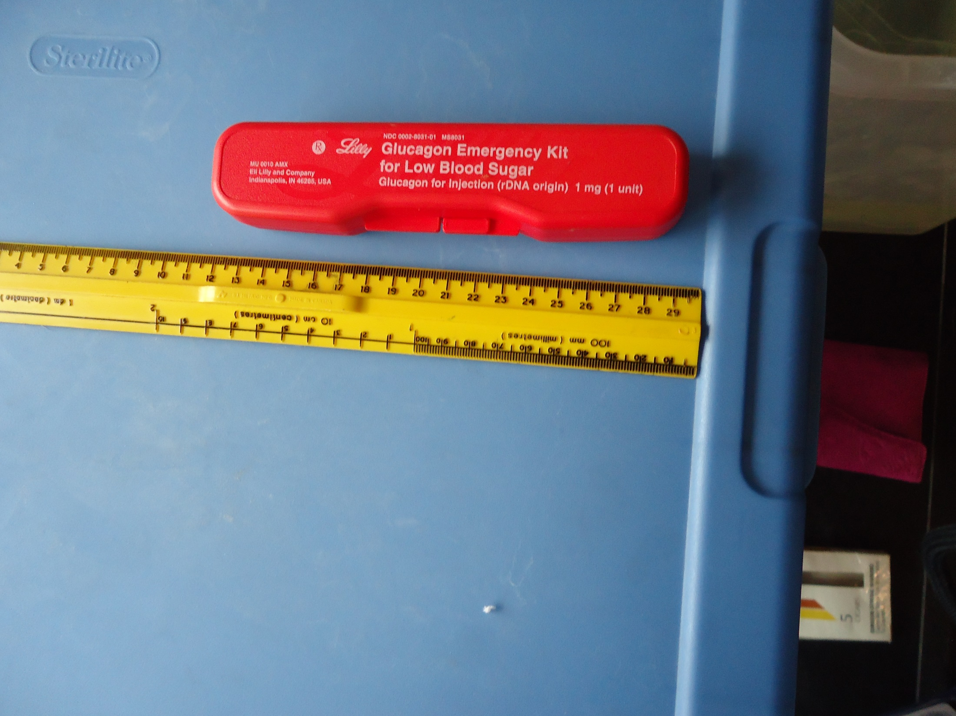

Slide 41
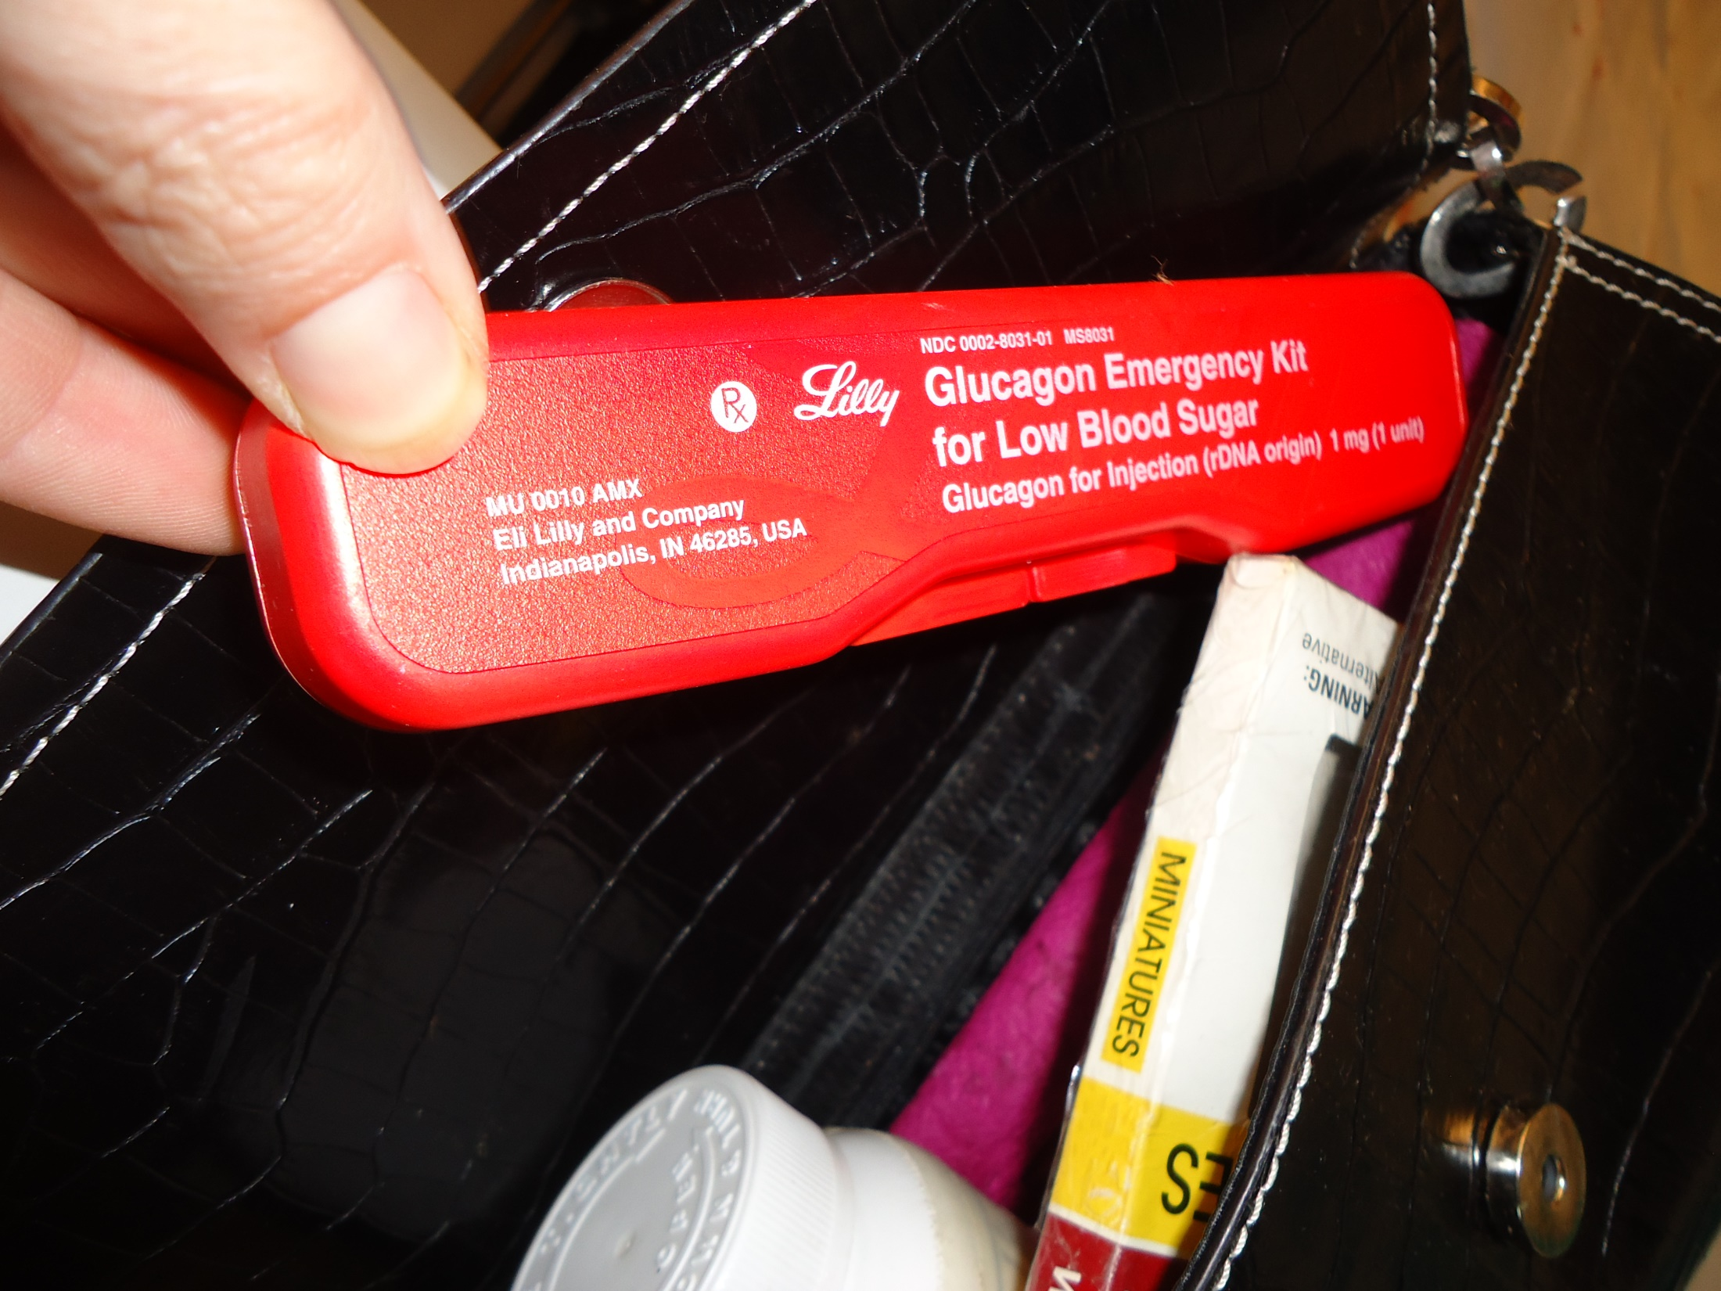

Slide 43
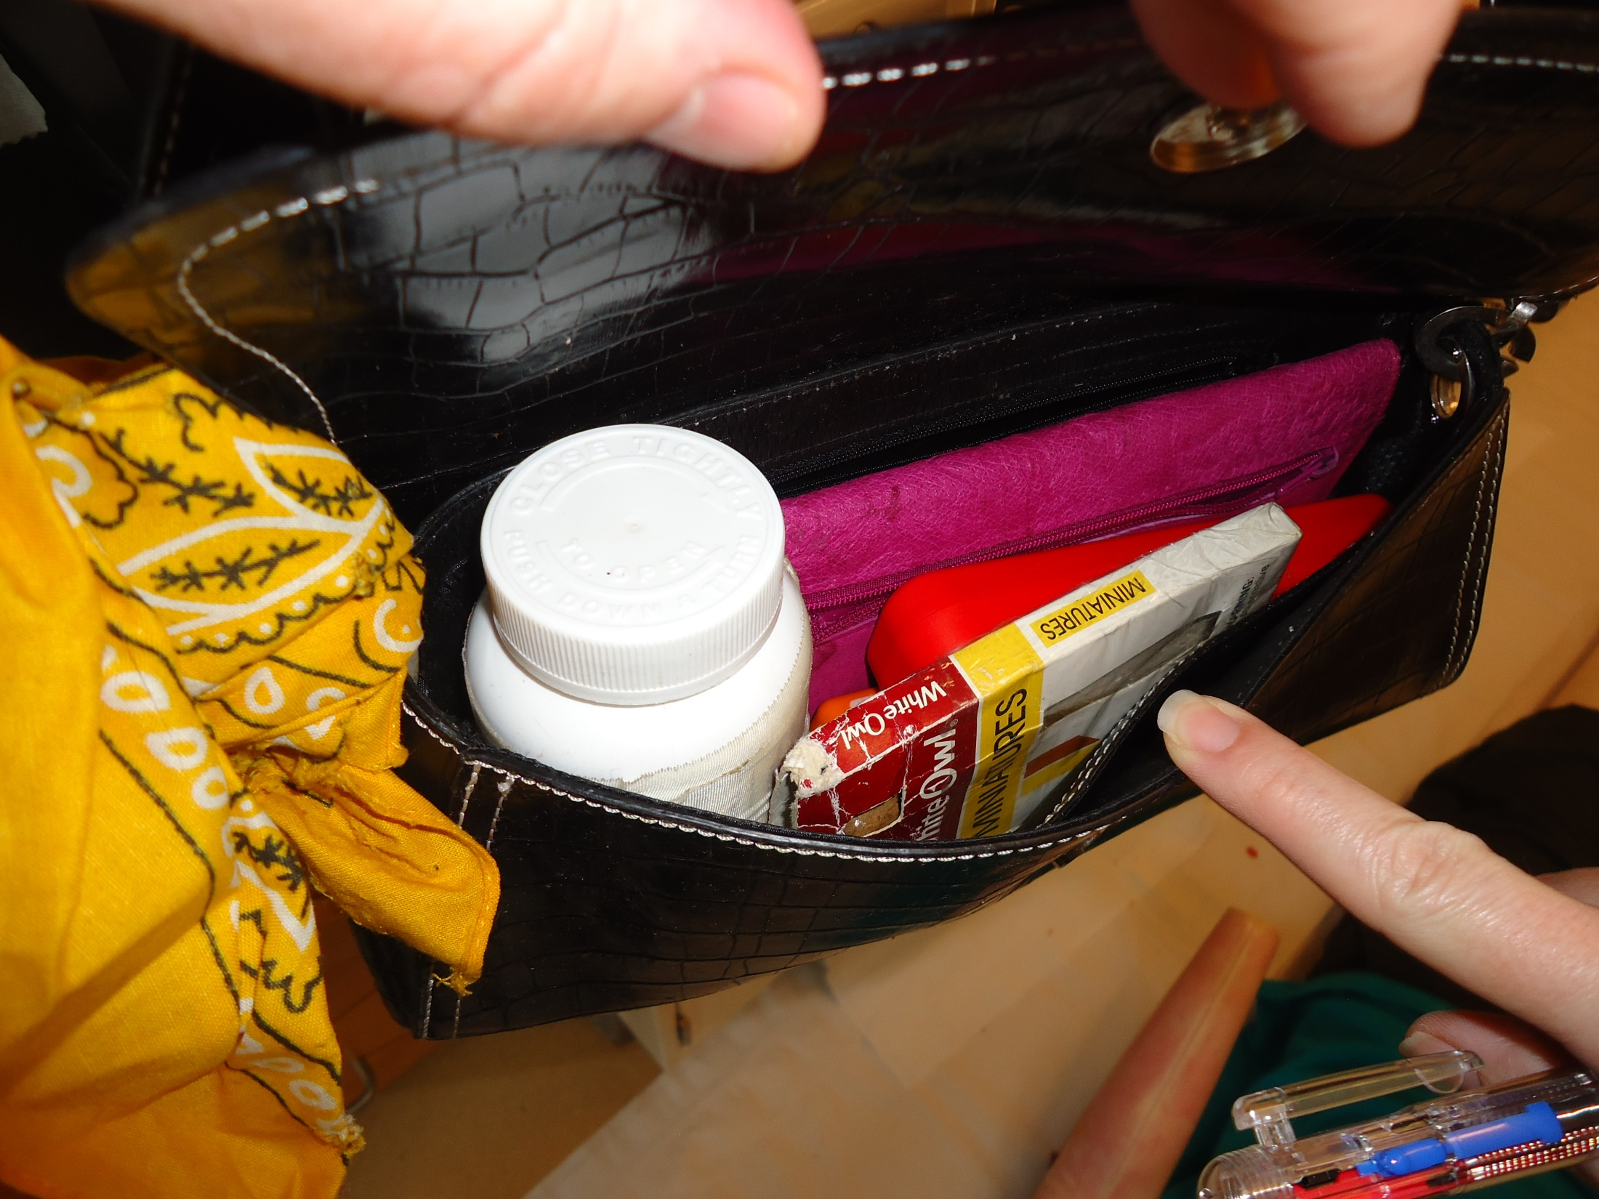

Slide 44
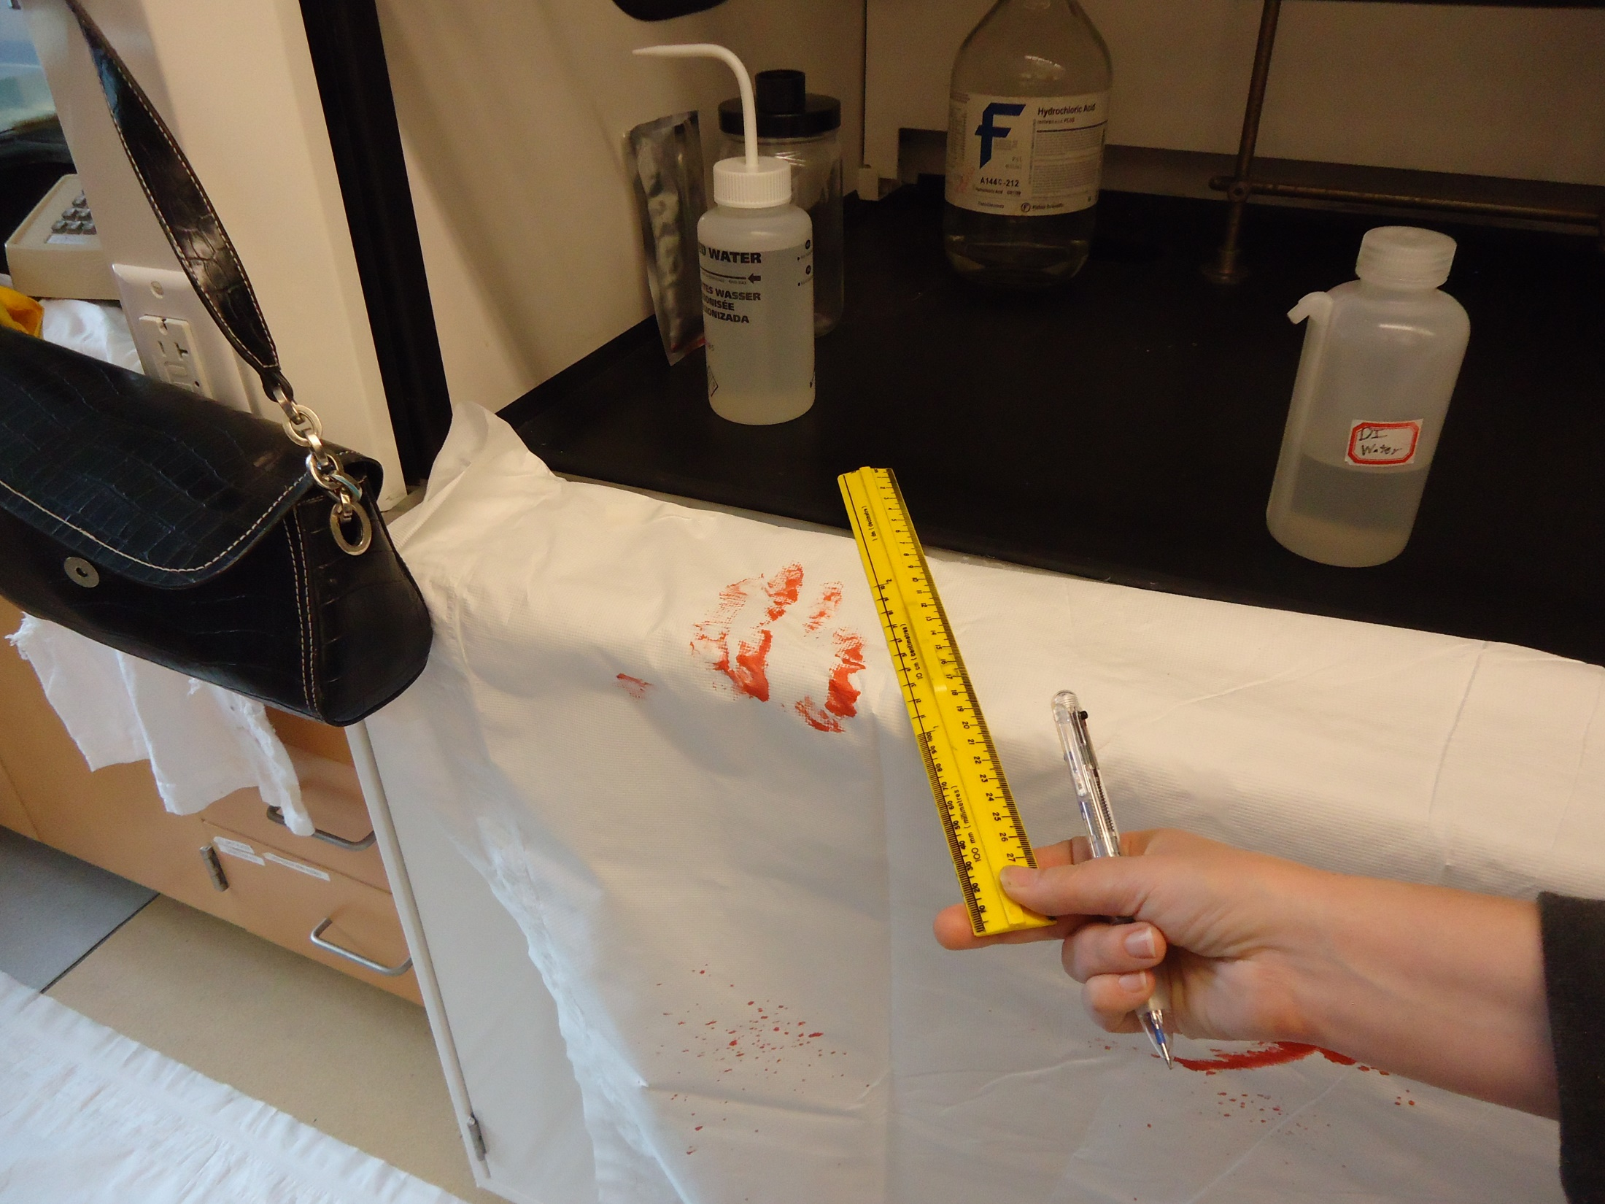

Slide 45
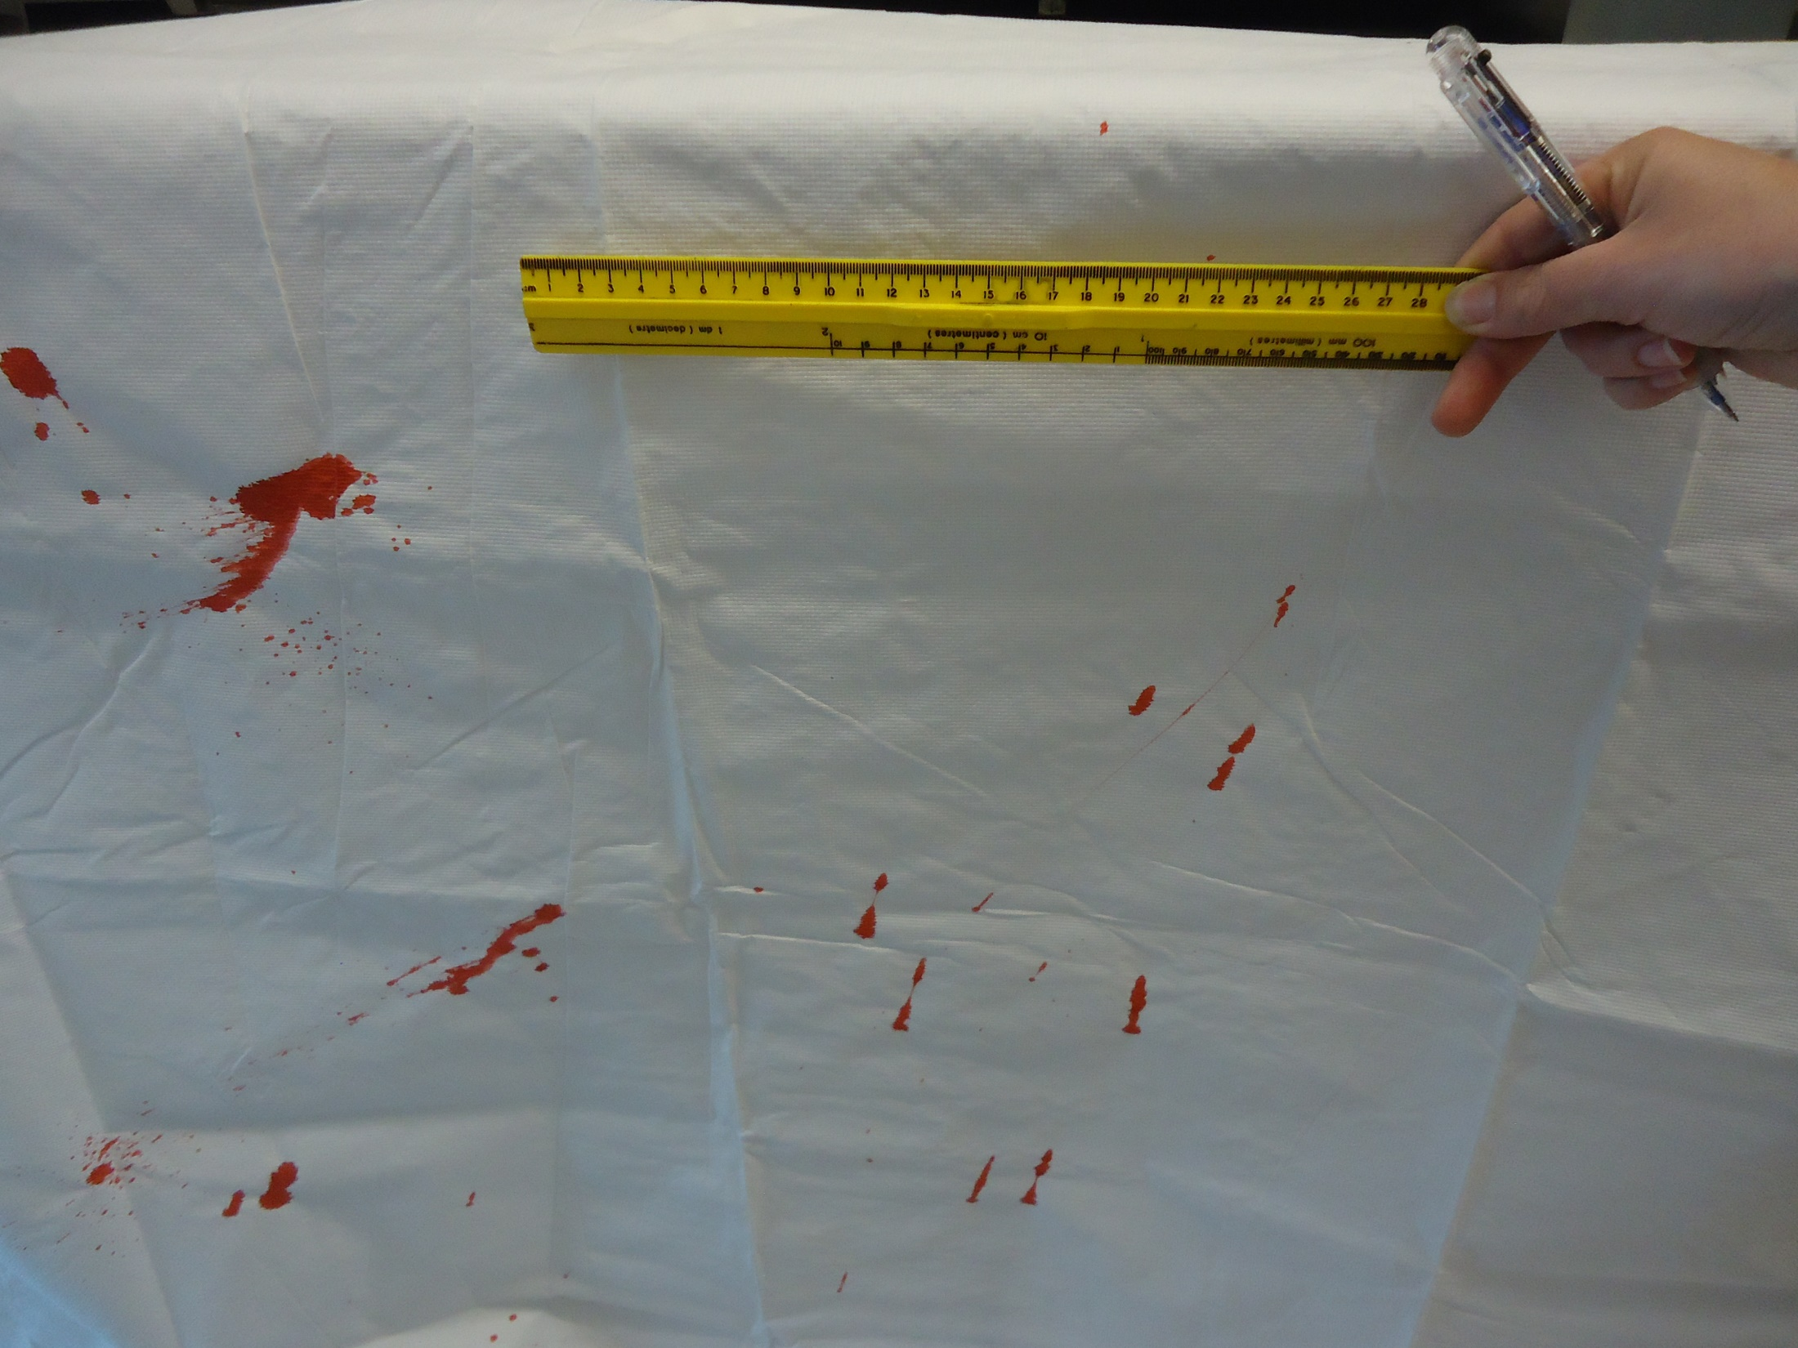

Slide 46
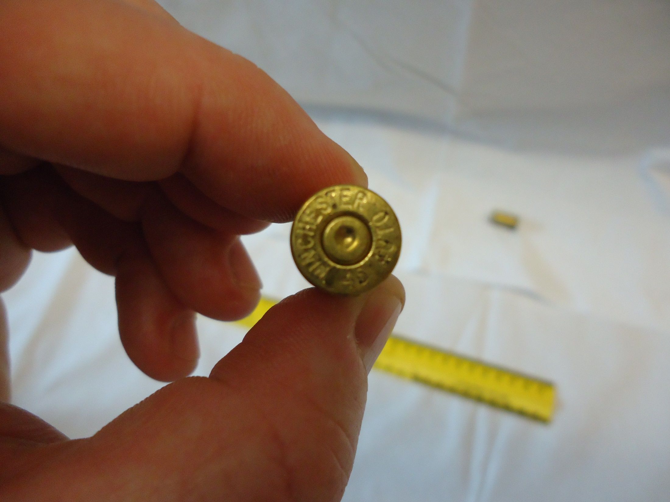

Slide 47
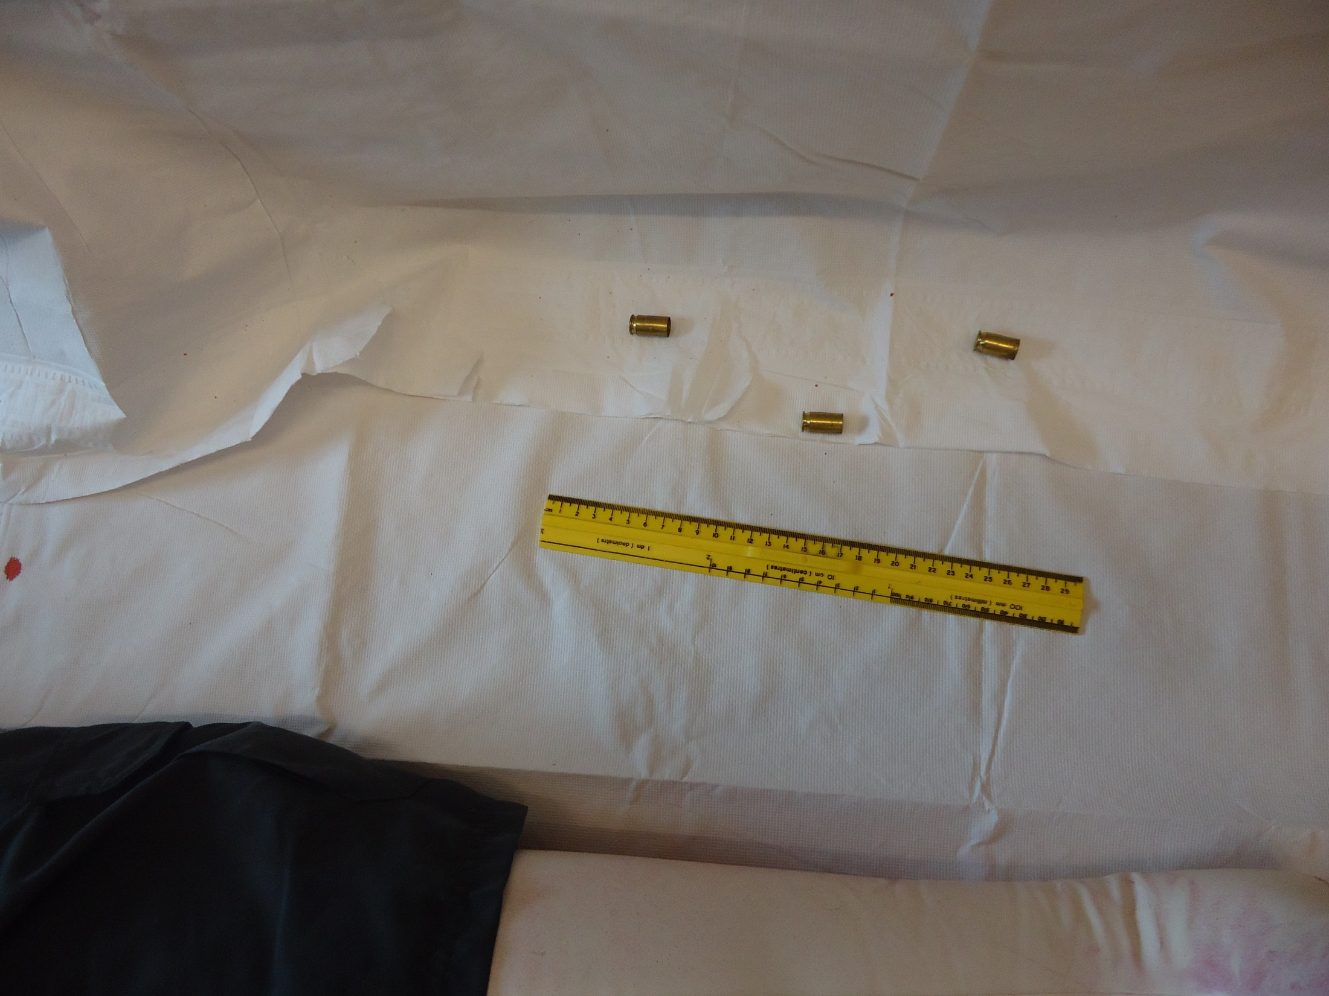

Slide 48
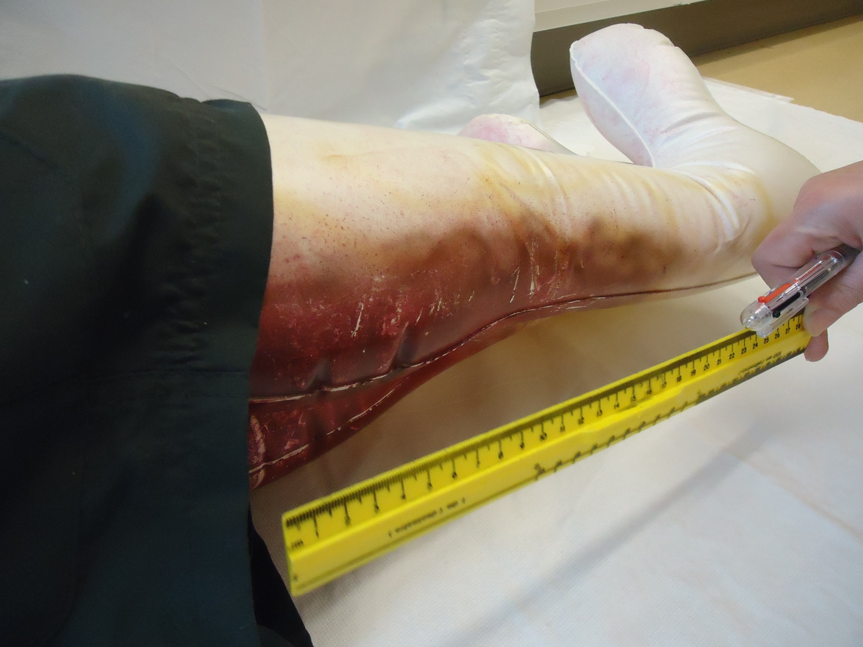

Slide 49
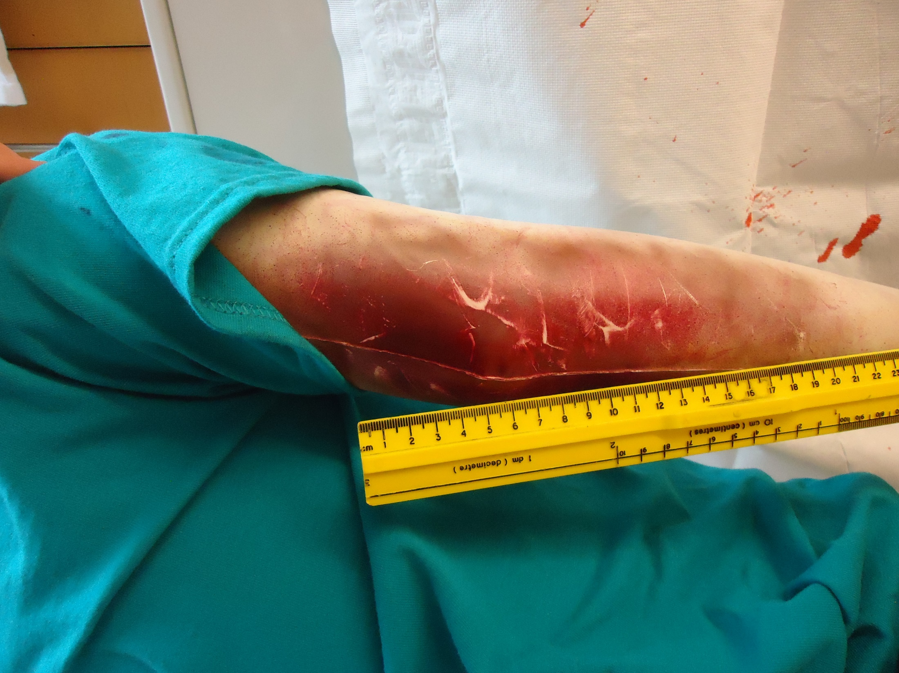

Slide 50
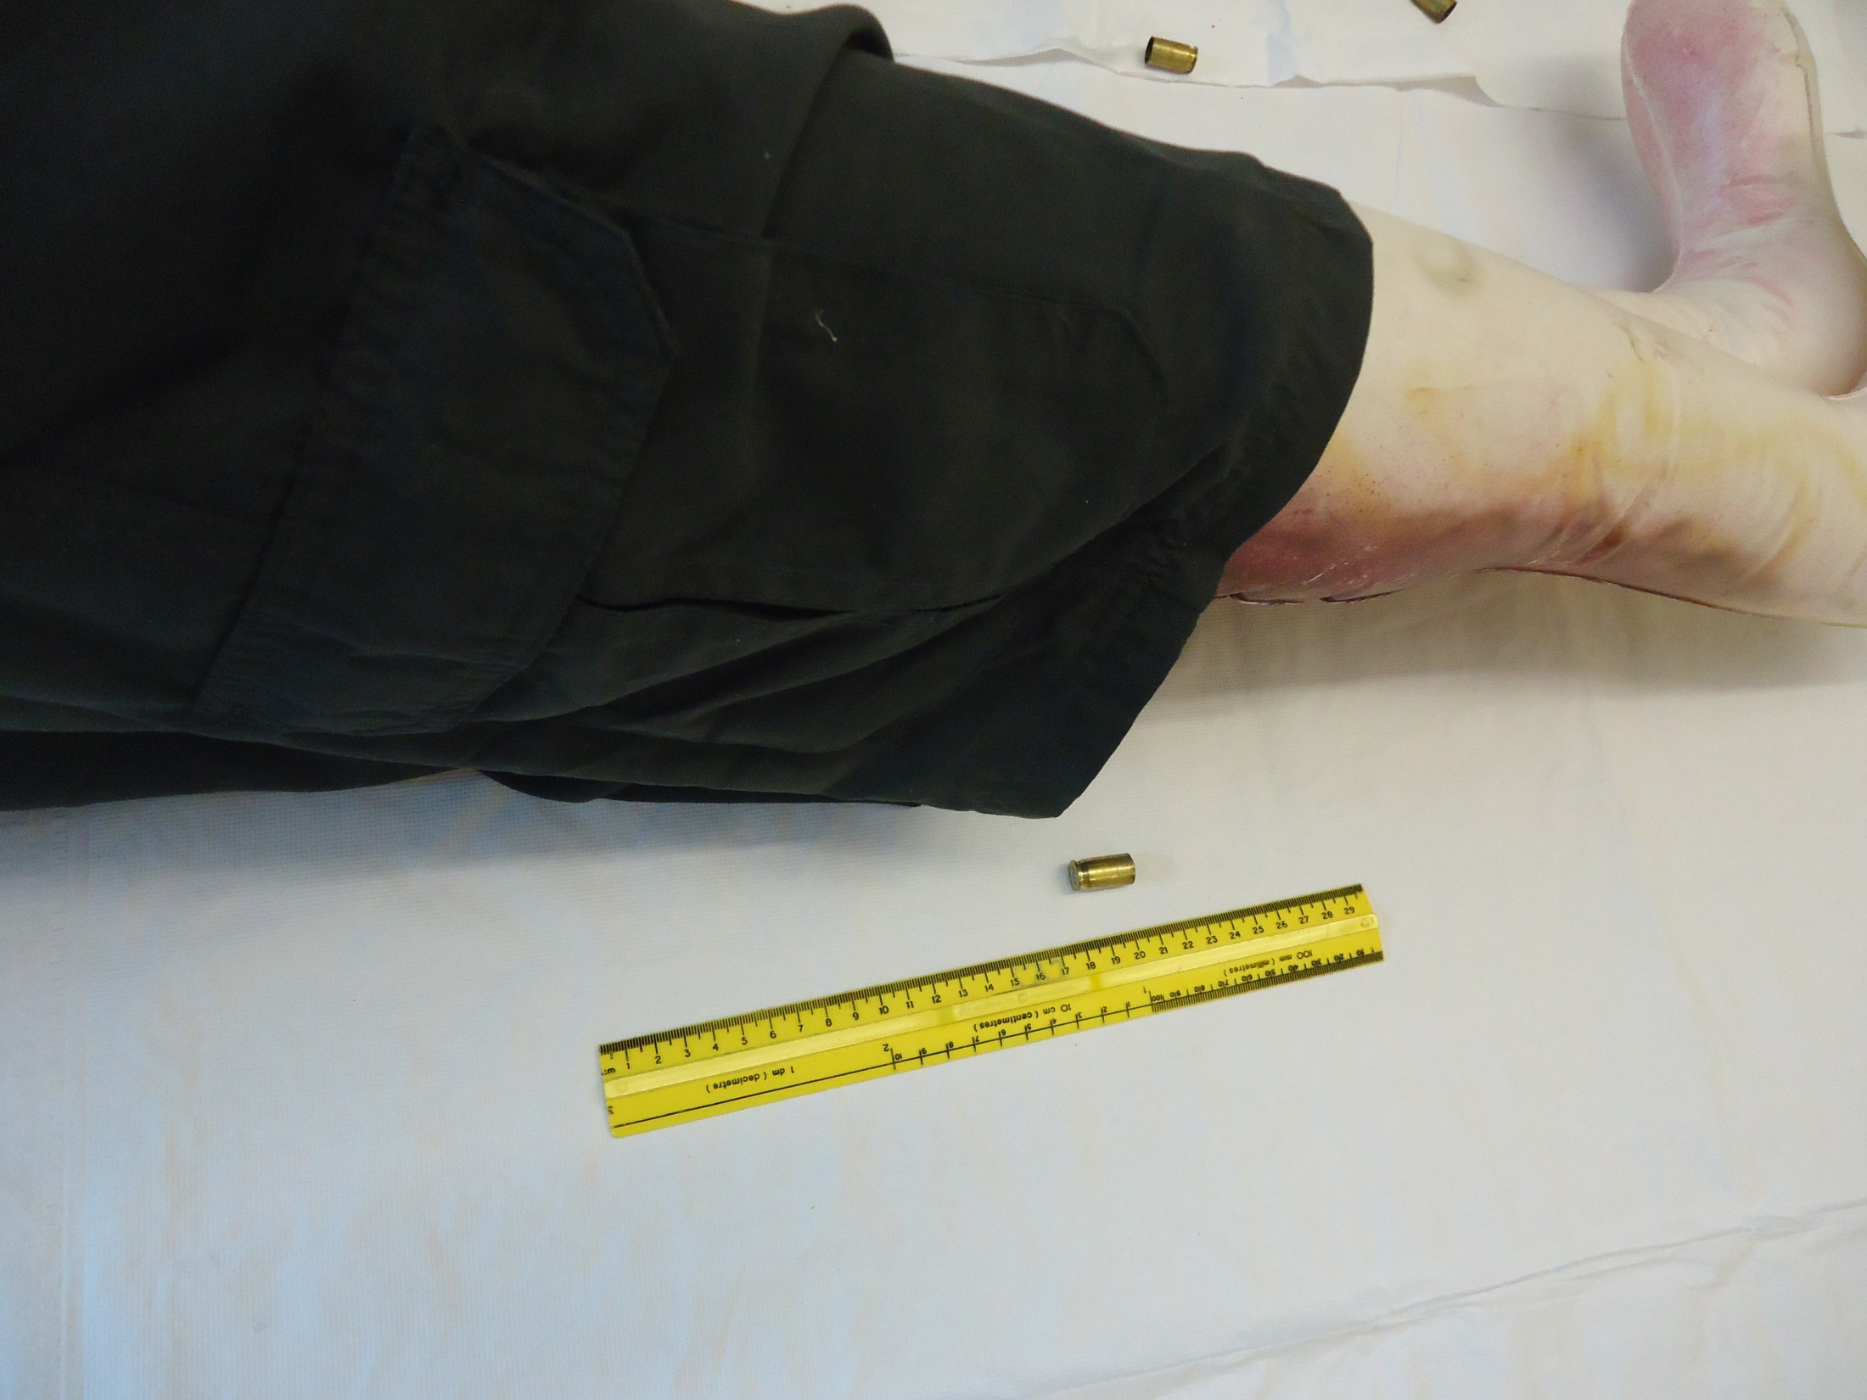

Slide 51
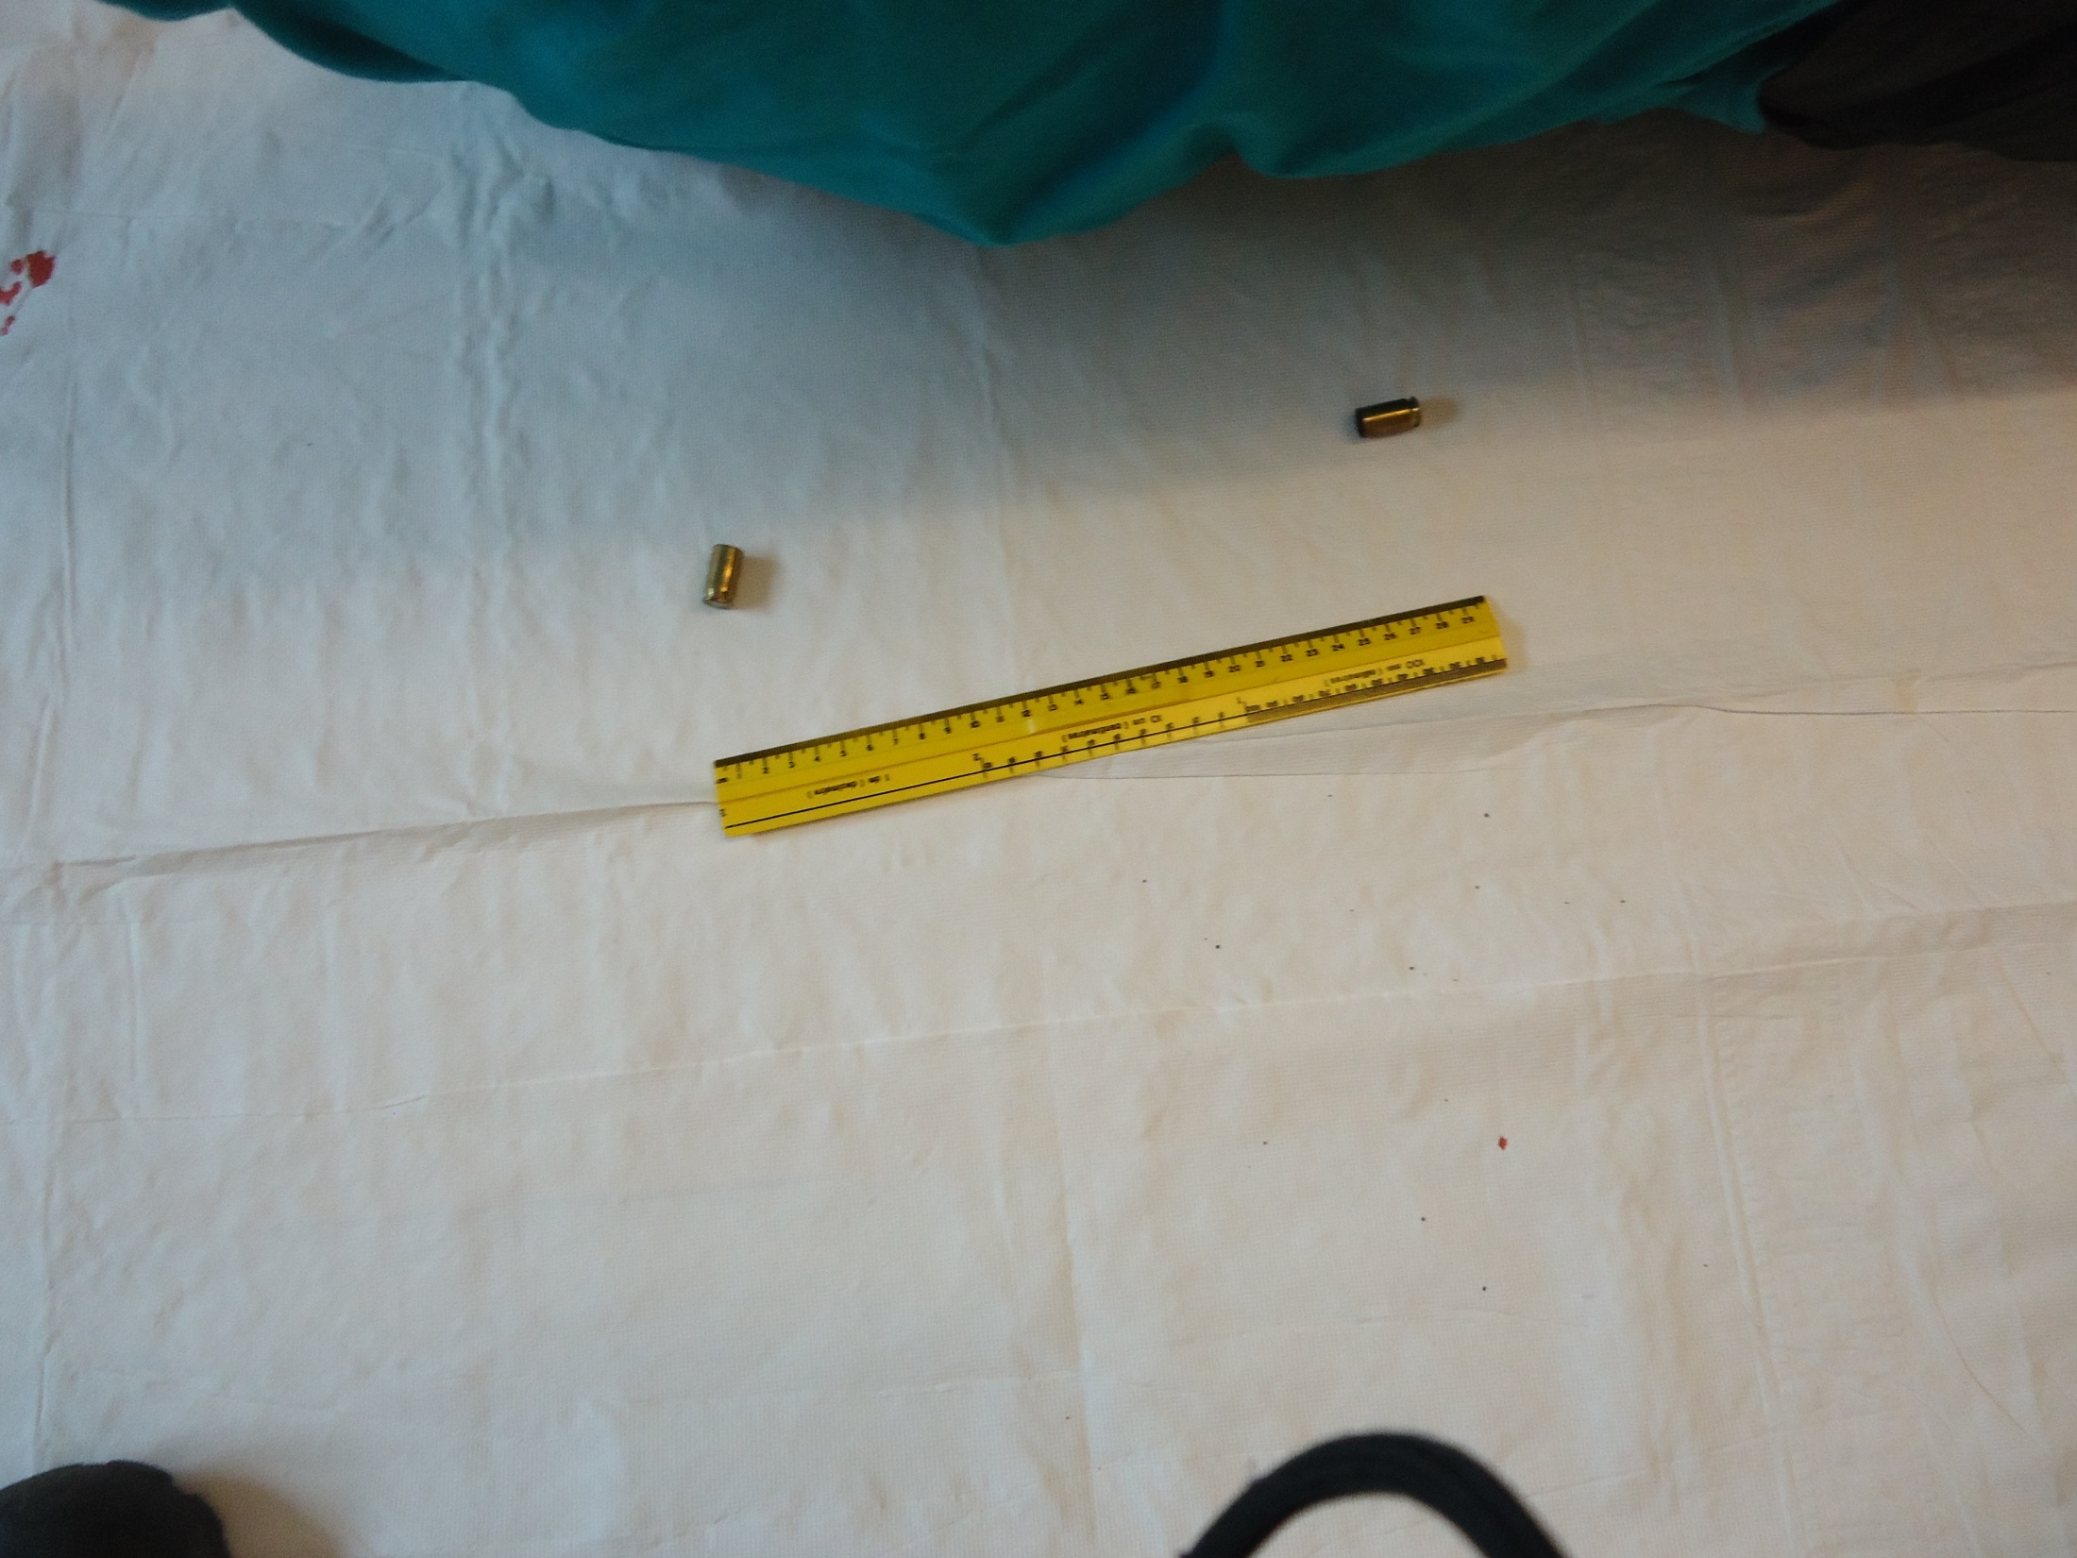

Slide 52
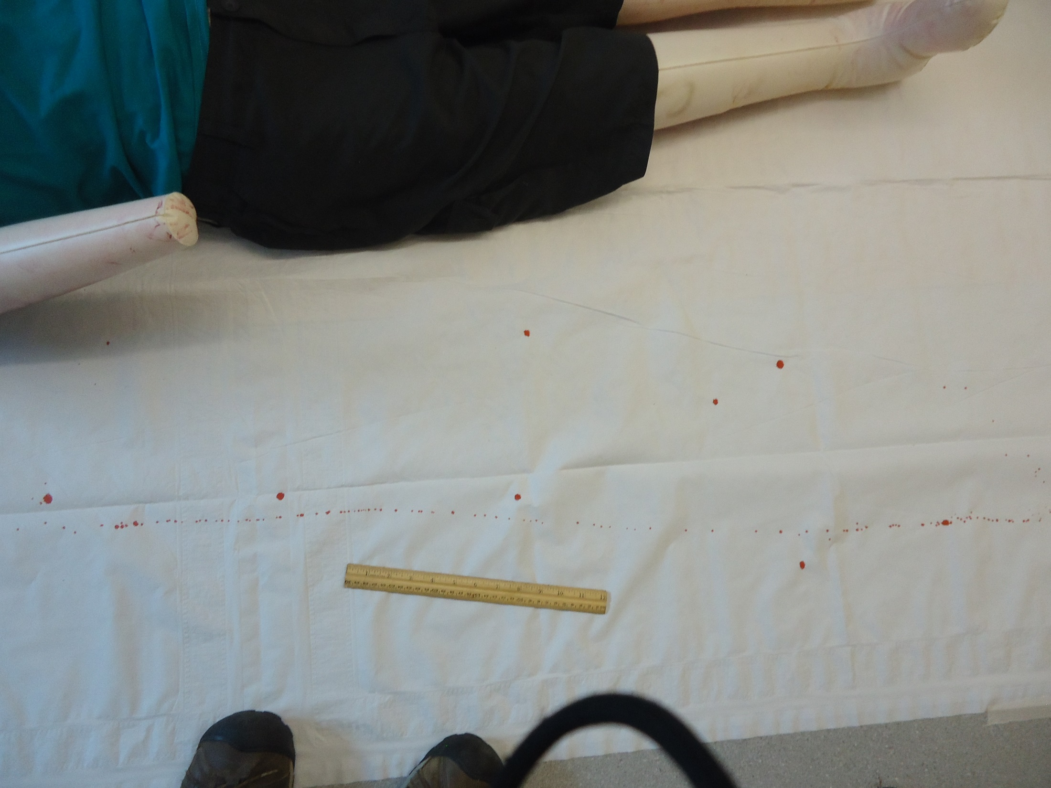

Slide 53
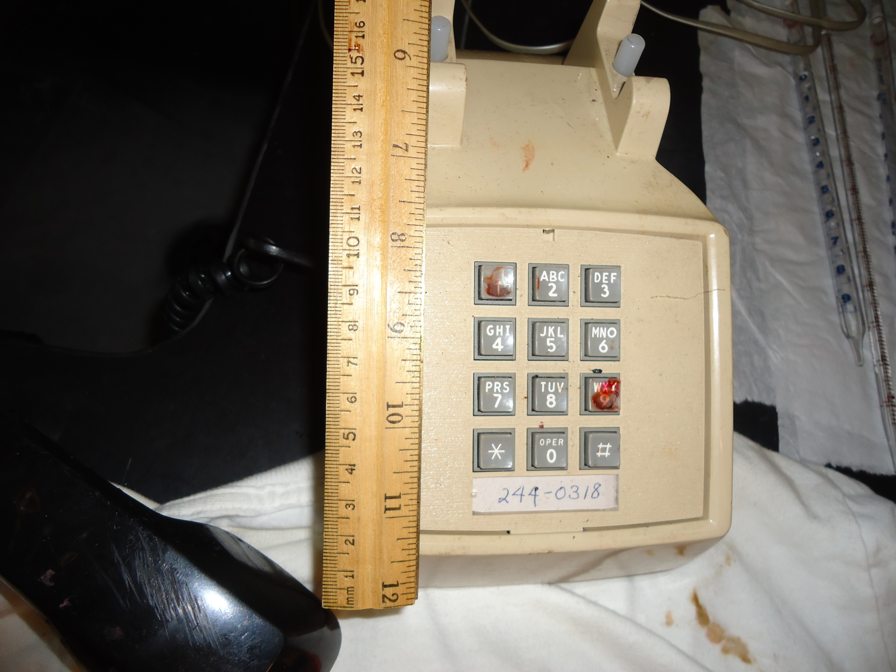

Slide 54
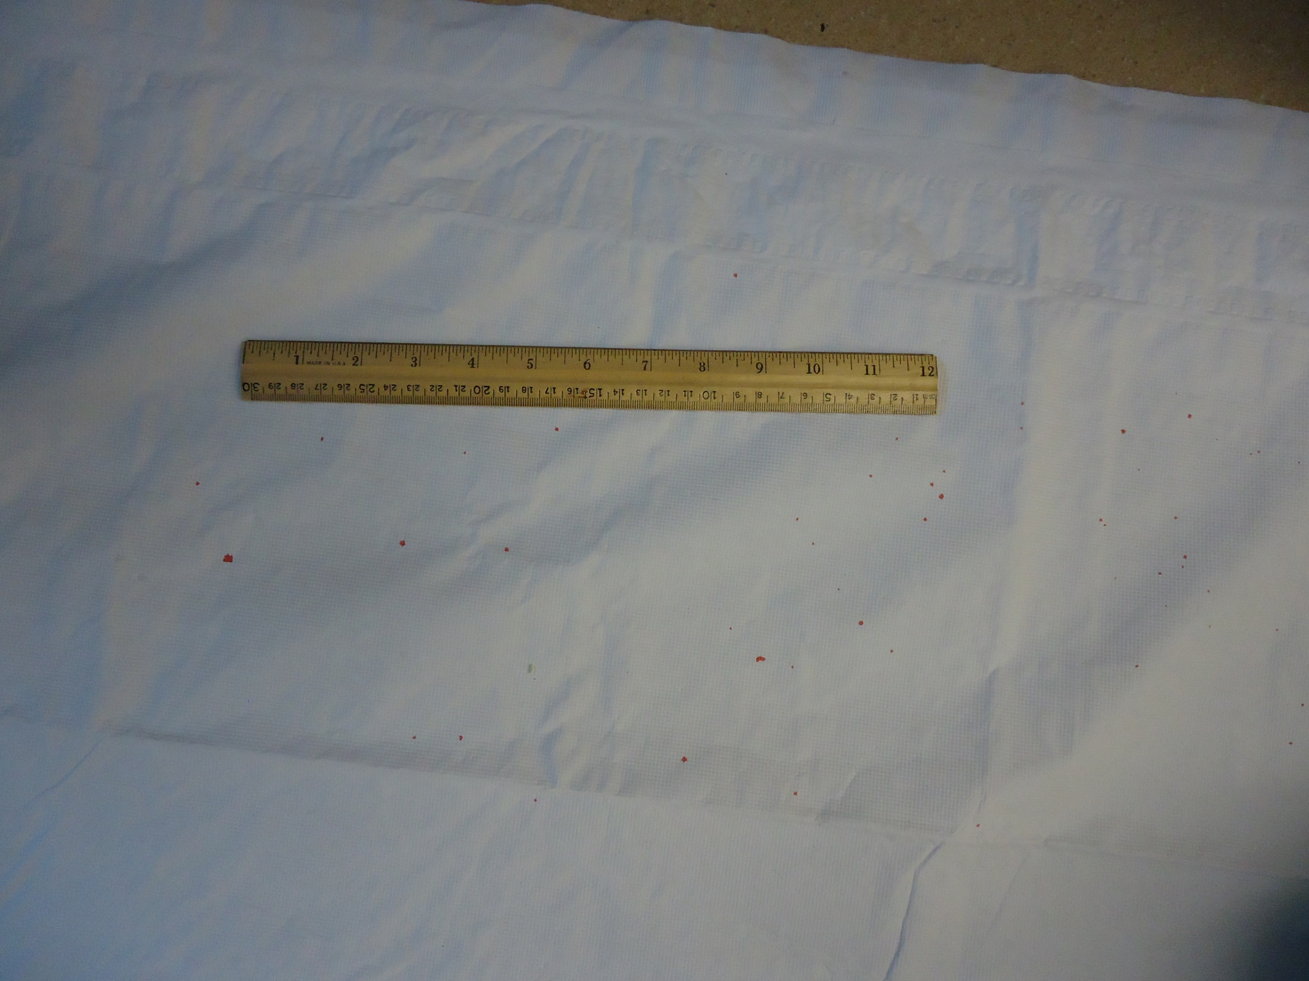

Slide 55
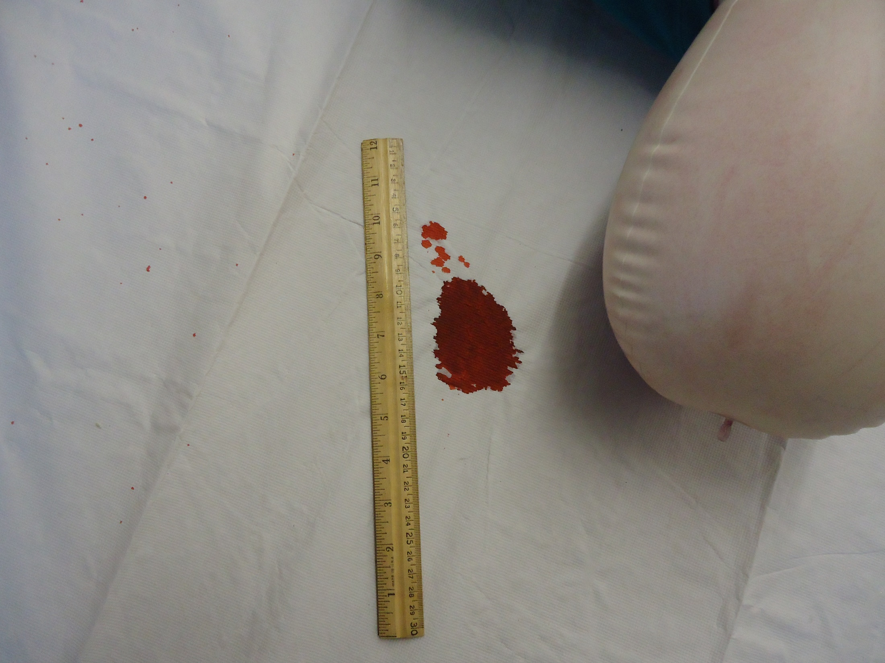

Slide 56
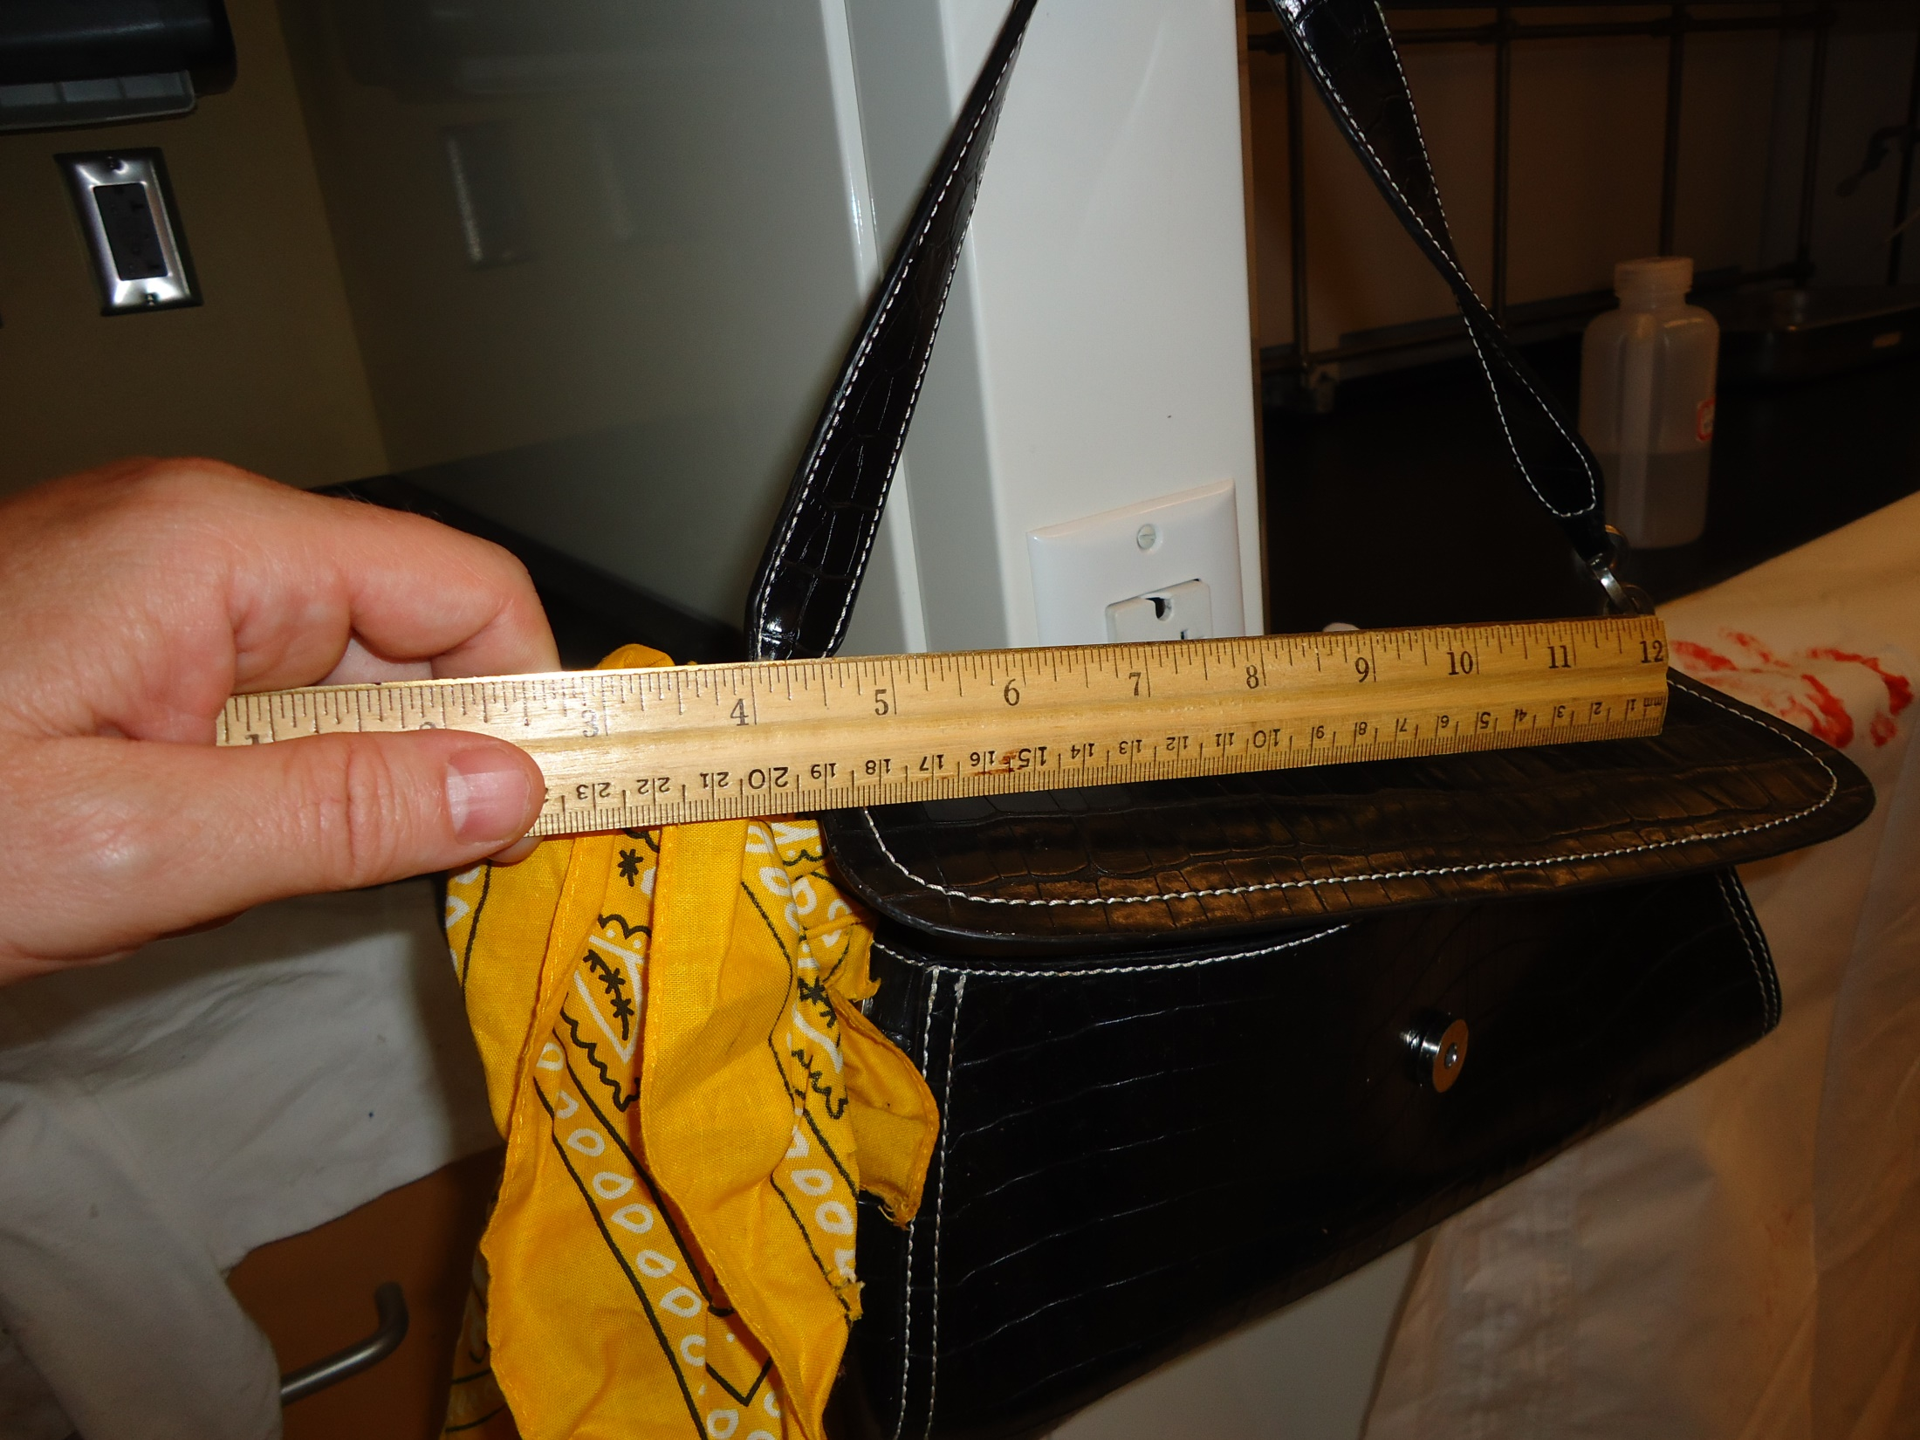

Slide 57
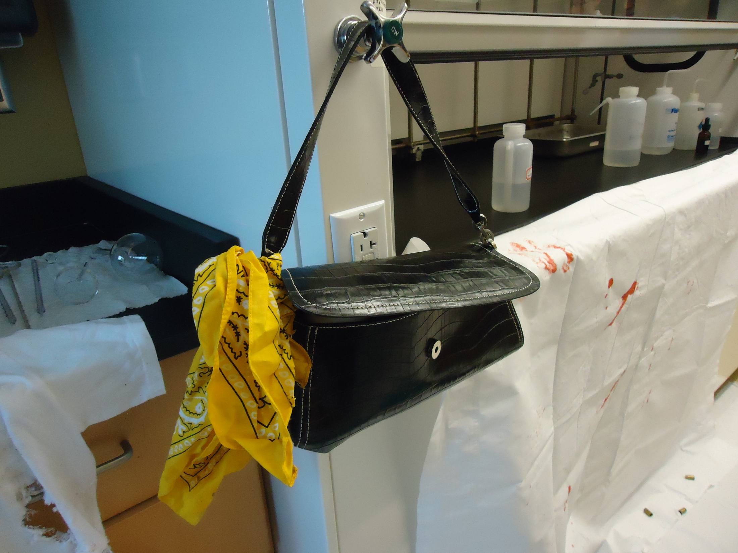

Slide 58
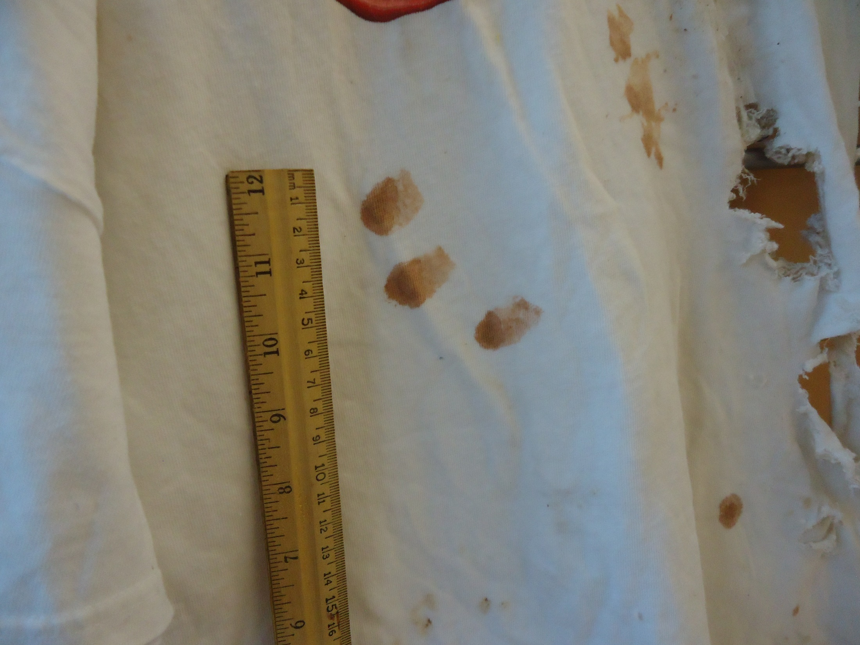

Slide 59
